Slide 1
PowerPoint template to accompany the LGBT+ History Month 2021 lesson pack for:
KS1 – England and Wales
P2 to P3 – Scotland
We know that good teaching is tailored to meet the needs of the children or young people in each individual class. That’s why we’ve created this editable PowerPoint template – feel free to adapt it to suit your teaching context or to add your school or college slide template to the background.
Who are Stonewall?
This resource is produced by Stonewall, a UK-based charity that stands for the freedom, equity and potential of all lesbian, gay, bi, trans, queer, questioning and ace (LGBTQ+) people. At Stonewall, we imagine a world where LGBTQ+ people everywhere can live our lives to the full. Founded in London in 1989, we now work in each nation of the UK and have established partnerships across the globe. Over the last three decades, we have created transformative change in the lives of LGBTQ+ people in the UK, helping win equal rights around marriage, having children and inclusive education.
Our campaigns drive positive change for our communities, and our sustained change and empowerment programmes ensure that LGBTQ+ people can thrive throughout our lives. We make sure that the world hears and learns from our communities, and our work is grounded in evidence and expertise.
Stonewall is proud to provide information, support and guidance on LGBTQ+ inclusion; working towards a world where we’re all free to be. This does not constitute legal advice, and is not intended to be a substitute for legal counsel on any subject matter. To find out more about our work, visit us at www.stonewall.org.uk.
Registered Charity No 1101255 (England and Wales) and SC039681 (Scotland)
Notes:
Visit our website for the lesson plan to accompany this PowerPoint.

Slide 2
LO: To ask questions about events from the past
brave
Notes:
Ask children to explain what they think word ‘brave’ means. Where have they heard the word used before?
Talk about different types of bravery or courage – overcoming a fear, trying a new challenge, speaking up for what you know is right, etc

Slide 3
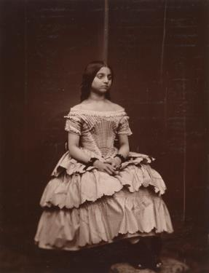
LO: To ask questions about events from the past
Catherine Duleep Singh
Notes:
Share the LO. Explain that today the children are going to be learning about a brave woman called Catherine Duleep Singh.
Explain that they are going to start off by being history detectives, using their investigation skills to look at some photos and see what they can find out about Catherine.

Slide 4
LO: To ask questions about events from the past
Catherine Duleep Singh
Who was she?
When did she live?
What might she have done that was brave?
What can you find out about Catherine?
Notes:
In groups, children discuss the photos related to Catherine Duleep Singh’s life. They should suggest:
Who she was
How long ago she lived
The brave thing she might have done
Any other information they can find
They should write their ideas on whiteboards or in their books.

Slide 5
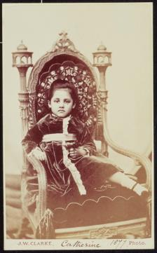
LO: To ask questions about events from the past
Catherine was born on 27th October 1871.
Notes:
Work through the PowerPoint about Catherine Duleep Singh and her life.
Ask the children to reflect on the aspects of Catherine’s life that required her to be brave

Slide 6
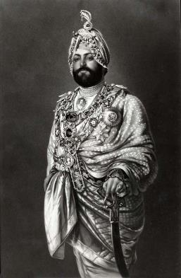
LO: To ask questions about events from the past
Catherine’s dad had been a member of a royal family in India.
He was called Maharajah Duleep Singh.
Notes:
Work through the PowerPoint about Catherine Duleep Singh and her life.
Ask the children to reflect on the aspects of Catherine’s life that required her to be brave

Slide 7
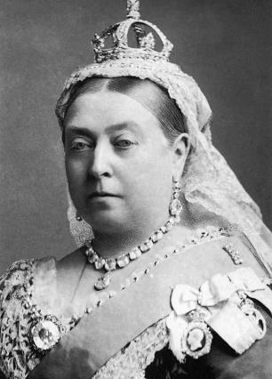
LO: To ask questions about events from the past
Maharajah Duleep Singh was friends with Queen Victoria.
Queen Victoria was Catherine’s godmother.
Notes:
Work through the PowerPoint about Catherine Duleep Singh and her life.
Ask the children to reflect on the aspects of Catherine’s life that required her to be brave

Slide 8
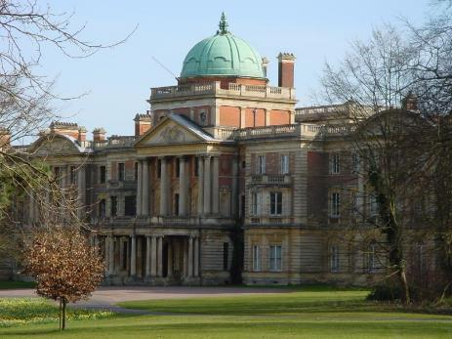
LO: To ask questions about events from the past
The family lived in a big house in England.
Notes:
Work through the PowerPoint about Catherine Duleep Singh and her life.
Ask the children to reflect on the aspects of Catherine’s life that required her to be brave

Slide 9
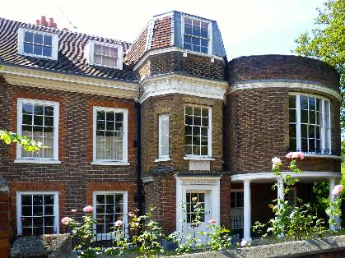
LO: To ask questions about events from the past
Catherine’s dad went on a long trip to India. She went to live in a house near the queen at Hampton Court Palace.
Notes:
Work through the PowerPoint about Catherine Duleep Singh and her life.
Ask the children to reflect on the aspects of Catherine’s life that required her to be brave

Slide 10
LO: To ask questions about events from the past
In the past, women were not allowed to vote. This was not fair.
Notes:
Work through the PowerPoint about Catherine Duleep Singh and her life.
Ask the children to reflect on the aspects of Catherine’s life that required her to be brave

Slide 11
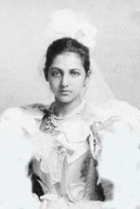
LO: To ask questions about events from the past
Catherine knew that it was unfair that she could not vote. She wanted things to change.
Notes:
Work through the PowerPoint about Catherine Duleep Singh and her life.
Ask the children to reflect on the aspects of Catherine’s life that required her to be brave

Slide 12
LO: To ask questions about events from the past
She was part of groups that asked for women to be treated fairly.
Notes:
Work through the PowerPoint about Catherine Duleep Singh and her life.
Ask the children to reflect on the aspects of Catherine’s life that required her to be brave

Slide 13
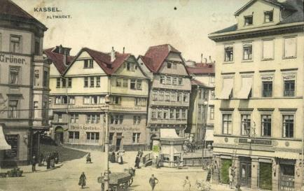
LO: To ask questions about events from the past
Catherine’s partner was called Lina and she went to live in Germany with her.
Notes:
Work through the PowerPoint about Catherine Duleep Singh and her life.
Ask the children to reflect on the aspects of Catherine’s life that required her to be brave

Slide 14
LO: To ask questions about events from the past
They lived in a town called Kassel for a very long time.
Notes:
Work through the PowerPoint about Catherine Duleep Singh and her life.
Ask the children to reflect on the aspects of Catherine’s life that required her to be brave

Slide 15
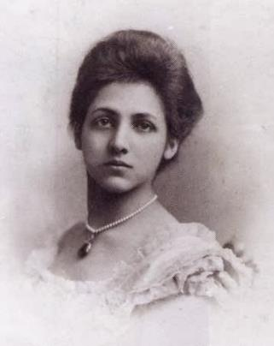
LO: To ask questions about events from the past
People were unkind to Catherine because of the colour of her skin.
Notes:
Work through the PowerPoint about Catherine Duleep Singh and her life.
Ask the children to reflect on the aspects of Catherine’s life that required her to be brave

Slide 16
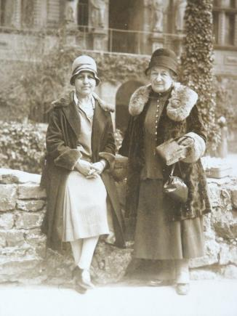
LO: To ask questions about events from the past
People were unkind to Catherine because her partner was a woman.
Notes:
Work through the PowerPoint about Catherine Duleep Singh and her life.
Ask the children to reflect on the aspects of Catherine’s life that required her to be brave

Slide 17
LO: To ask questions about events from the past
At that time in Germany, the people in charge treated Jewish people very badly indeed.
Notes:
Work through the PowerPoint about Catherine Duleep Singh and her life.
Ask the children to reflect on the aspects of Catherine’s life that required her to be brave

Slide 18
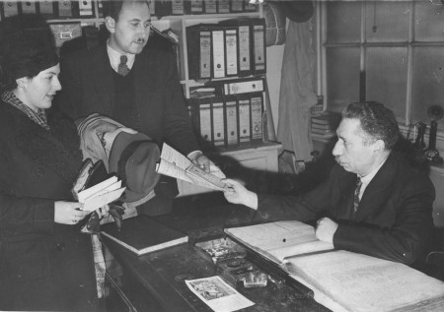
LO: To ask questions about events from the past
Catherine and Lina helped Jewish people to escape and live in a country where they would be safe.
Notes:
Work through the PowerPoint about Catherine Duleep Singh and her life.
Ask the children to reflect on the aspects of Catherine’s life that required her to be brave

Slide 19
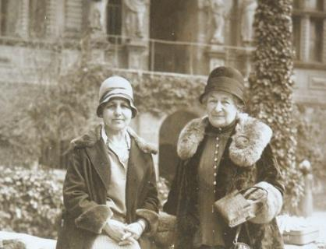
LO: To ask questions about events from the past
If they had been caught, Catherine and Lina could have been in danger themselves.
Notes:
Work through the PowerPoint about Catherine Duleep Singh and her life.
Ask the children to reflect on the aspects of Catherine’s life that required her to be brave

Slide 20
LO: To ask questions about events from the past
What did Catherine do that was brave?
Notes:
Ask the children to reflect on the aspects of Catherine’s life that required her to be brave. Ensure you include the following:
Speaking up for women’s rights
Being herself, even though it meant she will have been treated badly
Helping people who were in danger

Slide 21
LO: To ask questions about events from the past
If you met Catherine, what would you ask her?
Notes:
Explain to the children that they are going to continue with their history detective work interviewing Catherine Duleep Singh.
In pairs they should identify some questions that they would like to ask her about her life and her experiences.
An adult should take the role of Catherine Duleep Singh for hot seating.
Children take turns ask Catherine questions about her life and experiences.
Note: The adult in the hot seat can use the fact file ahead of time to ensure that they are able to answer most of the children’s questions

Slide 22
LO: To ask questions about events from the past
How did asking questions help you to learn?
Notes:
Ask the children: How did asking questions help you to learn about history today? Think. Pair. Share.

