Slide 1
PowerPoint template to accompany the LGBT+ History Month 2019 lesson pack for:
Year 3 and 4 – England and Wales
P4 and P5 – Scotland
We know that good teaching is tailored to meet the needs of the children or young people in each individual class. That’s why we’ve created this editable PowerPoint template – feel free to adapt it to suit your teaching context or to add your school or college slide template to the background.
Who are Stonewall?
This resource is produced by Stonewall, a UK-based charity that stands for the freedom, equity and potential of all lesbian, gay, bi, trans, queer, questioning and ace (LGBTQ+) people. At Stonewall, we imagine a world where LGBTQ+ people everywhere can live our lives to the full. Founded in London in 1989, we now work in each nation of the UK and have established partnerships across the globe. Over the last three decades, we have created transformative change in the lives of LGBTQ+ people in the UK, helping win equal rights around marriage, having children and inclusive education.
Our campaigns drive positive change for our communities, and our sustained change and empowerment programmes ensure that LGBTQ+ people can thrive throughout our lives. We make sure that the world hears and learns from our communities, and our work is grounded in evidence and expertise.
Stonewall is proud to provide information, support and guidance on LGBTQ+ inclusion; working towards a world where we’re all free to be. This does not constitute legal advice, and is not intended to be a substitute for legal counsel on any subject matter. To find out more about our work, visit us at www.stonewall.org.uk.
Registered Charity No 1101255 (England and Wales) and SC039681 (Scotland)
Notes:
Visit our website for the lesson plan to accompany this PowerPoint.

Slide 2
LO: To be able to use a metaphor

Slide 3
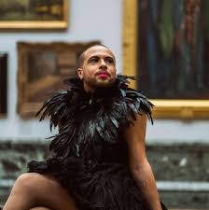
LO: To be able to use a metaphor
I want to be a pink flamingo – a poem by Dean Atta
Notes:
As a class, read or listen to part of I want to be a pink flamingo by Dean Atta. You can find the poem at 0:42 until 1:27 in the video here: https://www.youtube.com/watch?vs=0UdejBoQ1v8
Please note: The rest of the video is not included in this lesson plan. Some of the poems in the rest of the video are only suitable for older students.
Ask: Does the poet actually want to be a flamingo? Discuss/revisit the concept of a metaphor.

Slide 4
LO: To be able to use a metaphor
What is a metaphor?
Notes:
Discuss/revisit the concept of a metaphor.

Slide 5
LO: To be able to use a metaphor
A metaphor is a descriptive tool.
It is a word or phrase that describes something as if it were something else.
Notes:
Discuss/revisit the concept of a metaphor.
Challenge children to come up with some other metaphors. Think. Pair. Share.

Slide 6
LO: To be able to use a metaphor
I want to be a pink flamingo.
A wave of terror passed over them.
She had the eyes of a hawk.
Notes:
Discuss/revisit the concept of a metaphor.
Challenge children to come up with some other metaphors. Think. Pair. Share.

Slide 7
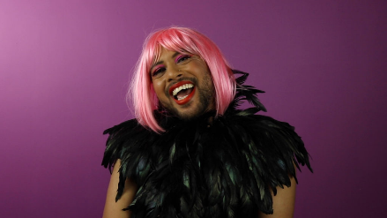
LO: To be able to use a metaphor
How can we let people know that it’s ok to be different?
Notes:
What can we do to help our friends know that it’s ok to be different? Discuss that it’s important to actively work to understand people’s differences and to show that we value them as an individual.

Slide 8
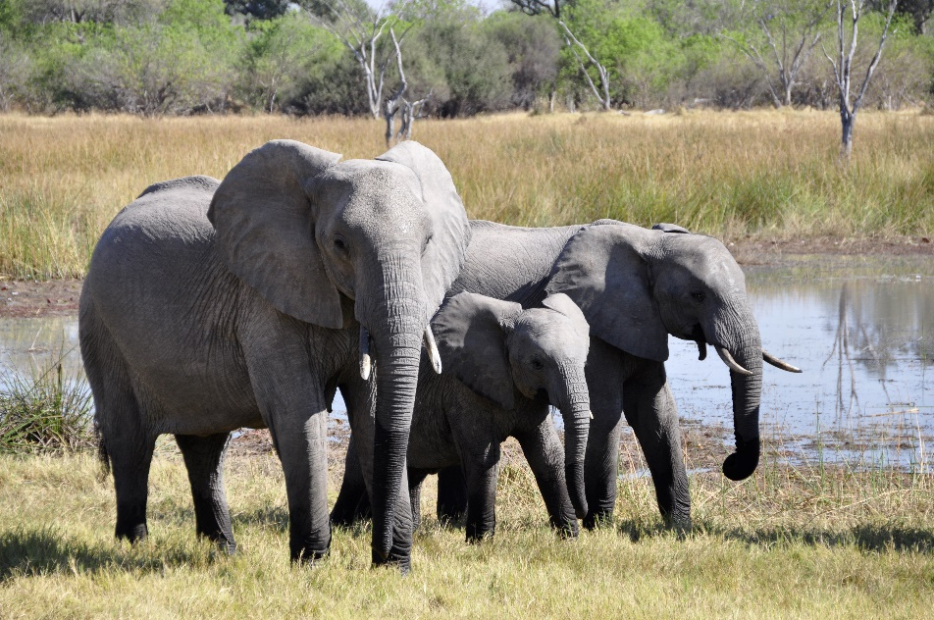
LO: To be able to use a metaphor
What animal would you like to be?
Why?
Notes:
In small groups, children should discuss:
What animal would you like to be and why? What characteristics of the animal would you like to have in your life? (for example being brave like a penguin or caring like an elephant)

Slide 9
LO: To be able to use a metaphor
Today we’re going to be writing an acrostic that uses metaphor.
Notes:
Children write an acrostic poem based on the animal they have chosen. The poem should make it clear that it is about them and that it is a metaphor for something they aspire to.

Slide 10
LO: To be able to use a metaphor
E
L
E
P
H
A
N
T
Notes:
Children write an acrostic poem based on the animal they have chosen. The poem should make it clear that it is about them and that it is a metaphor for something they aspire to.

Slide 11
LO: To be able to use a metaphor
Everyone knows I’m caring,
Looking after my family and friends.
Even when I’m tired and have walked for miles.
Please don’t think I’m scary.
Holding my friend’s tail with my trunk
As we walk through the savannah together.
Nobody can come between us,
That’s the way we are.
Notes:
Children write an acrostic poem based on the animal they have chosen. The poem should make it clear that it is about them and that it is a metaphor for something they aspire to.
For example:
Everyone knows I’m caring,
Looking after my family and friends.
Even when I’m tired and have walked for miles.
Please don’t think I’m scary.
Holding my friend’s tail with my trunk
As we walk through the savannah together.
Nobody can come between us,
That’s the way we are.

Slide 12
LO: To be able to use a metaphor
Write an acrostic poem using the name of your animal
The poem should use metaphor
The poem should be about you
Notes:
Children write an acrostic poem based on the animal they have chosen. The poem should make it clear that it is about them and that it is a metaphor for something they aspire to.
For example:
Everyone knows I’m caring,
Looking after my family and friends.
Even when I’m tired and have walked for miles.
Please don’t think I’m scary.
Holding my friend’s tail with my trunk
As we walk through the savannah together.
Nobody can come between us,
That’s the way we are.
Adaptation: Children who struggle with writing could work with the teacher or teaching assistant to shared write a poem about an animal.

Slide 13
LO: To be able to use a metaphor
Did the poem capture the characteristics of the animal?
Was it clear that it was a metaphor?
Which word choices did you like?
Suggest a word change to improve the poem.
Notes:
Children swap poems with a partner. Peer assess: Did the poem capture the characteristics of the animal? Was it clear that it was a metaphor? Which word choices did you like? Suggest a word change to improve the poem.

