Slide 1
PowerPoint template to accompany the LGBT+ History Month 2019 lesson pack for:
Learners with SEND/ALN/ASN – version 2
We know that good teaching is tailored to meet the needs of the children or young people in each individual class. That’s why we’ve created this editable PowerPoint template – feel free to adapt it to suit your teaching context or to add your school or college slide template to the background.
Who are Stonewall?
This resource is produced by Stonewall, a UK-based charity that stands for the freedom, equity and potential of all lesbian, gay, bi, trans, queer, questioning and ace (LGBTQ+) people. At Stonewall, we imagine a world where LGBTQ+ people everywhere can live our lives to the full. Founded in London in 1989, we now work in each nation of the UK and have established partnerships across the globe. Over the last three decades, we have created transformative change in the lives of LGBTQ+ people in the UK, helping win equal rights around marriage, having children and inclusive education.
Our campaigns drive positive change for our communities, and our sustained change and empowerment programmes ensure that LGBTQ+ people can thrive throughout our lives. We make sure that the world hears and learns from our communities, and our work is grounded in evidence and expertise.
Stonewall is proud to provide information, support and guidance on LGBTQ+ inclusion; working towards a world where we’re all free to be. This does not constitute legal advice, and is not intended to be a substitute for legal counsel on any subject matter. To find out more about our work, visit us at www.stonewall.org.uk.
Registered Charity No 1101255 (England and Wales) and SC039681 (Scotland)
Notes:
Visit our website for the lesson plan to accompany this PowerPoint.

Slide 2
To take part in a group activity AND To respond to choices
OR
To recognise symbols for family members AND To communicate about choices (list activity) or To follow simple instructions (soup activity)
OR
To communicate about family members AND To create a list (list activity) OR To follow instructions (soup activity)
OR
To share information about family members AND To write a simple recipe (recipe activity) OR To follow written instructions (soup activity)
Notes:
Choose the learning objective that is the best fit for your class from the Stonewall lesson plan.

Slide 3
LO:
Grandpa’s Soup by Jackie Kay
Notes:
Read Grandpa’s Soup by Jackie Kay to the students. You can find the poem here: https://www.scottishpoetrylibrary.org.uk/poem/grandpas-soup/
As you go through the poem, students should (choose as appropriate):
Point to the ingredient in the middle of the table
Match the symbol for the ingredient
Identify the symbol for the ingredient
Write the ingredient on the ‘shopping list’ worksheet.
Act out making the soup. Choose students to add the ingredients to the pan. You will need to explain that hough is a type of beef, for the purposes of the activity you could use corned beef instead.
Discuss that the reason Jackie liked the soup so much was not just because it was tasty, but because her Grandpa made it for her.
Note: If any of your students are vegetarian/vegan or don’t eat beef for religious reasons, do not do the ‘ingredients into the pan’ activity.

Slide 4
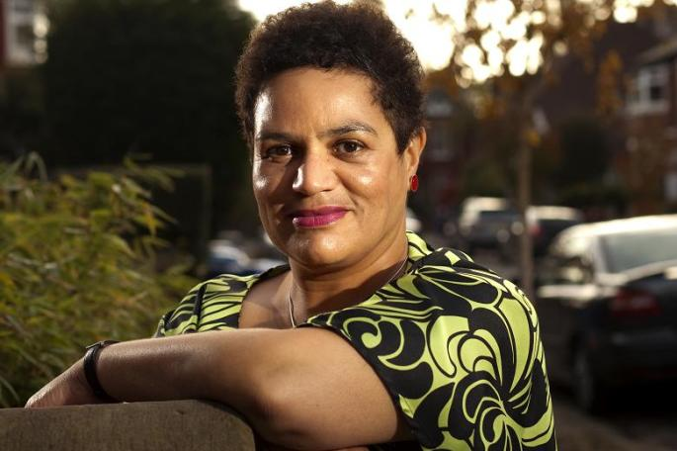
LO:
This is Jackie Kay
She is a poet.
She was adopted when she was a baby.
She grew up in Scotland.
She lives with her partner, who is called Denise.
She has two children.
Notes:
Show children a photo of Jackie Kay and talk about her family. Jackie was adopted when she was a baby and she grew up with her mum, dad and siblings. She now lives with her partner Denise. Jackie has two children, so Denise is their step-mum.

Slide 5
LO:
Who is in your family? What food is special to your family?
Notes:
Ask students: Who is in your family?
Students should (choose as appropriate):
Match the symbols for the people in their families
Identify the symbols for the people in their families
Tell the others in their class who is in their family
If relevant, talk about the fact that some people have their birth family and their foster family or foster carers.
Note: Be aware that children with a trans parent might use a different name for their parent instead of mum or dad.

Slide 6
LO:
What ingredients would you put in your soup?
Would your soup taste nice?
Notes:
Choose the most appropriate activity/activities for your class:
Students invent their own soup by choosing pictures of ingredients to cut out and stick onto the soup bowl outline.
Students identify ingredients they would like to include in their soup and list them on the ‘My recipe’ worksheet.
Students write their soup recipes on the ‘My recipe’ worksheet, using other soup recipes as a point of reference.
As a class, work together to make soup, following a simple recipe.
Ask students to look at their soup recipe and share with the class whether they think it would be tasty or horrible.
OR
Ask students to try the soup and identify if they liked or disliked it.

