Slide 1
PowerPoint template for the 2021 Black History Month Assembly for:
Learners with SEND/ALN/ASN – version 2
We know that good teaching is tailored to meet the needs of the children or young people in each individual class. That’s why we’ve created this editable PowerPoint template – feel free to adapt it to suit your teaching context or to add your school or college slide template to the background.
Who are Stonewall?
This resource is produced by Stonewall, a UK-based charity that stands for the freedom, equity and potential of all lesbian, gay, bi, trans, queer, questioning and ace (LGBTQ+) people. At Stonewall, we imagine a world where LGBTQ+ people everywhere can live our lives to the full. Founded in London in 1989, we now work in each nation of the UK and have established partnerships across the globe. Over the last three decades, we have created transformative change in the lives of LGBTQ+ people in the UK, helping win equal rights around marriage, having children and inclusive education.
Our campaigns drive positive change for our communities, and our sustained change and empowerment programmes ensure that LGBTQ+ people can thrive throughout our lives. We make sure that the world hears and learns from our communities, and our work is grounded in evidence and expertise.
Stonewall is proud to provide information, support and guidance on LGBTQ+ inclusion; working towards a world where we’re all free to be. This does not constitute legal advice, and is not intended to be a substitute for legal counsel on any subject matter. To find out more about our work, visit us at www.stonewall.org.uk.
Registered Charity No 1101255 (England and Wales) and SC039681 (Scotland)
Notes:
Visit our website for the lesson plan to accompany this PowerPoint.

Slide 2

Opening title slide
Black history month
Notes:
This assembly is designed for children and young people with SEND/ALN/ASN. This is the Widget symbol supported version, a non-symbol supported version is available at www.stonewall.org.uk. There are also assemblies designed for mainstream primary and secondary schools – us the resource which works best for your students.
Start the assembly by asking students if they have heard of Black History Month and whether they know anything about it.

Slide 3

Divider slide 2
Black History Month
A month where we celebrate Black people from history.
Notes:
Explain that sometimes in schools, people don’t find out much about Black people from history.
Black History Month is a month where we celebrate Black people from history. It is a chance to learn more about Black people’s stories and lives.
Ask students if they can name any of the people in the photos?

Slide 4
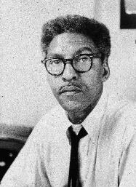
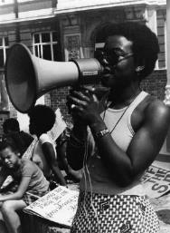
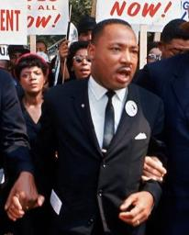
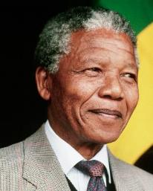
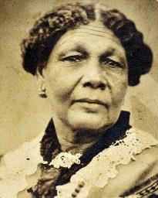
Divider slide 2
Black History Month
A month where we celebrate Black people from history.
Notes:
Ask students if they can name any of the people in the photos?

Slide 5
Divider slide 2
Bayard
Rustin
Olive
Morris
Martin
Luther
King
Nelson
Mandela
Mary
Seacole

Slide 6
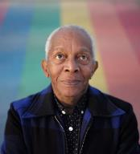
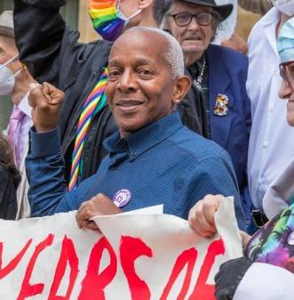
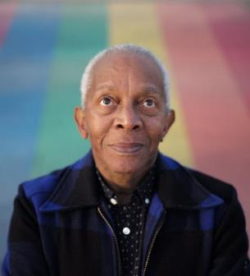
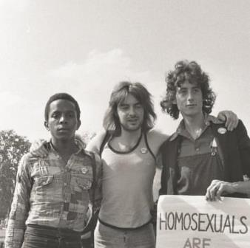
Infographic slide - style 1
Ted Brown
Notes:
Explain that the assembly is about Ted Brown today and tell students that we can look at the photos for clues about who Ted is and why we are learning about him.
Ask students what they can see in the photos.
Ensure students understand that:
Ted is a Black man
He’s standing in front of a rainbow, rainbows are an LGBTQ+ symbol so that could be a clue.
There is a black and white photo of Ted where he looks younger. The clothes are old fashioned too. This could be a clue we’re talking about something Ted did when he was younger.
In one of the photos Ted is with lots of holding a banner and is with lots of people – it looks like he might be at a protest.

Slide 7




Quote and image slide 1
Ted is gay.
Ted is Black.
Ted is British.
Notes:
Explain that today we’re learning about a man called Ted Brown
Explain that Ted is a gay, Black, British man.

Slide 8
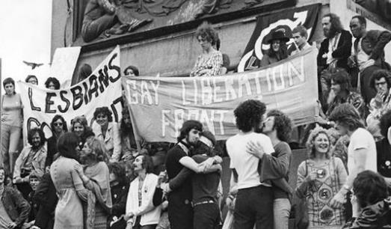
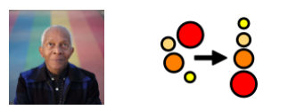

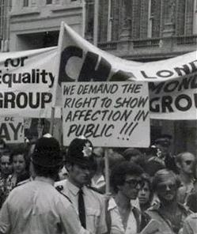

Quote and image slide 1
Ted organized
the first
London LGBTQ+ Pride
Notes:
Explain that Ted Helped to organise the first LGBTQ+ Pride march in London

Slide 9





Quote and image slide 1
People used to be
very unkind to
LGBTQ+ people.
Notes:
Explain that in the 1970s people were often very unkind to LGBTQ+ people and LGBTQ+ people were not treated fairly. That’s why Ted and his friends organised the march.

Slide 10



Quote and image slide 1
Being unkind
because someone is
gay is
called homophobia.
Notes:
Sometimes people are still unkind to LGBTQ+ people. Being unkind to people is wrong. That’s why we still have Pride marches – they are reminding people that we shouldn’t be unkind because someone is LGBTQ+.

Slide 11
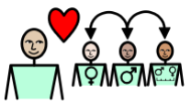

Quote and image slide 1
Being unkind
because someone is
bi is
called biphobia.
Notes:
Sometimes people are still unkind to LGBTQ+ people. Being unkind to people is wrong. That’s why we still have Pride marches – they are reminding people that we shouldn’t be unkind because someone is LGBTQ+.

Slide 12


Quote and image slide 1
Being unkind
because someone is
trans is
called transphobia.
Notes:
Sometimes people are still unkind to LGBTQ+ people. Being unkind to people is wrong. That’s why we still have Pride marches – they are reminding people that we shouldn’t be unkind because someone is LGBTQ+.

Slide 13
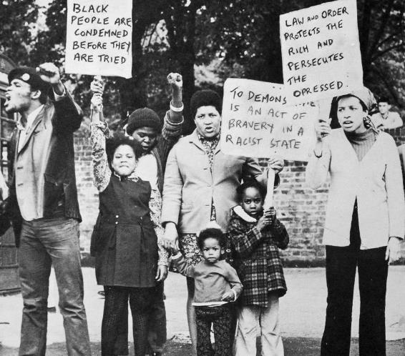
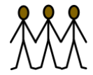
Quote and image slide 1
People used to be
very unkind to
Black people.
Notes:
Explain that in the 1970s people were often very unkind to Black people and Black people were not treated fairly. That’s why there were groups of Black people who organised protests.

Slide 14
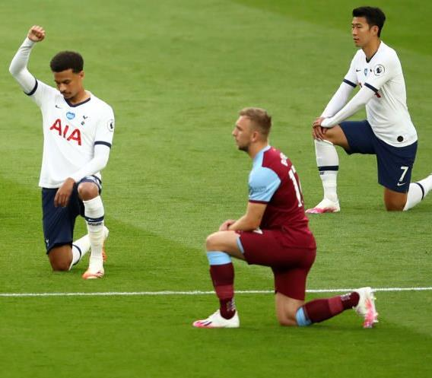


Quote and image slide 1
Being unkind
because of someone’s
skin colour is
called racism.
Notes:
Sometimes people are still unkind to Black people. Being unkind to people is wrong. That’s why football players kneel down at the start of a football match – they are reminding people that we shouldn’t be unkind because of someone’s skin colour. It’s important that we all say no to racism.

Slide 15
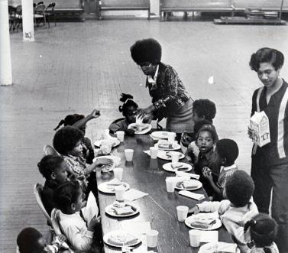
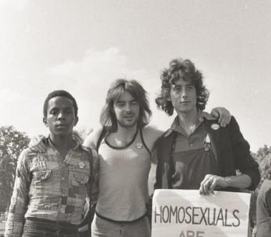

Infographic slide - style 1
It is important to be kind to people.
Notes:
Remind students that it is important to be kind to people and it is important to treat people fairly. Give examples of kind and unkind, fair and unfair.

Slide 16



Quote and image slide 1
Ted Brown
wants people
to be kind.
Notes:
Ted Brown wants people to be kind and to treat each other fairly.

Slide 17



Quote and image slide 1
What will you
do to be kind
today?
Notes:
Ask students what they will do to be kind

