Slide 1
PowerPoint template for the 2019 Anti-Bullying Week Assembly for:
Reception and Key Stage 1 – England and Wales
P1 to P3 - Scotland
We know that good teaching is tailored to meet the needs of the children or young people in each individual class. That’s why we’ve created this editable PowerPoint template – feel free to adapt it to suit your teaching context or to add your school or college slide template to the background.
Who are Stonewall?
This resource is produced by Stonewall, a UK-based charity that stands for the freedom, equity and potential of all lesbian, gay, bi, trans, queer, questioning and ace (LGBTQ+) people. At Stonewall, we imagine a world where LGBTQ+ people everywhere can live our lives to the full. Founded in London in 1989, we now work in each nation of the UK and have established partnerships across the globe. Over the last three decades, we have created transformative change in the lives of LGBTQ+ people in the UK, helping win equal rights around marriage, having children and inclusive education.
Our campaigns drive positive change for our communities, and our sustained change and empowerment programmes ensure that LGBTQ+ people can thrive throughout our lives. We make sure that the world hears and learns from our communities, and our work is grounded in evidence and expertise.
Stonewall is proud to provide information, support and guidance on LGBTQ+ inclusion; working towards a world where we’re all free to be. This does not constitute legal advice, and is not intended to be a substitute for legal counsel on any subject matter. To find out more about our work, visit us at www.stonewall.org.uk.
Registered Charity No 1101255 (England and Wales) and SC039681 (Scotland)
Notes:
This assembly is aimed at mainstream Primary Schools, specifically aimed at EYFS/KS1 or Scottish P1 to P3. Other versions of this assembly are available on Stonewall’s website: www.stonewall.org.uk
Play an anti-bullying song as the children enter assembly e.g. Beautiful by Christina Aguilera, Scars to Your Beautiful by Alessia Cara etc.
Introduce the assembly, explain to students that you are a Stonewall School Champion school.

Slide 2

Notes:
Explain that it is anti-bullying week and the theme is “Change Starts With Us”. Explain why LGBT inclusion is so important.
This year the goal is to inform schools and settings, children and young people, parents and carers to know that it takes a collective responsibility to stop bullying.
Bullying is usually defined as repeated behavior which is intended to hurt someone either emotionally or physically.

Slide 3

Time for a story!
Are You a Boy or Are You a Girl?
by Sarah Savage & Fox Fisher
Notes:
Read the book to the children and follow it with these questions: • How are boys and girls different?
• Do you think that Tiny is a boy or a girl?
• Does it matter if Tiny is a boy or a girl?
• Should Tiny be allowed to play football and dress up as a fairy?
• What would you ask Tiny if you met them?
• Would you like to play with Tiny?

Slide 4
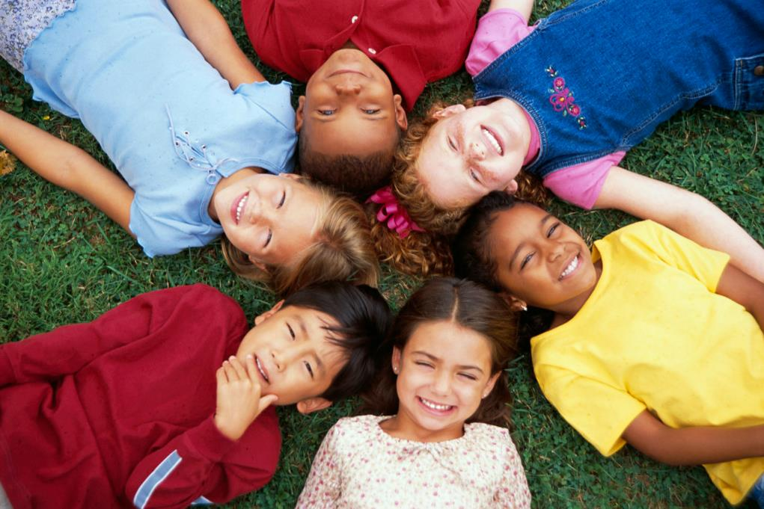
Kindness is what counts.
Notes:
Some people are “he”, some people are “she” and some people are “they”. Pronouns help us talk about another person with respect. We cannot always tell who a person is ‘on the inside’, just by looking at their ‘outside’. Someone might feel like a boy in their heart, a girl in their heart, both or neither. Whether a child is a boy or a girl, or non-binary, makes no difference to friendship. Kindness is what counts.

Slide 5
Challenge HBT bullying!
What is wrong with saying these things?
“You kick like a girl!”
“Boys can’t dance!”
Notes:
As children become exposed to assumptions of what boys and girls should like and how they should behave, it can make them reluctant to access things they perceive as ‘not being for them’. It can also limit their understanding of what is possible for them to do or achieve. Young people should feel able to be themselves. No one should be bullied for being different.
Open up a discussion with the children about why these statements are harmful. Challenge gender stereotypes – next slide includes examples of people not being held back by gender stereotypes.

Slide 6
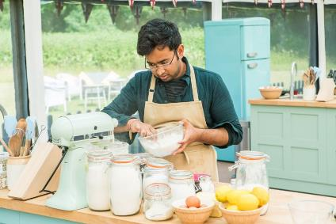

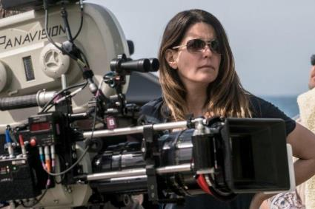
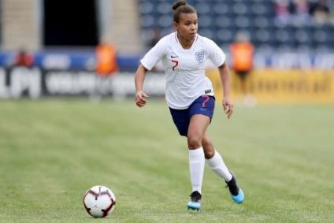

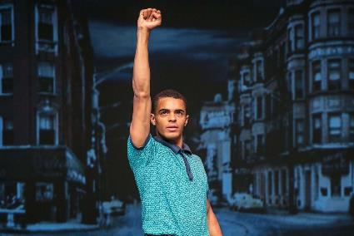
Challenging gender stereotypes!
Notes:
Everyone should feel free to be themselves and do things they enjoy!
Rahul Mandal – Great British Bake Off Winner 2018
Jessica Ennis-Hill – gold medalist at London Olympics 2012
James Charles – makeup artist
Nikita Parris – England footballer
Charlie Martin – British racing car driver
Layton Williams – dancer/actor
Patty Jenkins – director (directed Wonder Woman)

Slide 7
Lets celebrate difference!
Show of hands…
Notes:
Show of hands to celebrate difference - use different likes/interests/experiences as a point of reference. Ask the children to put up their hands if they like chocolate, for example. Encourage the children to look around the room and acknowledge that not everybody likes chocolate. Follow this up with further questions e.g. Who has a pet dog? Who has a pet guinea pig? Who doesn’t like the colour orange? Etc.
Tell the children that everyone is different, and different is good. Those differences should not be used to tease, exclude, or avoid another child. Is somebody not having a guinea pig a reason to tease? Of course not.

Slide 8
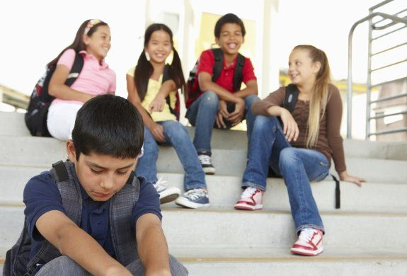
Challenge HBT bullying!
What can we do to help stop bullying?
THINK before you speak
REPORT bullying to an adult
HELP others to report bullying
CELEBRATE that we are all different
Notes:
Talk the children through this slide on how they can tackle bullying – link this to your behavior policy and school values.
Respect/Kind Words Remember to be kind to other people! Stop and think before you say or do something that could hurt someone. Just because someone is different to you – that doesn’t mean you are better than them or have a right to make them feel bad. Keep in mind that everyone is different. Not better or worse. Just different. If you mess up, say sorry. You don’t have to be friends with everyone – but you should always show respect. Support Make it clear that you don’t like it when people bully others and stick up for people who are having a hard time. Show them that you care by trying to include them. Sit with them at lunch or on the bus, talk to them at school, or invite them to do something. Just hanging out with them will help them know they aren’t alone. Report The important thing is that you tell someone. Don’t keep your feelings inside. Not saying anything could make it worse for everyone. The child who is bullying will think it is ok to keep treating others that way. Telling someone can help you feel less alone. They can help stop the bullying. If you feel you can, talk to a teacher you trust or your parents, brother or sister. If you don’t want to do that you can always call Childline 0800 11 11 or visit www.childline.org.uk.

Slide 9

Love your differences
Love other people’s differences
Notes:
Ask children to reflect on what they will do to make sure everyone feels included and celebrated.

