Slide 1
PowerPoint template to accompany the Relationships RSHE lesson pack for:
Secondary aged students – version 1 SEND
We know that good teaching is tailored to meet the needs of the children or young people in each individual class. That’s why we’ve created this editable PowerPoint template – feel free to adapt it to suit your teaching context or to add your school or college slide template to the background.
Who are Stonewall?
This resource is produced by Stonewall, a UK-based charity that stands for the freedom, equity and potential of all lesbian, gay, bi, trans, queer, questioning and ace (LGBTQ+) people. At Stonewall, we imagine a world where LGBTQ+ people everywhere can live our lives to the full. Founded in London in 1989, we now work in each nation of the UK and have established partnerships across the globe. Over the last three decades, we have created transformative change in the lives of LGBTQ+ people in the UK, helping win equal rights around marriage, having children and inclusive education.
Our campaigns drive positive change for our communities, and our sustained change and empowerment programmes ensure that LGBTQ+ people can thrive throughout our lives. We make sure that the world hears and learns from our communities, and our work is grounded in evidence and expertise.
Stonewall is proud to provide information, support and guidance on LGBTQ+ inclusion; working towards a world where we’re all free to be. This does not constitute legal advice, and is not intended to be a substitute for legal counsel on any subject matter. To find out more about our work, visit us at www.stonewall.org.uk.
Registered Charity No 1101255 (England and Wales) and SC039681 (Scotland)
Notes:
Visit our website for the lesson plan to accompany this PowerPoint.

Slide 2
To take part in a sensory story AND To look at pictures of different couples
To answer questions about a story AND To know that a romantic relationship can be between people of any gender
To talk about events in a story and link them to my own experiences AND To understand that a romantic relationship can be between people of any gender

Slide 3
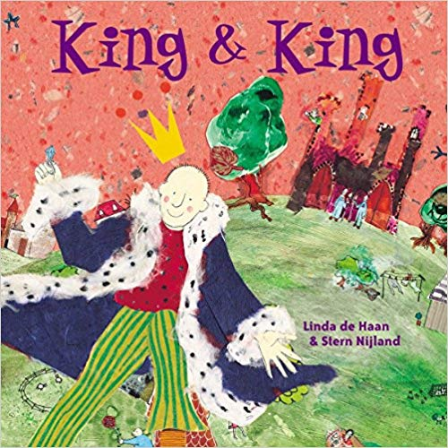
King and King
Notes:
As a class, read King and King. Use the sensory props to support understanding and engagement.

Slide 4
Who got married?
The princes
Notes:
Who got married in the story? Students to answer if they are able to, or match key symbols

Slide 5
Why did they get married?
Love
Notes:
Why did the two princes get married? Students to answer if they are able to, or match key symbols

Slide 6
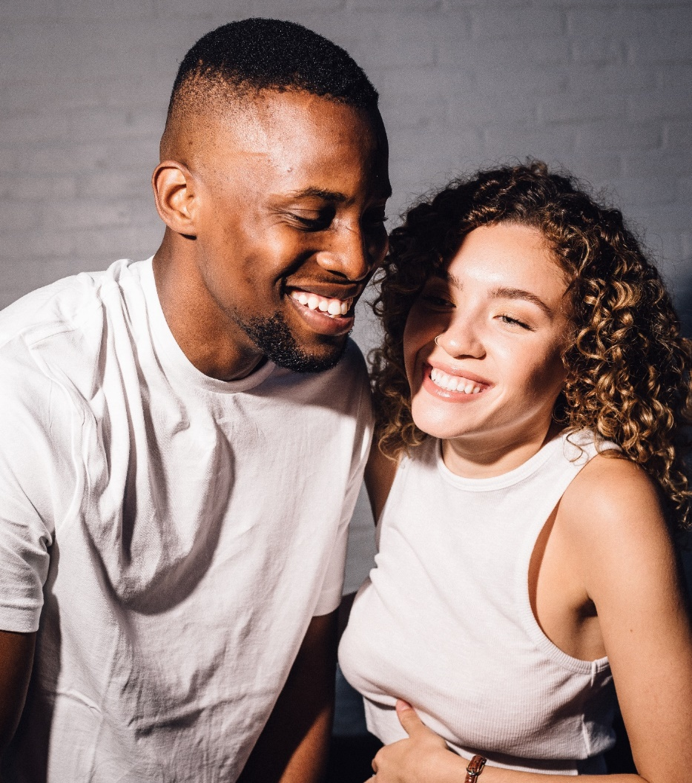
Notes:
Look at the photos of the different couples. Discuss that the photos show people who are married or in a relationship with each other. They are people that are in love with each other.

Slide 7
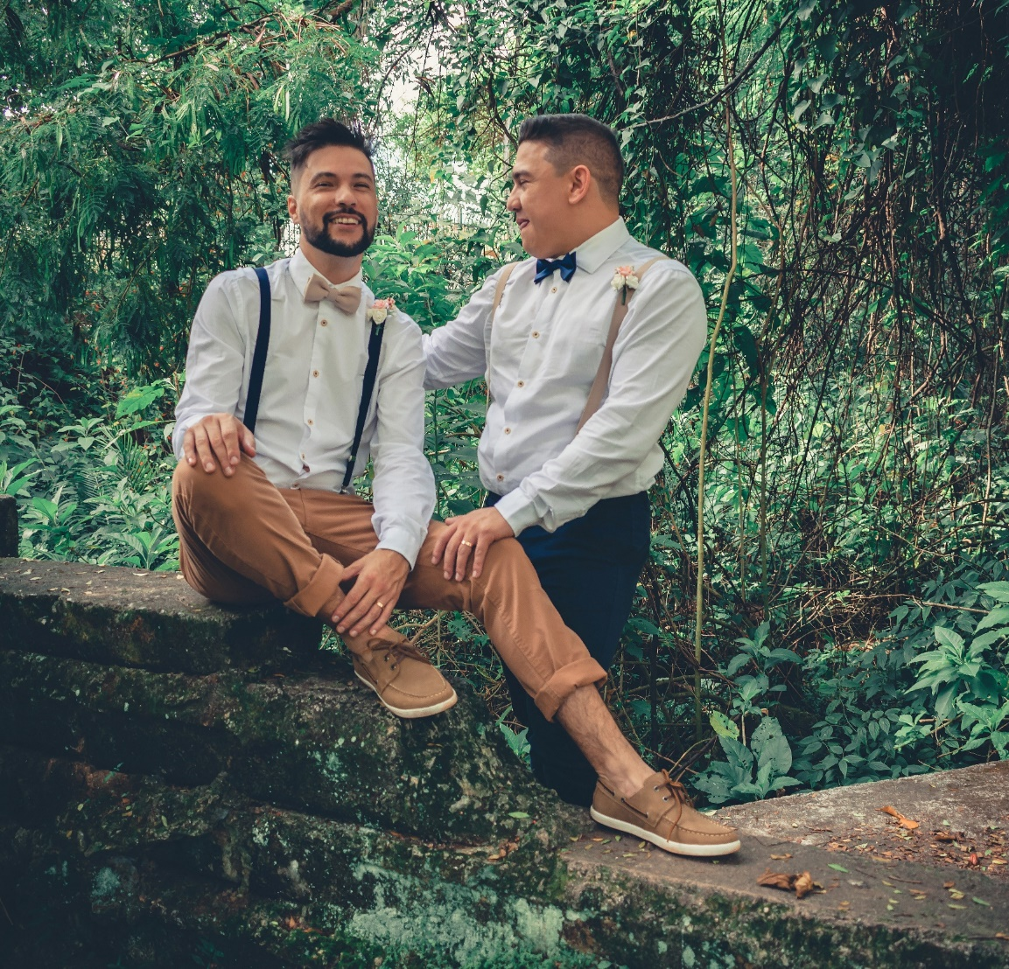
Notes:
Look at the photos of the different couples. Discuss that the photos show people who are married or in a relationship with each other. They are people that are in love with each other.

Slide 8
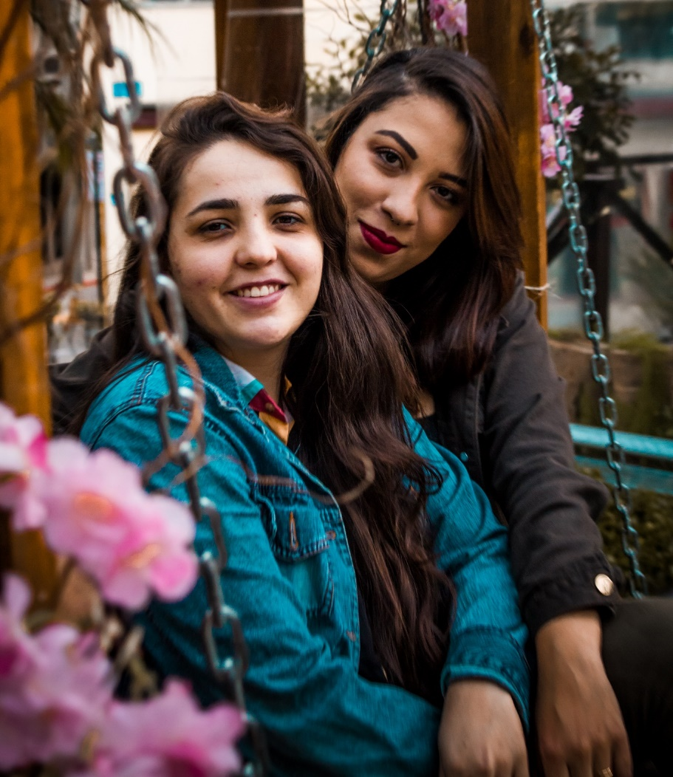
Notes:
Look at the photos of the different couples. Discuss that the photos show people who are married or in a relationship with each other. They are people that are in love with each other.

Slide 9
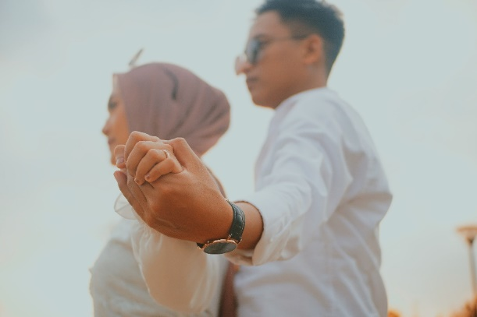
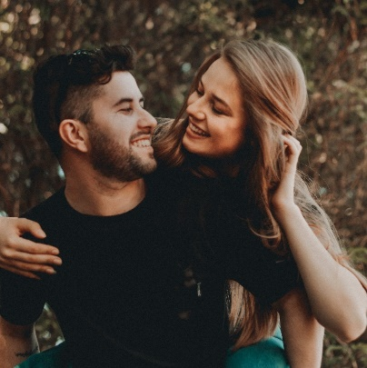
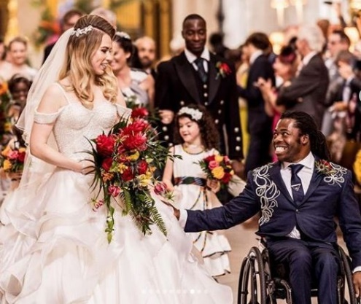
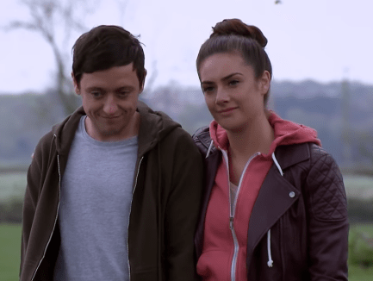

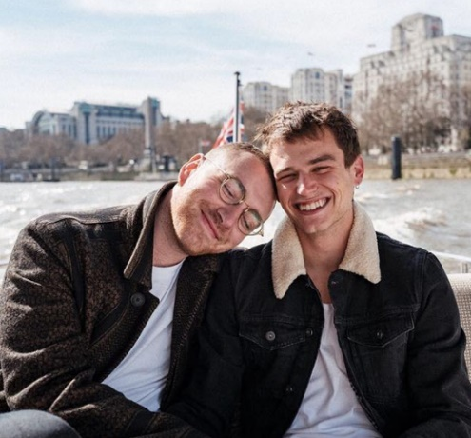
Different gender couples
Notes:
Explain that some people have a relationship with people of a different gender to them. This includes if one of the people in the relationship is non-binary, like Sam Smith (bottom right)

Slide 10


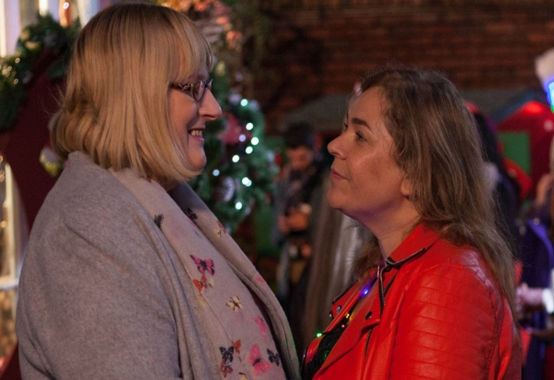
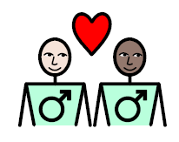
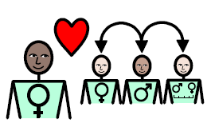
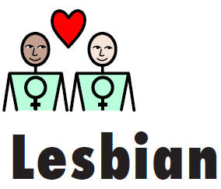


Same gender couples
Notes:
Explain that some people are gay, lesbian or bi. Lesbian and gay people are attracted to people of the same gender as them.

Slide 11
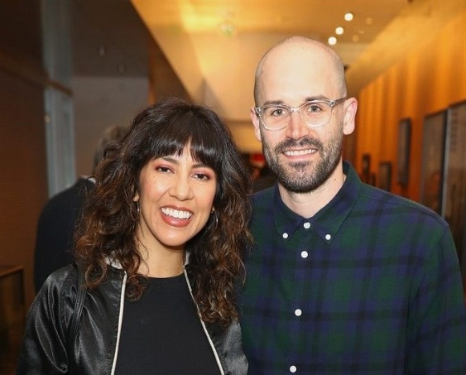
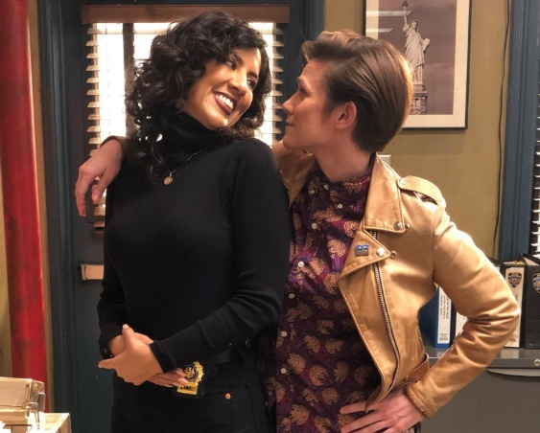
Some people are bi.
Bi people love men.
Bi people love women.
Bi people love non-binary people.
LGBT
Notes:
Explain the word bi and reiterate that some people don’t mind which gender their partner is.

Slide 12
Make a poster about relationships
Notes:
Students create a poster about relationships, choose an activity as appropriate:
• Students stick pictures of different couples onto an A3 piece of paper and stick on or match symbols relating to different types of couple (same gender, different gender).
• Students stick pictures of different couples onto an A3 piece of paper and write some key words or sentences about relationships.
• Students create their own poster that shows different couples and that gives a message that some people are LGBT and it’s ok.

