Slide 1
PowerPoint template to accompany the Rainbow Laces 2022 lesson pack for:
Year 5 and 6 – England and Wales
P6 and P7 - Scotland
We know that good teaching is tailored to meet the needs of the children or young people in each individual class. That’s why we’ve created this editable PowerPoint template – feel free to adapt it to suit your teaching context or to add your school or college slide template to the background.
Who are Stonewall?
This resource is produced by Stonewall, a UK-based charity that stands for the freedom, equity and potential of all lesbian, gay, bi, trans, queer, questioning and ace (LGBTQ+) people. At Stonewall, we imagine a world where LGBTQ+ people everywhere can live our lives to the full. Founded in London in 1989, we now work in each nation of the UK and have established partnerships across the globe. Over the last three decades, we have created transformative change in the lives of LGBTQ+ people in the UK, helping win equal rights around marriage, having children and inclusive education.
Our campaigns drive positive change for our communities, and our sustained change and empowerment programmes ensure that LGBTQ+ people can thrive throughout our lives. We make sure that the world hears and learns from our communities, and our work is grounded in evidence and expertise.
Stonewall is proud to provide information, support and guidance on LGBTQ+ inclusion; working towards a world where we’re all free to be. This does not constitute legal advice, and is not intended to be a substitute for legal counsel on any subject matter. To find out more about our work, visit us at www.stonewall.org.uk.
Registered Charity No 1101255 (England and Wales) and SC039681 (Scotland)
Notes:
Visit our website for the lesson plan and resources to accompany this PowerPoint.

Slide 2

LO: To explain the importance of respecting other people’s differences
LO: To summarise information using bullet points

Slide 3
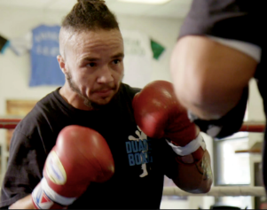
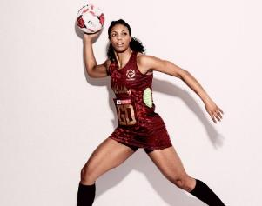

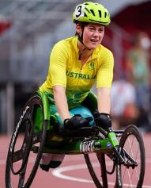
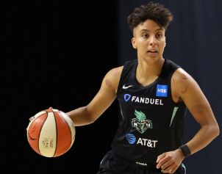
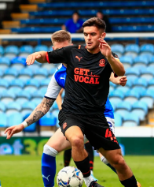
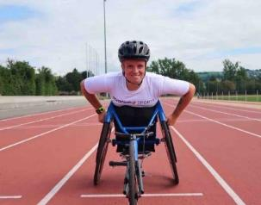
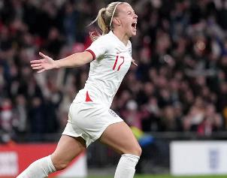
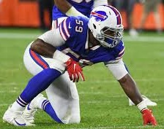
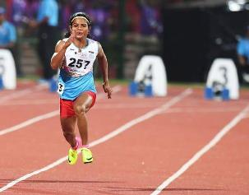
LO: To explain the importance of respecting other people’s differences
LO: To summarise information using bullet points
Notes:
Show students different sportspeople on the board (Pat Manuel - boxer, Stacey Frances-Bayman – Netball Player, Ruby Tui– rugby player, Robyn Lambird – wheelchair racer, , Layshia Clarendon – basketball player, Jake Daniels – football player, , Lizzie Williams – wheelchair racer, Beth Mead- football player, Ryan Russell – American Football player, Duttee Chand – sprinter)
Ask: What have these people got in common? Think. Pair. Share.
Ask: What else might these people have in common? Think. Pair. Share.

Slide 4
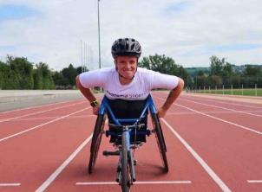
LO: To explain the importance of respecting other people’s differences
LO: To summarise information using bullet points
Beth Mead plays football for England. She is gay.
Lizzie Williams is a wheelchair racer. She is a wheelchair user and she is a lesbian.
Jake Daniels plays football for Blackpool. He is gay.
Layshia Clarendon is a basketball player. Layshia is not a man or a woman. Layshia is non-binary.
Notes:
Share the additional information about each person and discuss that they are all LGBTQ+.

Slide 5

LO: To explain the importance of respecting other people’s differences
LO: To summarise information using bullet points
Stacey Frances-Bayman has played netball for England. She is married to a woman she met playing netball.
Ryan Russell is an American Football player. He is bi.
Pat Manuel is a professional boxer. He is trans.
Duttee Chand is a sprinter and competes for India. She is a lesbian.
Notes:
Share the additional information about each person and discuss that they are all LGBTQ+.

Slide 6
LO: To explain the importance of respecting other people’s differences
LO: To summarise information using bullet points
Robyn Lambird is a wheelchair racer. Robyn is non-binary and uses ‘they’ and ‘them’ pronouns.
Ruby Tui plays rugby for New Zealand. She is LGBTQ+.
Notes:
Share the additional information about each person and discuss that they are all LGBTQ+.

Slide 7
LO: To explain the importance of respecting other people’s differences
LO: To retrieve and record information from a fact file
How might it feel to be discriminated against because of being lesbian, gay, bi or trans?
Notes:
Explain that these people face prejudice because of being LGBTQ+ – for example, people saying mean things about them or laws in some countries saying that it’s ok to discriminate against people. Discuss that in some countries Stacey wouldn’t have been allowed to get married to her wife. In some countries Pat Manuel wouldn’t be allowed to change his birth certificate. In some countries Jake could be put in prison for having a boyfriend. But even in this country, people call other people names or want to hurt them because they’re LGBTQ+.
Ask: How might that make them feel? Think. Pair. Share.

Slide 8
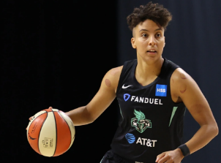
LO: To explain the importance of respecting other people’s differences
LO: To retrieve and record information from a fact file
How does it feel to be respected?
Notes:
Ask: How does it feel to be respected?

Slide 9

LO: To explain the importance of respecting other people’s differences
LO: To summarise information using bullet points
Choose a sports person to focus on.
Research the sports person using the fact file.
Make a fact sheet about the sports person – remember to use bullet points.
Notes:
Working in pairs, children should use the fact sheet to make their own fact file about one of the sports people that had been featured at the start of the lesson.

Slide 10
LO: To explain the importance of respecting other people’s differences
LO: To summarise information using bullet points
Make a fact sheet about yourself. You could include:
What your interests are
What you are good at
What might make you different to other people
Notes:
Each child should make their own fact file about themselves.
They could include:
what their interests are
what they are good at
what might make them different to other people
What you are good at

Slide 11

LO: To explain the importance of respecting other people’s differences
LO: To summarise information using bullet points
How are we similar?
How are we different?
Notes:
Children find someone with the same interest written on their fact file. Once they find them, they should look at what else is on each others’ fact file . Can they find things that are different about each other?
Next children find someone that is good at different things to them. Once they find them, they should look at what else is on each others’ fact file – can they find things that are similar? Have they got anything in common that isn’t written down?

Slide 12
LO: To explain the importance of respecting other people’s differences
LO: To summarise information using bullet points
Let’s make sport everyone’s game.
Notes:
Ask children to feed back about their similarities and differences and that they can still choose to respect people even if they have a lot of differences.
Link the conversation back to the conversation on LGBT sports people – all people are worthy of respect and it is wrong to disrespect people because of being LGBT.

