Slide 1
PowerPoint template to accompany the Rainbow Laces 2022 lesson pack for:
SEND/ASN/ALN pack Version 1 (more complex)
We know that good teaching is tailored to meet the needs of the children or young people in each individual class. That’s why we’ve created this editable PowerPoint template – feel free to adapt it to suit your teaching context or to add your school or college slide template to the background.
Who are Stonewall?
This resource is produced by Stonewall, a UK-based charity that stands for the freedom, equity and potential of all lesbian, gay, bi, trans, queer, questioning and ace (LGBTQ+) people. At Stonewall, we imagine a world where LGBTQ+ people everywhere can live our lives to the full. Founded in London in 1989, we now work in each nation of the UK and have established partnerships across the globe. Over the last three decades, we have created transformative change in the lives of LGBTQ+ people in the UK, helping win equal rights around marriage, having children and inclusive education.
Our campaigns drive positive change for our communities, and our sustained change and empowerment programmes ensure that LGBTQ+ people can thrive throughout our lives. We make sure that the world hears and learns from our communities, and our work is grounded in evidence and expertise.
Stonewall is proud to provide information, support and guidance on LGBTQ+ inclusion; working towards a world where we’re all free to be. This does not constitute legal advice, and is not intended to be a substitute for legal counsel on any subject matter. To find out more about our work, visit us at www.stonewall.org.uk.
Registered Charity No 1101255 (England and Wales) and SC039681 (Scotland)
Notes:
Visit our website for the lesson plan and resources to accompany this PowerPoint.

Slide 2











Notes:
Show students different sportspeople on the board (Pat Manuel - boxer, Stacey Frances-Bayman – Netball Player, Ruby Tui– rugby player, Robyn Lambird – wheelchair racer, , Layshia Clarendon – basketball player, Jake Daniels – football player, , Lizzie Williams – wheelchair racer, Beth Mead- football player, Ryan Russell – American Football player, Duttee Chand – sprinter)
Ask: What do these people do for a job?

Slide 3

Notes:
They are all sports people!

Slide 4


Notes:
Match the sports person to their sport. For each sport, students should:
Match or identify the symbol for the sport
OR Sign or say the name of the sport
OR Write the name of the sport

Slide 5

Notes:
Match the sports person to their sport. For each sport, students should:
Match or identify the symbol for the sport
OR Sign or say the name of the sport
OR Write the name of the sport

Slide 6


Slide 7


Slide 8


Slide 9


Slide 10
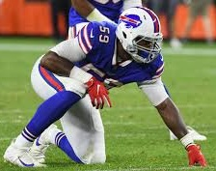

Slide 11


Slide 12


Slide 13


Slide 14


Slide 15


Slide 16


Slide 17


Slide 18


Slide 19


Slide 20



Notes:
Tell the students that these sports people have something else in common. All of these people are LGBTQ+.

Slide 21



Notes:
Look through the additional information about each person. Use the PowerPoint to help students’ understanding of the words lesbian, gay, bi and trans.
For each person, students should:
Match or identify the symbol for lesbian, gay, bi or trans
OR Sign or say the word lesbian, gay, bi or trans
OR Write lesbian, gay, bi or trans

Slide 22



Notes:
Look through the additional information about each person. Use the PowerPoint to help students’ understanding of the words lesbian, gay, bi and trans.
For each person, students should:
Match or identify the symbol for lesbian, gay, bi or trans
OR Sign or say the word lesbian, gay, bi or trans
OR Write lesbian, gay, bi or trans

Slide 23


Notes:
Look through the additional information about each person. Use the PowerPoint to help students’ understanding of the words lesbian, gay, bi and trans.
For each person, students should:
Match or identify the symbol for lesbian, gay, bi or trans
OR Sign or say the word lesbian, gay, bi or trans
OR Write lesbian, gay, bi or trans

Slide 24

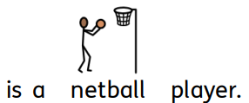

Notes:
Look through the additional information about each person. Use the PowerPoint to help students’ understanding of the words lesbian, gay, bi and trans.
For each person, students should:
Match or identify the symbol for lesbian, gay, bi or trans
OR Sign or say the word lesbian, gay, bi or trans
OR Write lesbian, gay, bi or trans

Slide 25



Notes:
Look through the additional information about each person. Use the PowerPoint to help students’ understanding of the words lesbian, gay, bi and trans.
For each person, students should:
Match or identify the symbol for lesbian, gay, bi or trans
OR Sign or say the word lesbian, gay, bi or trans
OR Write lesbian, gay, bi or trans

Slide 26
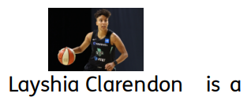

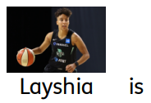



Notes:
Look through the additional information about each person. Use the PowerPoint to help students’ understanding of the words lesbian, gay, bi and trans.
For each person, students should:
Match or identify the symbol for lesbian, gay, bi or trans
OR Sign or say the word lesbian, gay, bi or trans
OR Write lesbian, gay, bi or trans

Slide 27
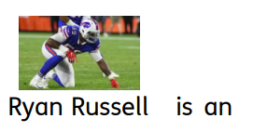

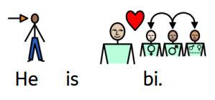
Notes:
Look through the additional information about each person. Use the PowerPoint to help students’ understanding of the words lesbian, gay, bi and trans.
For each person, students should:
Match or identify the symbol for lesbian, gay, bi or trans
OR Sign or say the word lesbian, gay, bi or trans
OR Write lesbian, gay, bi or trans

Slide 28



Notes:
Look through the additional information about each person. Use the PowerPoint to help students’ understanding of the words lesbian, gay, bi and trans.
For each person, students should:
Match or identify the symbol for lesbian, gay, bi or trans
OR Sign or say the word lesbian, gay, bi or trans
OR Write lesbian, gay, bi or trans

Slide 29
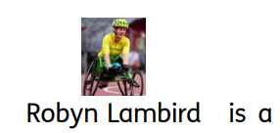
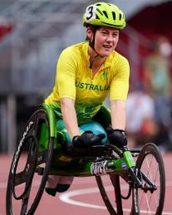

Notes:
Look through the additional information about each person. Use the PowerPoint to help students’ understanding of the words lesbian, gay, bi and trans.
For each person, students should:
Match or identify the symbol for lesbian, gay, bi or trans
OR Sign or say the word lesbian, gay, bi or trans
OR Write lesbian, gay, bi or trans

Slide 30

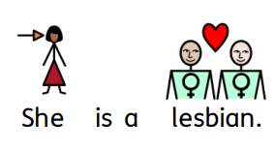
Notes:
Look through the additional information about each person. Use the PowerPoint to help students’ understanding of the words lesbian, gay, bi and trans.
For each person, students should:
Match or identify the symbol for lesbian, gay, bi or trans
OR Sign or say the word lesbian, gay, bi or trans
OR Write lesbian, gay, bi or trans

Slide 31




