Slide 1
PowerPoint template to accompany the Rainbow Laces 2022 lesson pack for:
SEND/ASN/ALN pack Version 1 (more complex)
We know that good teaching is tailored to meet the needs of the children or young people in each individual class. That’s why we’ve created this editable PowerPoint template – feel free to adapt it to suit your teaching context or to add your school or college slide template to the background.
Who are Stonewall?
This resource is produced by Stonewall, a UK-based charity that stands for the freedom, equity and potential of all lesbian, gay, bi, trans, queer, questioning and ace (LGBTQ+) people. At Stonewall, we imagine a world where LGBTQ+ people everywhere can live our lives to the full. Founded in London in 1989, we now work in each nation of the UK and have established partnerships across the globe. Over the last three decades, we have created transformative change in the lives of LGBTQ+ people in the UK, helping win equal rights around marriage, having children and inclusive education.
Our campaigns drive positive change for our communities, and our sustained change and empowerment programmes ensure that LGBTQ+ people can thrive throughout our lives. We make sure that the world hears and learns from our communities, and our work is grounded in evidence and expertise.
Stonewall is proud to provide information, support and guidance on LGBTQ+ inclusion; working towards a world where we’re all free to be. This does not constitute legal advice, and is not intended to be a substitute for legal counsel on any subject matter. To find out more about our work, visit us at www.stonewall.org.uk.
Registered Charity No 1101255 (England and Wales) and SC039681 (Scotland)
Notes:
Visit our website for the lesson plan and resources to accompany this PowerPoint.

Slide 2
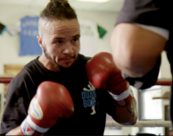
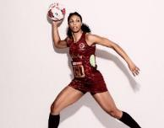

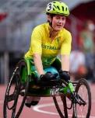
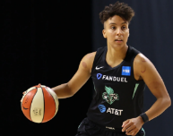

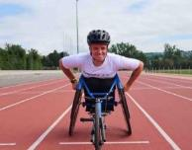

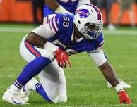
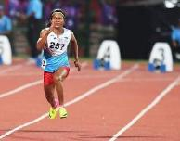
What job do they do?
Notes:
Show students different sportspeople on the board (Pat Manuel - boxer, Stacey Frances-Bayman – Netball Player, Ruby Tui– rugby player, Robyn Lambird – wheelchair racer, , Layshia Clarendon – basketball player, Jake Daniels – football player, , Lizzie Williams – wheelchair racer, Beth Mead- football player, Ryan Russell – American Football player, Duttee Chand – sprinter)
Ask: What do these people do for a job?

Slide 3
They are sports people.
Notes:
They are all sports people!

Slide 4
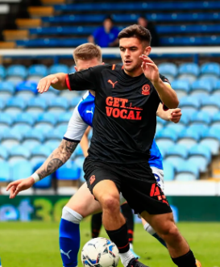
What is the sport?
Notes:
Match the sports person to their sport. For each sport, students should:
Match or identify the symbol for the sport
OR Sign or say the name of the sport
OR Write the name of the sport

Slide 5
Football
Notes:
Match the sports person to their sport. For each sport, students should:
Match or identify the symbol for the sport
OR Sign or say the name of the sport
OR Write the name of the sport

Slide 6

What is the sport?

Slide 7
Boxing

Slide 8
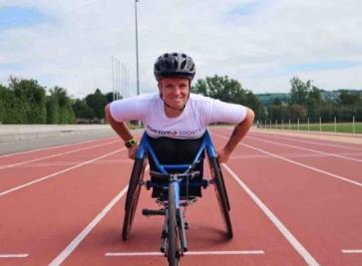
What is the sport?

Slide 9
Wheelchair racing

Slide 10

What is the sport?

Slide 11
American Football

Slide 12

What is the sport?

Slide 13
Netball

Slide 14

What is the sport?

Slide 15
Rugby

Slide 16

What is the sport?

Slide 17
Running

Slide 18

What is the sport?

Slide 19
Basketball

Slide 20
They are all lesbian, gay, bi or trans.
Notes:
Tell the students that these sports people have something else in common. All of these people are LGBTQ+.

Slide 21
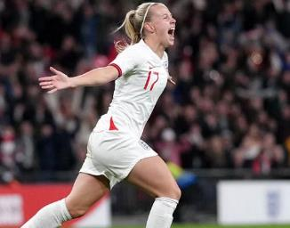
Beth Mead plays football for England. She is gay.
Notes:
Look through the additional information about each person. Use the PowerPoint to help students’ understanding of the words lesbian, gay, bi and trans.
For each person, students should:
Match or identify the symbol for lesbian, gay, bi or trans
OR Sign or say the word lesbian, gay, bi or trans
OR Write lesbian, gay, bi or trans

Slide 22

Jake Daniels plays football for Blackpool. He is gay.
Notes:
Look through the additional information about each person. Use the PowerPoint to help students’ understanding of the words lesbian, gay, bi and trans.
For each person, students should:
Match or identify the symbol for lesbian, gay, bi or trans
OR Sign or say the word lesbian, gay, bi or trans
OR Write lesbian, gay, bi or trans

Slide 23
Pat Manuel is a professional boxer. He is trans.
Notes:
Look through the additional information about each person. Use the PowerPoint to help students’ understanding of the words lesbian, gay, bi and trans.
For each person, students should:
Match or identify the symbol for lesbian, gay, bi or trans
OR Sign or say the word lesbian, gay, bi or trans
OR Write lesbian, gay, bi or trans

Slide 24
Stacey Frances-Bayman played netball for England. She is a lesbian.
Notes:
Look through the additional information about each person. Use the PowerPoint to help students’ understanding of the words lesbian, gay, bi and trans.
For each person, students should:
Match or identify the symbol for lesbian, gay, bi or trans
OR Sign or say the word lesbian, gay, bi or trans
OR Write lesbian, gay, bi or trans

Slide 25
Lizzie Williams is a wheelchair racer. She is a wheelchair user and she is a lesbian.
Notes:
Look through the additional information about each person. Use the PowerPoint to help students’ understanding of the words lesbian, gay, bi and trans.
For each person, students should:
Match or identify the symbol for lesbian, gay, bi or trans
OR Sign or say the word lesbian, gay, bi or trans
OR Write lesbian, gay, bi or trans

Slide 26
Layshia Clarendon is a basketball player. Layshia is not a man or a woman. Layshia is non-binary.
Notes:
Look through the additional information about each person. Use the PowerPoint to help students’ understanding of the words lesbian, gay, bi and trans.
For each person, students should:
Match or identify the symbol for lesbian, gay, bi or trans
OR Sign or say the word lesbian, gay, bi or trans
OR Write lesbian, gay, bi or trans

Slide 27
Ryan Russell is an American Football player. He is bi.
Notes:
Look through the additional information about each person. Use the PowerPoint to help students’ understanding of the words lesbian, gay, bi and trans.
For each person, students should:
Match or identify the symbol for lesbian, gay, bi or trans
OR Sign or say the word lesbian, gay, bi or trans
OR Write lesbian, gay, bi or trans

Slide 28
Ruby Tui plays rugby for New Zealand. She is LGBTQ+.
Notes:
Look through the additional information about each person. Use the PowerPoint to help students’ understanding of the words lesbian, gay, bi and trans.
For each person, students should:
Match or identify the symbol for lesbian, gay, bi or trans
OR Sign or say the word lesbian, gay, bi or trans
OR Write lesbian, gay, bi or trans

Slide 29

Robyn Lambird is a wheelchair racer. Robyn is non-binary and uses ‘they’ and ‘them’ pronouns.
Notes:
Look through the additional information about each person. Use the PowerPoint to help students’ understanding of the words lesbian, gay, bi and trans.
For each person, students should:
Match or identify the symbol for lesbian, gay, bi or trans
OR Sign or say the word lesbian, gay, bi or trans
OR Write lesbian, gay, bi or trans

Slide 30
Duttee Chand is a runner and competes for India. She is a lesbian.
Notes:
Look through the additional information about each person. Use the PowerPoint to help students’ understanding of the words lesbian, gay, bi and trans.
For each person, students should:
Match or identify the symbol for lesbian, gay, bi or trans
OR Sign or say the word lesbian, gay, bi or trans
OR Write lesbian, gay, bi or trans

Slide 31
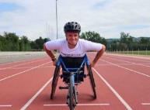
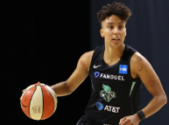

Make a poster about an LGBTQ+ sports person.
Write a message to show that it’s ok to be lesbian, gay, bi or trans.

