Slide 1
PowerPoint template to accompany the Rainbow Laces 2022 lesson pack for:
Key Stage 4 and Post-16 – England and Wales
S4 to S6 - Scotland
We know that good teaching is tailored to meet the needs of the children or young people in each individual class. That’s why we’ve created this editable PowerPoint template – feel free to adapt it to suit your teaching context or to add your school or college slide template to the background.
Who are Stonewall?
This resource is produced by Stonewall, a UK-based charity that stands for the freedom, equity and potential of all lesbian, gay, bi, trans, queer, questioning and ace (LGBTQ+) people. At Stonewall, we imagine a world where LGBTQ+ people everywhere can live our lives to the full. Founded in London in 1989, we now work in each nation of the UK and have established partnerships across the globe. Over the last three decades, we have created transformative change in the lives of LGBTQ+ people in the UK, helping win equal rights around marriage, having children and inclusive education.
Our campaigns drive positive change for our communities, and our sustained change and empowerment programmes ensure that LGBTQ+ people can thrive throughout our lives. We make sure that the world hears and learns from our communities, and our work is grounded in evidence and expertise.
Stonewall is proud to provide information, support and guidance on LGBTQ+ inclusion; working towards a world where we’re all free to be. This does not constitute legal advice, and is not intended to be a substitute for legal counsel on any subject matter. To find out more about our work, visit us at www.stonewall.org.uk.
Registered Charity No 1101255 (England and Wales) and SC039681 (Scotland)
Notes:
Visit our website for the lesson plan and resources to accompany this PowerPoint.

Slide 2

LO: To be able to use statistics to support an argument
Notes:
What is respect and why is it important? Feed back as a group.

Slide 3
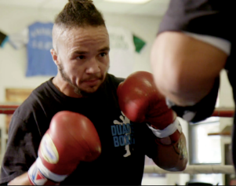
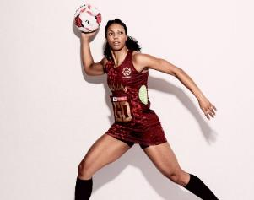

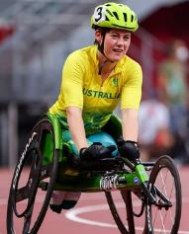
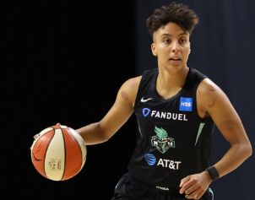
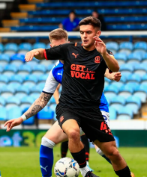
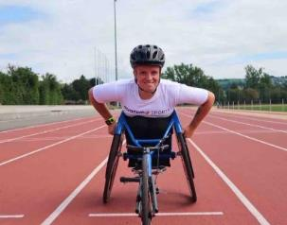

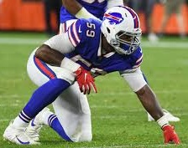
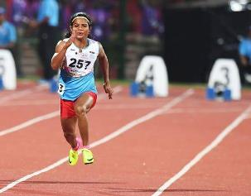
To be able to use statistics to support an argument
Notes:
Show students different sportspeople on the board (Pat Manuel - boxer, Stacey Frances-Bayman – Netball Player, Ruby Tui– rugby player, Robyn Lambird – wheelchair racer, , Layshia Clarendon – basketball player, Jake Daniels – football player, , Lizzie Williams – wheelchair racer, Beth Mead- football player, Ryan Russell – American Football player, Duttee Chand – sprinter)
Ask: What have these people got in common? Think. Pair. Share.
Ask: What else might these people have in common? Think. Pair. Share.

Slide 4
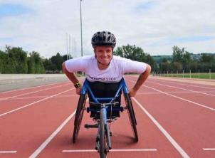
To be able to use statistics to support an argument
Beth Mead plays football for England. As the top goal scorer during the 2022 European Championships, Beth was named player of the tournament. She’s also gay.
Lizzie Williams is a wheelchair racer. She competes for Britain. Lizzie also happens to be a lesbian.
Jake Daniels plays football for Blackpool. As well as making his first team debut in 2022, he came out as gay in an interview with Sky Sports.
Layshia Clarendon is a basketball player. Layshia is non-binary and lives with their wife and child.
Notes:
Share the additional information about each person and discuss that they are all LGBTQ+.

Slide 5

To be able to use statistics to support an argument
Stacey Frances-Bayman has played netball for England. Her wife is also a netball player.
Duttee Chand is the Indian 100m women’s champion. She felt able to talk about her girlfriend once homosexuality was decriminalized in India.
Pat Manuel is a professional boxer. He was the first trans person in the USA to become a professional boxer.
Ryan Russell is an American Football player. When he came out as bi, he made international news.
Notes:
Share the additional information about each person and discuss that they are all LGBTQ+.

Slide 6
To be able to use statistics to support an argument
Robyn Lambird is a wheelchair racer. Robyn is a former wheelchair rugby player and is also non-binary.
Ruby Tui plays rugby for New Zealand. Her girlfriend, Dani, is a journalist.
Notes:
Share the additional information about each person and discuss that they are all LGBTQ+.

Slide 7
To be able to use statistics to support an argument
What challenges can people face as a consequence of being LGBTQ+?
Notes:
Ask: What challenges can people face as a consequence of being LGBTQ+? Think. Pair. Share.
Discuss that LGBTQ+ people face prejudice because of being LGBTQ+. Share examples of homophobia, biphobia and transphobia.

Slide 8
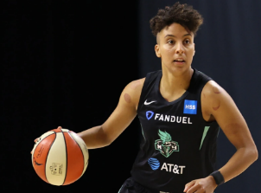
To be able to use statistics to support an argument
What impact might homophobia, biphobia or transphobia have on a person?
Notes:
Ask: What impact might homophobia, biphobia or transphobia have on a person? Think. Pair. Share.

Slide 9
To be able to use statistics to support an argument
36% of LGBT people say they aren’t comfortable walking down the street while holding their partner's hand.
40% of trans people adjust the way they dress because of fear of discrimination and harassment.
72% of LGBT young people aged 18 to 24 have seen homophobic, biphobic and transphobic abuse online recently.
19% of LGBT disabled people have been discriminated against in shops and stores
48% of trans people do not feel comfortable using public toilets
Notes:
Use the PowerPoint to discuss some of the statistics from Stonewall’s LGBT in Britain – Hate Crime report

Slide 10
To be able to use statistics to support an argument
43% of LGBT people think public sporting events aren’t a welcoming space for LGBT people.
One in ten LGBT people who attended a live sporting event in the last year experienced discrimination because of their sexual orientation and/or gender identity.
38% of trans people avoid going to the gym or participating in sports groups because of fear of discrimination and harassment
11% of LGBT people have been discriminated against while exercising at a fitness club or taking part in group sport in the last year
Notes:
Use the PowerPoint to discuss some of the statistics from Stonewall’s LGBT in Britain – Hate Crime report

Slide 11
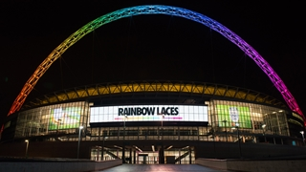
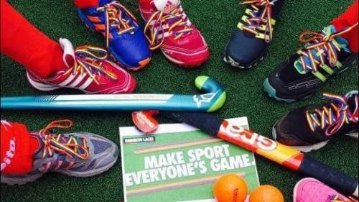
To be able to use statistics to support an argument
Stonewall’s Rainbow Laces Campaign works towards making sport everyone’s game.
Why might this campaign be needed?
What might the impact of homophobia, biphobia and transphobia in sport be?
Notes:
Talk about the Rainbow Laces Campaign.
Ask: Why might the Rainbow Laces Campaign be needed?
Ask: What might the impact of homophobia, biphobia and transphobia in sport be? Think. Pair. Share.

Slide 12

To be able to use statistics to support an argument
Create a news report.
You should:
Highlight the impact of homophobia, biphobia and transphobia in sport
Use the Stonewall statistics to support your argument
Notes:
Students work in pairs or threes to create a news report to highlight the impact of homophobia, biphobia and transphobia in sport but also in wider society. This could be a newspaper report, a TV news report or a radio report.
Students should use the Stonewall Stats sheet to help with their research.

Slide 13

To be able to use statistics to support an argument
Let’s make sport everyone’s game.
Notes:
Students share their work with the rest of the class, either by delivering their TV or radio report or by giving their peers the opportunity to read their article.
As a class, ask students to share the really important points that they had picked up on from the lesson.
Note: You could record any TV or radio reports and share them on the school website.

