Slide 1
PowerPoint template to accompany the Rainbow Laces 2022 lesson pack for:
Key Stage 3 – England and Wales
S1 to S3 - Scotland
We know that good teaching is tailored to meet the needs of the children or young people in each individual class. That’s why we’ve created this editable PowerPoint template – feel free to adapt it to suit your teaching context or to add your school or college slide template to the background.
Who are Stonewall?
This resource is produced by Stonewall, a UK-based charity that stands for the freedom, equity and potential of all lesbian, gay, bi, trans, queer, questioning and ace (LGBTQ+) people. At Stonewall, we imagine a world where LGBTQ+ people everywhere can live our lives to the full. Founded in London in 1989, we now work in each nation of the UK and have established partnerships across the globe. Over the last three decades, we have created transformative change in the lives of LGBTQ+ people in the UK, helping win equal rights around marriage, having children and inclusive education.
Our campaigns drive positive change for our communities, and our sustained change and empowerment programmes ensure that LGBTQ+ people can thrive throughout our lives. We make sure that the world hears and learns from our communities, and our work is grounded in evidence and expertise.
Stonewall is proud to provide information, support and guidance on LGBTQ+ inclusion; working towards a world where we’re all free to be. This does not constitute legal advice, and is not intended to be a substitute for legal counsel on any subject matter. To find out more about our work, visit us at www.stonewall.org.uk.
Registered Charity No 1101255 (England and Wales) and SC039681 (Scotland)
Notes:
Visit our website for the lesson plan and resources to accompany this PowerPoint.

Slide 2

LO: To be able to explain the importance of challenging prejudice
What is respect?
Notes:
What is respect and why is it important? Feed back as a group.

Slide 3
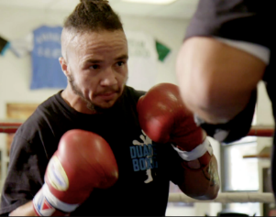
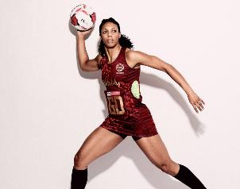

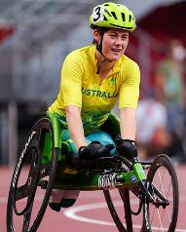


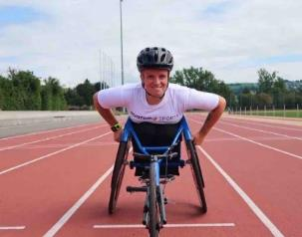
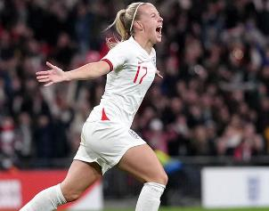
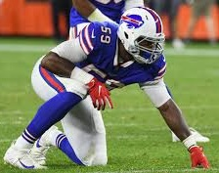
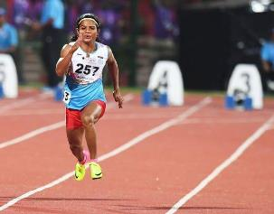
LO: To be able to explain the importance of challenging prejudice
Notes:
Show students different sportspeople on the board (Pat Manuel - boxer, Stacey Frances-Bayman – Netball Player, Ruby Tui– rugby player, Robyn Lambird – wheelchair racer, , Layshia Clarendon – basketball player, Jake Daniels – football player, , Lizzie Williams – wheelchair racer, Beth Mead- football player, Ryan Russell – American Football player, Duttee Chand – sprinter)
Ask: What have these people got in common? Think. Pair. Share.
Ask: What else might these people have in common? Think. Pair. Share.

Slide 4
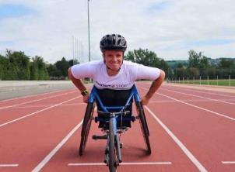
LO: To be able to explain the importance of challenging prejudice
Beth Mead plays football for England. As the top goal scorer during the 2022 European Championships, Beth was named player of the tournament. She’s also gay.
Lizzie Williams is a wheelchair racer. She competes for Britain. Lizzie also happens to be a lesbian.
Jake Daniels plays football for Blackpool. As well as making his first team debut in 2022, he came out as gay in an interview with Sky Sports.
Layshia Clarendon is a basketball player. Layshia is non-binary and lives with their wife and child.
Notes:
Share the additional information about each person and discuss that they are all LGBTQ+.

Slide 5

LO: To be able to explain the importance of challenging prejudice
Stacey Frances-Bayman has played netball for England. Her wife is also a netball player.
Duttee Chand is the Indian 100m women’s champion. She felt able to talk about her girlfriend once homosexuality was decriminalized in India.
Pat Manuel is a professional boxer. He was the first trans person in the USA to become a professional boxer.
Ryan Russell is an American Football player. When he came out as bi, he made international news.
Notes:
Share the additional information about each person and discuss that they are all LGBTQ+.

Slide 6
LO: To be able to explain the importance of challenging prejudice
Robyn Lambird is a wheelchair racer. Robyn is a former wheelchair rugby player and is also non-binary.
Ruby Tui plays rugby for New Zealand. Her girlfriend, Dani, is a journalist.
Notes:
Share the additional information about each person and discuss that they are all LGBTQ+.

Slide 7
LO: To be able to explain the importance of challenging prejudice
What challenges can people face as a consequence of being LGBTQ+?
Notes:
Ask: What challenges can people face as a consequence of being LGBTQ+? Think. Pair. Share.
Discuss that LGBTQ+ people face prejudice because of being LGBTQ+. Share examples of homophobia, biphobia and transphobia.

Slide 8
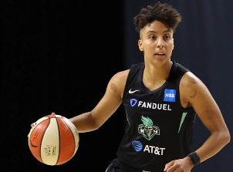
LO: To be able to explain the importance of challenging prejudice
How might homophobia, biphobia or transphobia make someone feel?
Notes:
Ask: How might homophobia, biphobia and transphobia make someone feel? Think. Pair. Share.

Slide 9
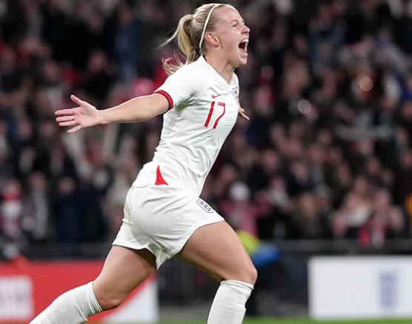
LO: To be able to explain the importance of challenging prejudice
How might the feeling of being respected be different to the experience of facing prejudice?
Notes:
Ask: How might the feeling of being respected be different to the experience of facing prejudice? Think. Pair. Share.
As a group, discuss that being LGBT is just part of who all these people are, that there is nothing wrong with being LGBT and that we should respect everyone. Reflect back on the conversations from Activity 1 about what respect is and why it is important.

Slide 10
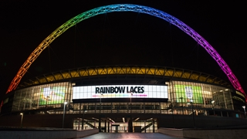
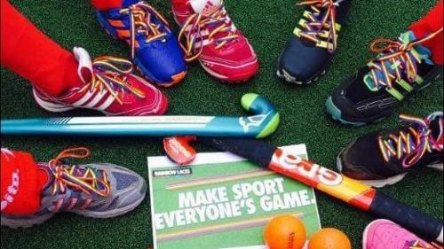
LO: To be able to explain the importance of challenging prejudice
Stonewall’s Rainbow Laces Campaign works towards making sport everyone’s game.
Why might this campaign be needed?
Notes:
Talk about the Rainbow Laces Campaign.
Ask: Why might the Rainbow Laces Campaign be needed?

Slide 11

LO: To be able to explain the importance of challenging prejudice
Make a poster to encourage people to challenge homophobia, biphobia and transphobia in sport.
You could include information on:
The importance of respect
LGBTQ+ sports people
What it means to be LGBTQ+
Notes:
Students work in pairs to make posters to show why people should challenge homophobia, biphobia and transphobia in sport and in the wider community.
They could include information on:
the importance of respect
LGBTQ+ role models (using the fact files or their wider knowledge of LGBTQ+ sports people to help them)
that being LGBTQ+ is just part of who somebody is

Slide 12

LO: To be able to explain the importance of challenging prejudice
Let’s make sport everyone’s game.
Notes:
Give students the opportunity to look at each other’s posters.
As a class, ask students to share the really important points that they had picked up on from the lesson – either through discussions of through looking at each others’ posters.

