Slide 1
PowerPoint template to accompany the My Family RSHE lesson pack for:
Reception – England and Wales
P1 - Scotland
We know that good teaching is tailored to meet the needs of the children or young people in each individual class. That’s why we’ve created this editable PowerPoint template – feel free to adapt it to suit your teaching context or to add your school or college slide template to the background.
Who are Stonewall?
This resource is produced by Stonewall, a UK-based charity that stands for the freedom, equity and potential of all lesbian, gay, bi, trans, queer, questioning and ace (LGBTQ+) people. At Stonewall, we imagine a world where LGBTQ+ people everywhere can live our lives to the full. Founded in London in 1989, we now work in each nation of the UK and have established partnerships across the globe. Over the last three decades, we have created transformative change in the lives of LGBTQ+ people in the UK, helping win equal rights around marriage, having children and inclusive education.
Our campaigns drive positive change for our communities, and our sustained change and empowerment programmes ensure that LGBTQ+ people can thrive throughout our lives. We make sure that the world hears and learns from our communities, and our work is grounded in evidence and expertise.
Stonewall is proud to provide information, support and guidance on LGBTQ+ inclusion; working towards a world where we’re all free to be. This does not constitute legal advice, and is not intended to be a substitute for legal counsel on any subject matter. To find out more about our work, visit us at www.stonewall.org.uk.
Registered Charity No 1101255 (England and Wales) and SC039681 (Scotland)
Notes:
Visit our website for the lesson plan to accompany this PowerPoint.

Slide 2

LO: To be able to talk about my family
Notes:
As a class, read The Family Book by Todd Parr. Discuss the different types of family, including families with same gender parents, foster families and adoptive families

Slide 3
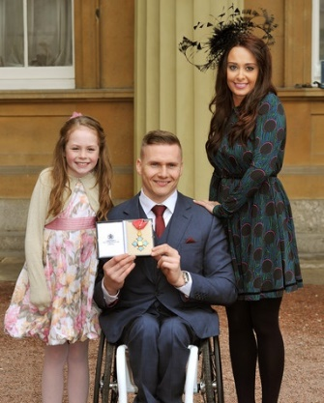
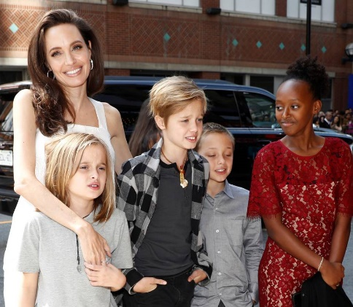
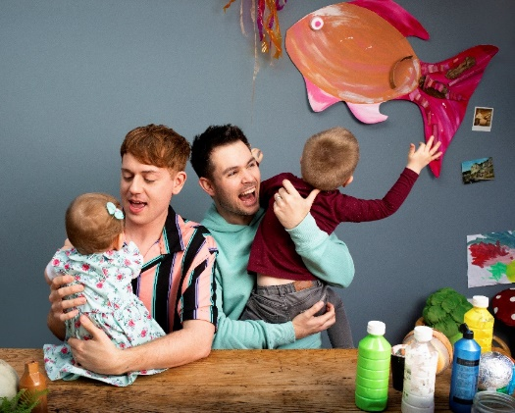
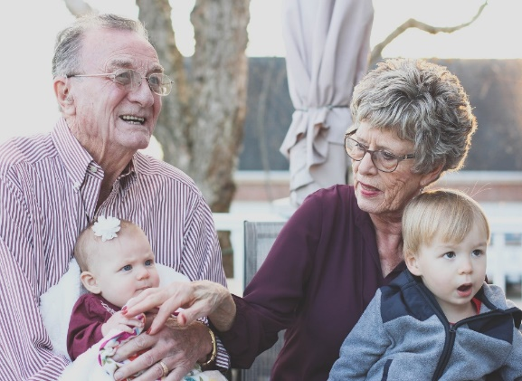
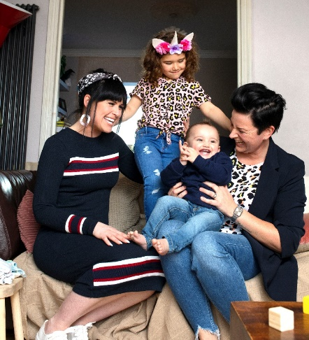
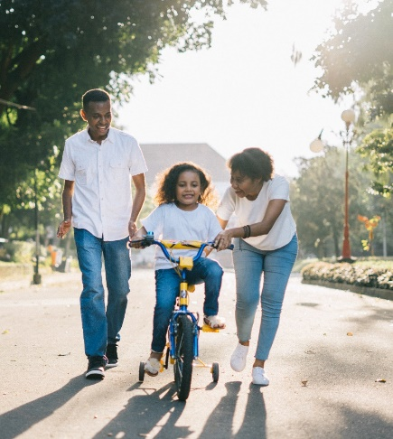
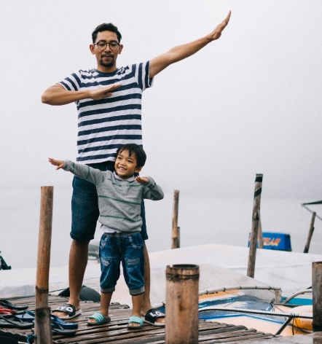
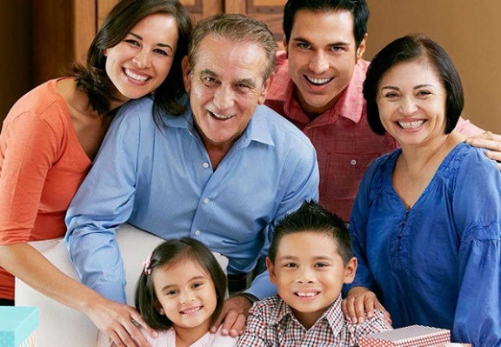
LO: To be able to talk about my family
Who is in these families?
Notes:
Who are the people in these different families?

Slide 4
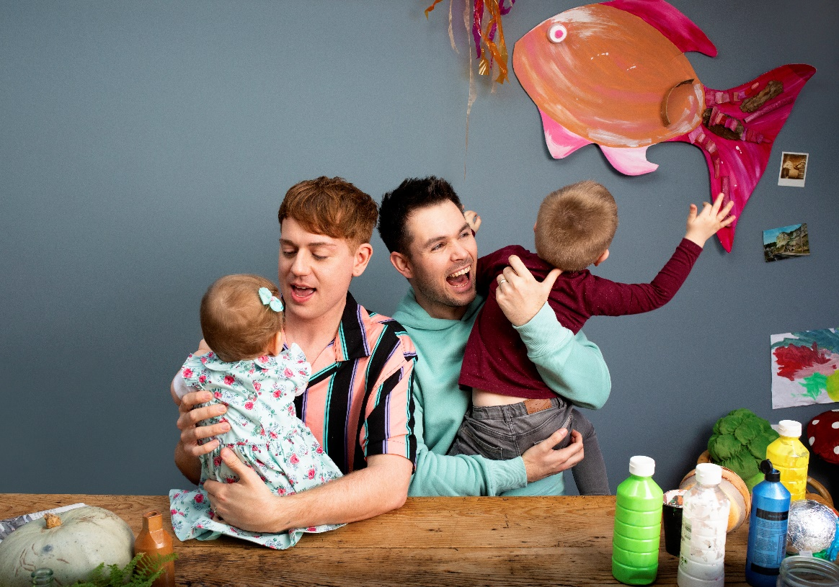
LO: To be able to talk about my family
Who is in your family?
Notes:
Use the book and the Family Portraits PowerPoint as a stimulus for children to discuss their families with a partner and then as a class.

Slide 5

LO: To be able to talk about my family
Make a family portrait
Make your family out of play dough
Write the names of the people in your family on paper
Put the names next to your play dough people
Take a photo of your family portrait
Notes:
Ask children: What does family mean to you? Children use play dough to create a 3D family portrait. They should make their family members out of play dough.
Children can write the names of their family members on slips of paper in order to label the family portrait.

Slide 6
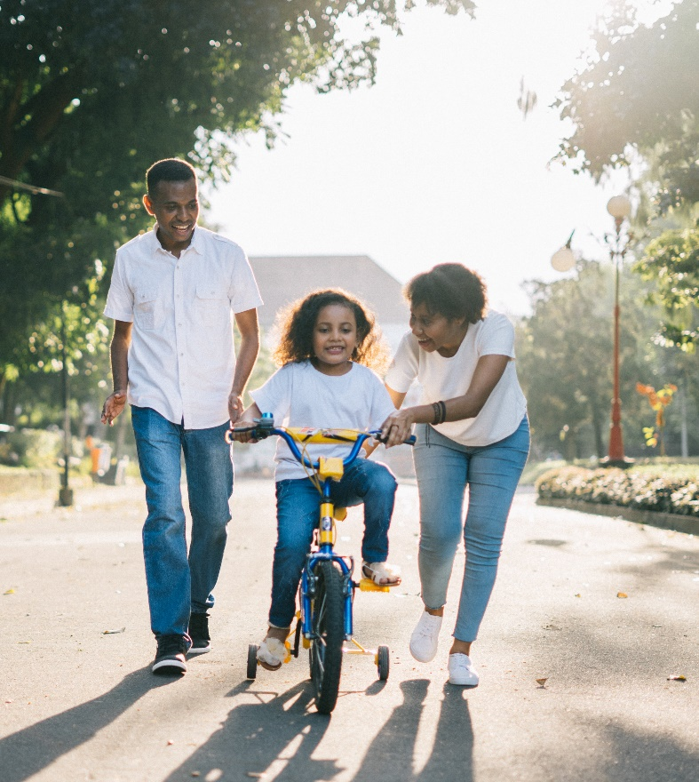
LO: To be able to talk about my family
Who is in our families?
Notes:
As a class, look around the class gallery of 3D family portraits, give children the opportunity to share about their families – make sure that a diverse range of families are discussed.

