Slide 1
PowerPoint template to accompany the Who Am I? lesson pack for:
Learners with SEND/ASN/ALN
We know that good teaching is tailored to meet the needs of the children or young people in each individual class. That’s why we’ve created this editable PowerPoint template – feel free to adapt it to suit your teaching context or to add your school or college slide template to the background.
Who are Stonewall?
This resource is produced by Stonewall, a UK-based charity that stands for the freedom, equity and potential of all lesbian, gay, bi, trans, queer, questioning and ace (LGBTQ+) people. At Stonewall, we imagine a world where LGBTQ+ people everywhere can live our lives to the full. Founded in London in 1989, we now work in each nation of the UK and have established partnerships across the globe. Over the last three decades, we have created transformative change in the lives of LGBTQ+ people in the UK, helping win equal rights around marriage, having children and inclusive education.
Our campaigns drive positive change for our communities, and our sustained change and empowerment programmes ensure that LGBTQ+ people can thrive throughout our lives. We make sure that the world hears and learns from our communities, and our work is grounded in evidence and expertise.
Stonewall is proud to provide information, support and guidance on LGBTQ+ inclusion; working towards a world where we’re all free to be. This does not constitute legal advice, and is not intended to be a substitute for legal counsel on any subject matter. To find out more about our work, visit us at www.stonewall.org.uk.
Registered Charity No 1101255 (England and Wales) and SC039681 (Scotland)
Notes:
Visit our website for the lesson plan to accompany this PowerPoint.

Slide 2
Title page
School & College Role Models
People and Religion
Notes:
This PowerPoint is for use with learners with SEND/ALN/ASN who are working below age related expectations. It can be used with the Stonewall x Burberry School & College Role Models My Faith lesson pack, which can be downloaded from our website. This is Version 2. You’ll find Version 2, which is more complex, on our website. Our mainstream resources may also be more appropriate for some learners, they’re also available on the Stonewall website.

Slide 3
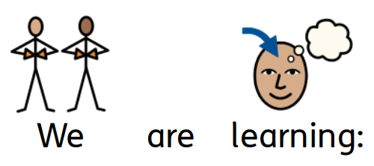
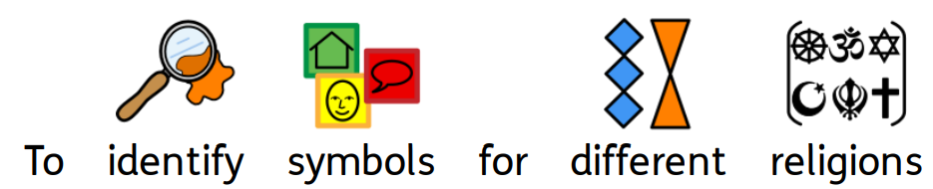
Learning objective
Notes:
Choose the learning objective to add here:
To take part in activities relating to religions
To identify symbols for different religions
To name some religions
To understand the role religion might play in a person's life

Slide 4

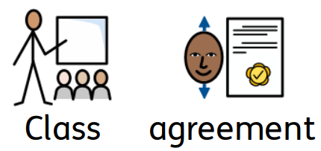
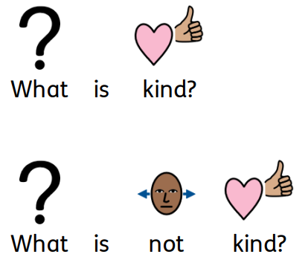
Class agreement 1
Notes:
As a class, agree some ground rules for the session. For example, being kind to others (including the person on the video), recognising that not everyone has the same opinions and that's ok.

Slide 5
Class agreement 2
Notes:
As a class, agree some ground rules for the session. For example, being kind to others (including the person on the video), recognising that not everyone has the same opinions and that's ok.

Slide 6

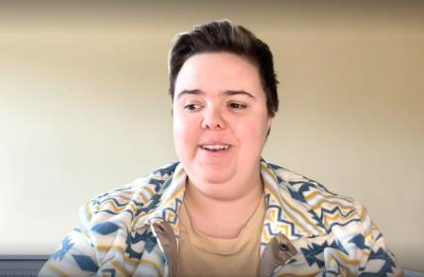
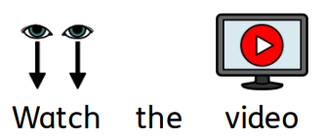
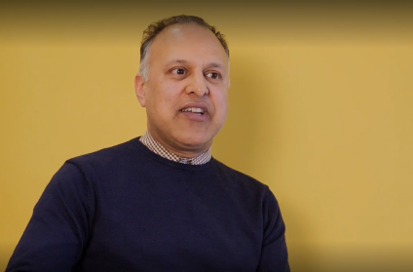
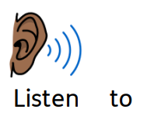
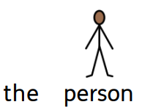
Video
Notes:
Watch one or more of Stonewall's School & College Role Model videos. Miki, Khakan and Philip are all people of faith, so you might wish to choose them.

Slide 7
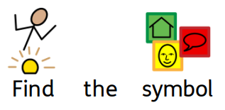
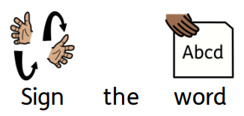
Sign and symbol
Notes:
Easier activity:
After watching the video once, you could watch it again, pausing when the person talks about an important part of their life or identity. Encourage students to match or find the symbols on their communication mat or to sign key words.
Harder activity:
After watching the video, ask students to identify some of the things the person said about their life and about their religion. What was their religion? Were there parts of their life where religion was particuarly important? (for example, weddings, social events)

Slide 8
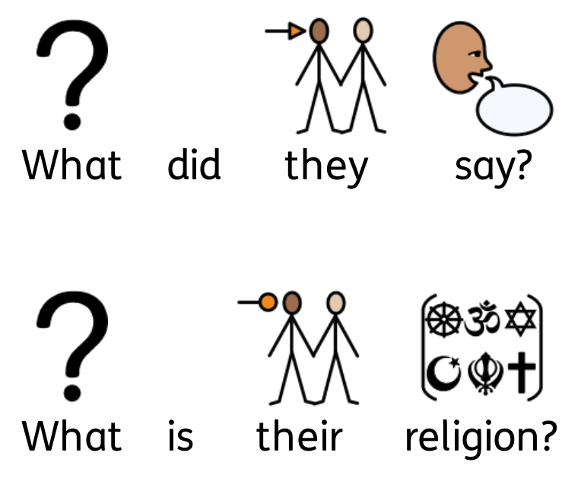
What did they say?
Notes:
Easier activity:
After watching the video once, you could watch it again, pausing when the person talks about an important part of their life or identity. Encourage students to match or find the symbols on their communication mat or to sign key words.
Harder activity:
After watching the video, ask students to identify some of the things the person said about their life and about their religion. What was their religion? Were there parts of their life where religion was particuarly important? (for example, weddings, social events)

Slide 9
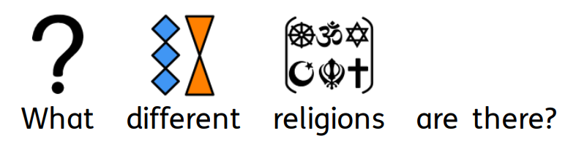
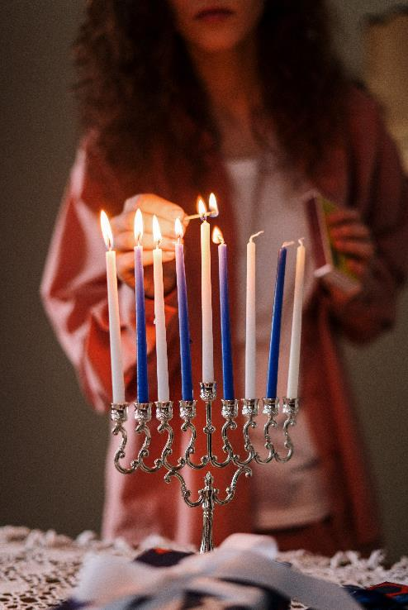
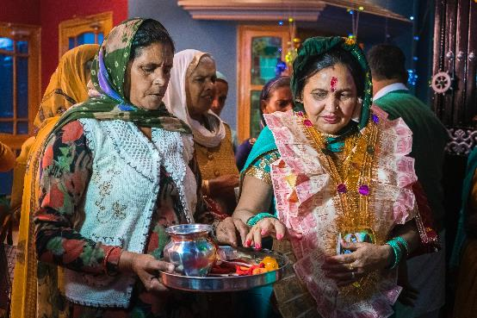
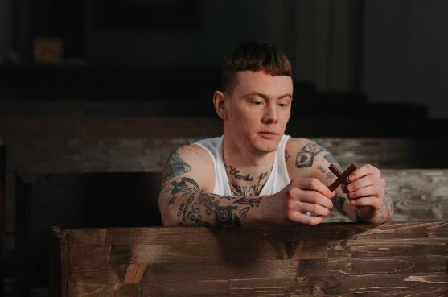
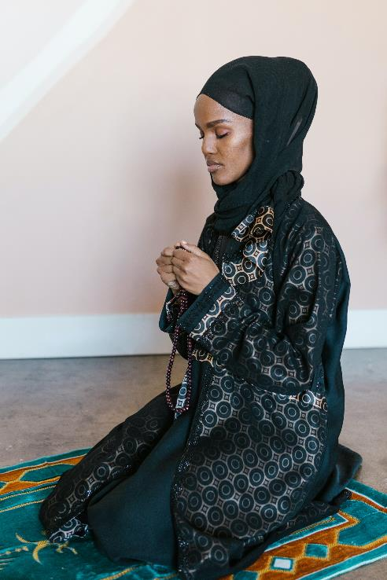
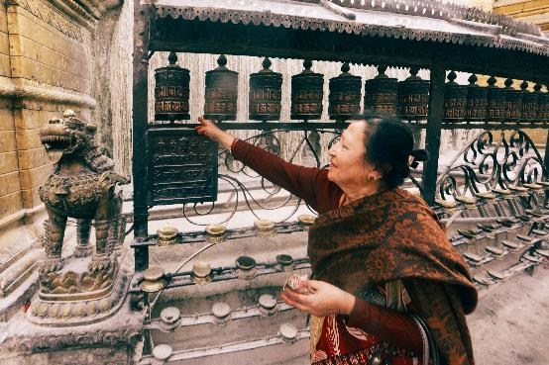
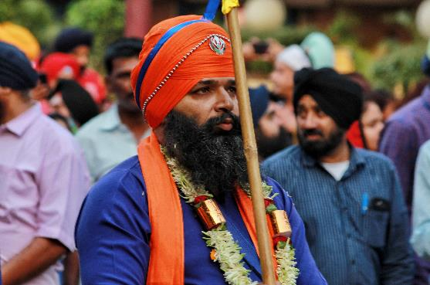
What different religions are there?
Notes:
Play 'Religious Symbol Bingo'. Start the session by encouraging the students to look at the symbols for each of the religions included in the set - if they are religious or are from a religious background, encourage them to identify the symbol associated with their faith or their family's faith. Use sensory props (for example, a puja set, a prayer mat, a kippah, a crucifix) to reinforce their association between the symbol and the religion.

Slide 10
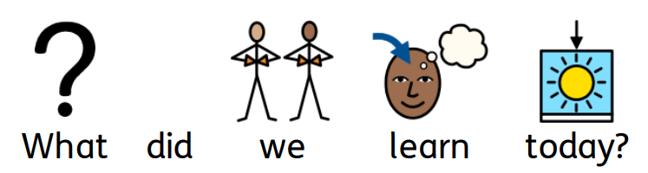
Recap
Notes:
Revisit the learning objective(s) for the lesson and encourage students to reflect on their learning in the lesson. Use your usual self-assessment tools or techniques to facilitate this.

