Slide 1
PowerPoint template to accompany the LGBT+ History Month 2019 lesson pack for:
Key Stage 4 – England and Wales
S4 to S5 – Scotland
We know that good teaching is tailored to meet the needs of the children or young people in each individual class. That’s why we’ve created this editable PowerPoint template – feel free to adapt it to suit your teaching context or to add your school or college slide template to the background.
Who are Stonewall?
This resource is produced by Stonewall, a UK-based charity that stands for the freedom, equity and potential of all lesbian, gay, bi, trans, queer, questioning and ace (LGBTQ+) people. At Stonewall, we imagine a world where LGBTQ+ people everywhere can live our lives to the full. Founded in London in 1989, we now work in each nation of the UK and have established partnerships across the globe. Over the last three decades, we have created transformative change in the lives of LGBTQ+ people in the UK, helping win equal rights around marriage, having children and inclusive education.
Our campaigns drive positive change for our communities, and our sustained change and empowerment programmes ensure that LGBTQ+ people can thrive throughout our lives. We make sure that the world hears and learns from our communities, and our work is grounded in evidence and expertise.
Stonewall is proud to provide information, support and guidance on LGBTQ+ inclusion; working towards a world where we’re all free to be. This does not constitute legal advice, and is not intended to be a substitute for legal counsel on any subject matter. To find out more about our work, visit us at www.stonewall.org.uk.
Registered Charity No 1101255 (England and Wales) and SC039681 (Scotland)
Notes:
Visit our website for the lesson plan to accompany this PowerPoint.

Slide 2
LO: To be able to compare the language used in poems with similar themes

Slide 3

LO: To be able to compare the language used in poems with similar themes
Before You Were Mine –
a poem by Carol Ann Duffy
what my mother (a poet) might say –
a poem by Mary Jean Chan
Identify:
• The common theme
• Similarities and differences in language use
The cultural references
Notes:
Students work in pairs to read and then compare the poems Before You Were Mine by Carol Ann Duffy and what my mother (a poet) might say by Mary Jean Chan.
You can find the poems here:
https://genius.com/Carol-ann-duffy-before-you-were-mine-annotated
https://poems.poetrysociety.org.uk/poems/what-my-mother-a-poet-might-say/
They should identify:
The common theme of the two poems
Use of cultural references
Similarities and differences in relation to language usage

Slide 4

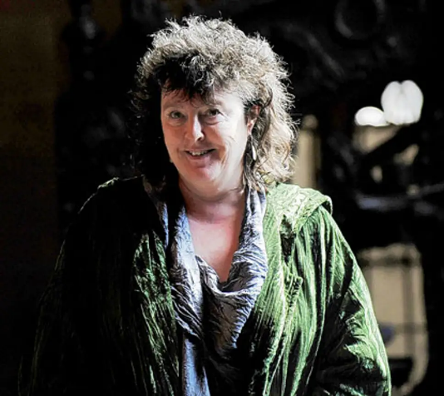
LO: To be able to compare the language used in poems with similar themes
What was the common theme?
How did the poems differ in structure and language?
What was the impact?
Notes:
Ask students to identify the common theme of the poems: their mothers.
How are the poems different in structure and language usage? How does that impact the feel of the poem and the way in which the two mothers are portrayed?
Discuss the poets’ relationships to their mothers and their mothers’ histories. Are they positive associations? Share that both Carol Ann Duffy and Mary Jean Chan are lesbians. How could that potentially affect their relationships with mothers? How could cultural heritage impact that?
You could discuss that in China, it was illegal to be gay up until the change of law in 1997 and until 2001 being gay was classified as being a mental illness. This may have had an impact on Mary Jean’s mother’s attitude towards her daughter being a lesbian. However, it is essential to highlight that this does not mean that all Chinese people or people of Chinese heritage are homophobic, biphobic or transphobic. You could also discuss with students how attitudes towards LGBT people have shifted and changed within the UK – for example, Section 28 prevented schools from talking about and celebrating LGBT people and this law was only repealed in 2003.

Slide 5

LO: To be able to compare the language used in poems with similar themes
What are the common features shared by When You Were Mine by Carol Ann Duffy and what my mother (a poet) might say by Mary Jean Chan?
Notes:
Students answer the question: What are the common features shared by When You Were Mine by Carol Ann Duffy and what my mother (a poet) might say by Mary Jean Chan?

