Slide 1
PowerPoint template to accompany the LGBT+ History Month 2019 lesson pack for:
Key Stage 3 – England and Wales
S1 to S3 – Scotland
We know that good teaching is tailored to meet the needs of the children or young people in each individual class. That’s why we’ve created this editable PowerPoint template – feel free to adapt it to suit your teaching context or to add your school or college slide template to the background.
Who are Stonewall?
This resource is produced by Stonewall, a UK-based charity that stands for the freedom, equity and potential of all lesbian, gay, bi, trans, queer, questioning and ace (LGBTQ+) people. At Stonewall, we imagine a world where LGBTQ+ people everywhere can live our lives to the full. Founded in London in 1989, we now work in each nation of the UK and have established partnerships across the globe. Over the last three decades, we have created transformative change in the lives of LGBTQ+ people in the UK, helping win equal rights around marriage, having children and inclusive education.
Our campaigns drive positive change for our communities, and our sustained change and empowerment programmes ensure that LGBTQ+ people can thrive throughout our lives. We make sure that the world hears and learns from our communities, and our work is grounded in evidence and expertise.
Stonewall is proud to provide information, support and guidance on LGBTQ+ inclusion; working towards a world where we’re all free to be. This does not constitute legal advice, and is not intended to be a substitute for legal counsel on any subject matter. To find out more about our work, visit us at www.stonewall.org.uk.
Registered Charity No 1101255 (England and Wales) and SC039681 (Scotland)
Notes:
Visit our website for the lesson plan to accompany this PowerPoint.

Slide 2
LO: To be able to identify the use of metaphor

Slide 3
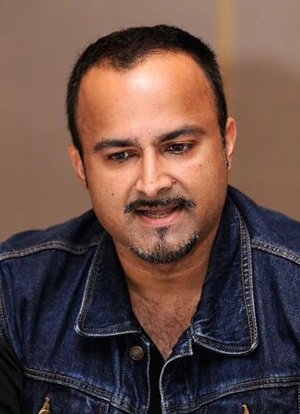
LO: To be able to identify the use of metaphor
Love Transposed –
a poem by Ian Iqbal Rashid
Identify the metaphors.
Notes:
Students work in pairs to underline the metaphors in the poem Love Transposed by Ian Iqbal Rashid. You can find the poem here: http://cordite.org.au/poetry/transqueer/love-transposed/

Slide 4
LO: To be able to identify the use of metaphor
Ian Iqbal Rashid
He was born in Tanzania in 1971, but his family were forced to leave during his early childhood. The family were granted asylum in Canada, which is where Ian Iqbal Rashid grew up.
Notes:
Look at the biography of Ian Iqbal Rashid on the board. Does knowing that he’s gay, had previously been an asylum seeker, that he’s of Indian descent, that his early life was spent in Tanzania change your understanding of the poem at all?

Slide 5
LO: To be able to identify the use of metaphor
Ian Iqbal Rashid now lives in London with his partner Peter. As well as being a poet, he is known for his writing for film, TV and radio.
Notes:
Look at the biography of Ian Iqbal Rashid on the board. Does knowing that he’s gay, had previously been an asylum seeker, that he’s of Indian descent, that his early life was spent in Tanzania change your understanding of the poem at all?

Slide 6
LO: To be able to identify the use of metaphor
How might the experience of discrimination or prejudice have impacted Ian Iqbal Rashid’s work?
Notes:
Ask students to identify the metaphors they had spotted. As a class, unpack the different metaphors. Discuss the different aspects of love within the poem – warm and bright, but also something muddy that can weigh us down.
Look at the biography of Ian Iqbal Rashid on the board. Does knowing that he’s gay, had previously been an asylum seeker, that he’s of Indian descent, that his early life was spent in Tanzania change your understanding of the poem at all?
How might a same gender relationship be more difficult than a mixed gender relationship? How might it potentially be different as a person of colour?
For example, being in a same gender relationship might be more difficult because of how others treat you in society – LGBT people still face discrimination in lots of countries around the world, including in the UK. Being a person of colour is difficult because of racism – many people of colour still experience racism and discrimination all over the world. Being a gay person of colour might be difficult because of racism within and outside of the LGBT community and because of homophobic attitudes within society.
Note: It is important to avoid racial and religious stereotypes during this discussion. You should challenge any assumptions and generalisations that students make regarding attitudes towards LGBT people in BAME and/or religious communities.

Slide 7

LO: To be able to identify the use of metaphor
How does Ian Iqbal Rashid use metaphor to describe love in Love Transposed?
Notes:
Students answer the question: How does Ian Iqbal Rashid use metaphor to describe love in Love Transposed?

