Slide 1
PowerPoint template to accompany the Everybody’s Family is Different RSHE lesson pack for:
Year 5 and year 6 - England
We know that good teaching is tailored to meet the needs of the children or young people in each individual class. That’s why we’ve created this editable PowerPoint template – feel free to adapt it to suit your teaching context or to add your school or college slide template to the background.
Who are Stonewall?
This resource is produced by Stonewall, a UK-based charity that stands for the freedom, equity and potential of all lesbian, gay, bi, trans, queer, questioning and ace (LGBTQ+) people. At Stonewall, we imagine a world where LGBTQ+ people everywhere can live our lives to the full. Founded in London in 1989, we now work in each nation of the UK and have established partnerships across the globe. Over the last three decades, we have created transformative change in the lives of LGBTQ+ people in the UK, helping win equal rights around marriage, having children and inclusive education.
Our campaigns drive positive change for our communities, and our sustained change and empowerment programmes ensure that LGBTQ+ people can thrive throughout our lives. We make sure that the world hears and learns from our communities, and our work is grounded in evidence and expertise.
Stonewall is proud to provide information, support and guidance on LGBTQ+ inclusion; working towards a world where we’re all free to be. This does not constitute legal advice, and is not intended to be a substitute for legal counsel on any subject matter. To find out more about our work, visit us at www.stonewall.org.uk.
Registered Charity No 1101255 (England and Wales) and SC039681 (Scotland)
Notes:
Visit our website for the lesson plan to accompany this PowerPoint.

Slide 2
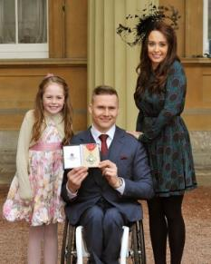
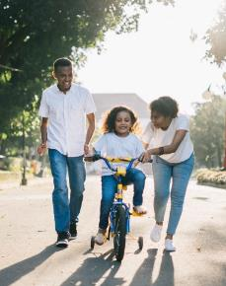

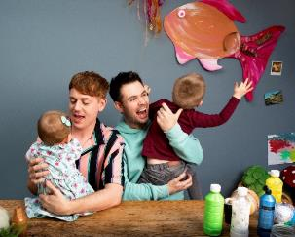
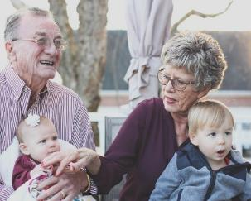
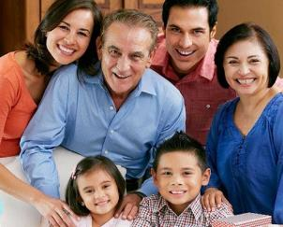
LO: To understand that some children have trans parents
Your family: 3 truths and a lie
Notes:
Ask children to write three real facts and one made up thing about their family.
Choose a child to share the four ‘facts’ with the class. The rest of the class should guess which ‘fact’ was made up.
Repeat several times.

Slide 3
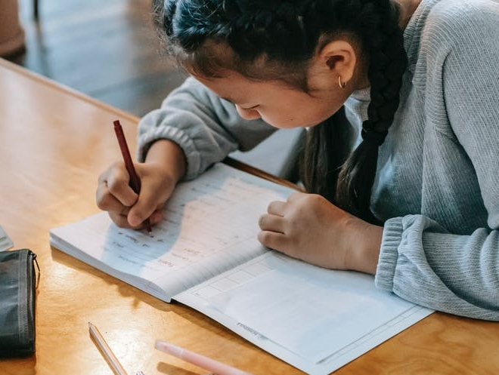
LO: To understand that some children have trans parents
If you had to write a definition of
family, what would you write?
Notes:
Ask children: If you had to write the definition of ‘family’ for a dictionary, what would you write?
Think. Pair. Share.
Ensure that children have shown an understanding that all families are different, but one thing that it’s important for a family to have is love. Be sure to address any misconceptions about families all having 2 parents, a mum and a dad, etc.

Slide 4

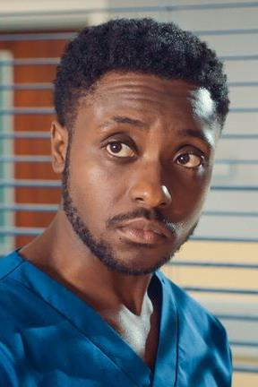
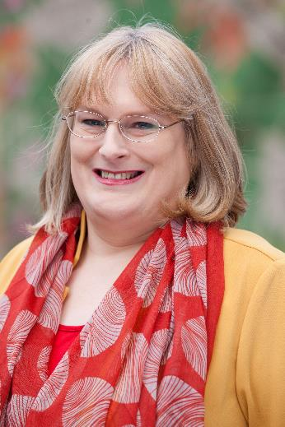
LO: To understand that some children have trans parents
What does trans mean?
Notes:
Share the learning objective.
Explain to the children that they’re going to watch a video where one of the parents is transgender.
Check in to see that they understand what the word ‘transgender’ means.

Slide 5
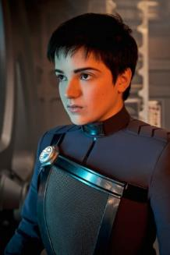
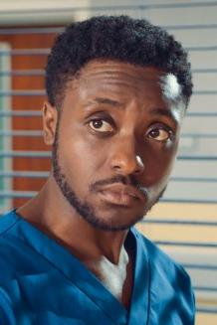

LO: To understand that some children have trans parents
What does trans mean?
Someone is trans if their gender doesn’t match the label they were given at birth.
Non-binary
A person who is not a boy/man and not a girl/woman.
Trans man
A man who was given the label ‘girl’ when he was born.
Trans woman
A woman who was given the label ‘boy’ when she was born.
Notes:
Ensure that they know that someone is trans if their gender (ie being a girl/woman, a boy/man or a non-binary person) doesn’t match with the label (ie boy or girl) they were given at birth.

Slide 6
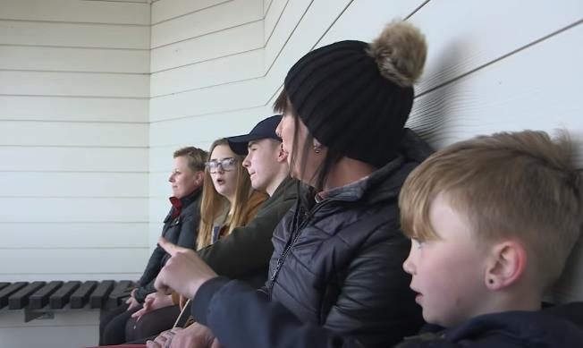
LO: To understand that some children have trans parents
May’s family
What does May’s family have in common with your family?
What makes May’s family different to your family?
Notes:
Watch ‘When dad became Charlotte’: https://www.youtube.com/watch?v=YOd7hUx874w&feature=youtu.be
After watching the video children should discuss in pairs:
5 things that the family in the video have in common with their family
5 things that make the family in the video different from their family
Share some of the similarities and differences as a class.

Slide 7
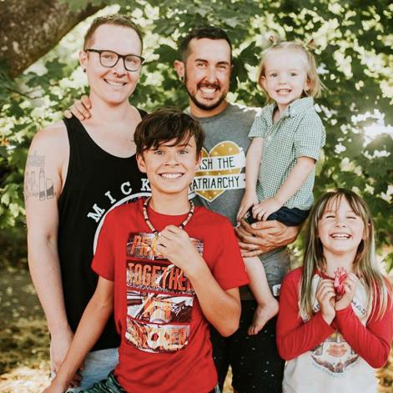
LO: To understand that some children have trans parents
What would you do?
During a lesson about families, Izzy mentions that her dad is trans and that up until 2 years ago, she used to call him ‘mum’.
At playtime you overhear some children from the class telling Izzy that she can’t play with them because her dad’s a ‘weirdo’ and so is she.
Notes:
Share the scenario with the class:
During a lesson about families, Izzy mentions that her dad is trans and that up until 2 years ago, she used to call him ‘mum’. At playtime you overhear some children from the class telling Izzy that she can’t play with them because her dad’s a ‘weirdo’ and so is she.
In groups of 3, ask children to answer the question: What would you do in this scenario?
As a class, discuss what children could do in the situation. Ensure that you discuss:
Why it’s important to support other people when they’re upset.
What they can do if they think someone is being bullied.
The importance of not being a bystander.

Slide 8

LO: To understand that some children have trans parents
Summarise the message of the lesson.
Can you say it in 5 words?
Notes:
Challenge children to summarise the message of the lesson in 5 words. Once they have done that, challenge them to summarise the message in 1 word.
Share some of the children’s suggestions as a class.

