Slide 1
PowerPoint template to accompany the Everybody’s Family is Different RSHE lesson pack for:
Reception - England
We know that good teaching is tailored to meet the needs of the children or young people in each individual class. That’s why we’ve created this editable PowerPoint template – feel free to adapt it to suit your teaching context or to add your school or college slide template to the background.
Who are Stonewall?
This resource is produced by Stonewall, a UK-based charity that stands for the freedom, equity and potential of all lesbian, gay, bi, trans, queer, questioning and ace (LGBTQ+) people. At Stonewall, we imagine a world where LGBTQ+ people everywhere can live our lives to the full. Founded in London in 1989, we now work in each nation of the UK and have established partnerships across the globe. Over the last three decades, we have created transformative change in the lives of LGBTQ+ people in the UK, helping win equal rights around marriage, having children and inclusive education.
Our campaigns drive positive change for our communities, and our sustained change and empowerment programmes ensure that LGBTQ+ people can thrive throughout our lives. We make sure that the world hears and learns from our communities, and our work is grounded in evidence and expertise.
Stonewall is proud to provide information, support and guidance on LGBTQ+ inclusion; working towards a world where we’re all free to be. This does not constitute legal advice, and is not intended to be a substitute for legal counsel on any subject matter. To find out more about our work, visit us at www.stonewall.org.uk.
Registered Charity No 1101255 (England and Wales) and SC039681 (Scotland)
Notes:
Visit our website for the lesson plan to accompany this PowerPoint.

Slide 2
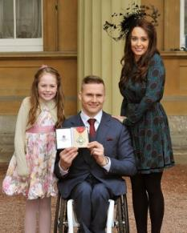
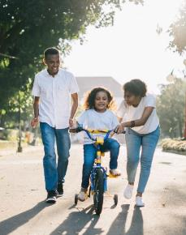
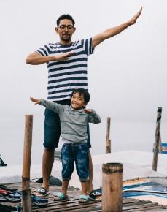
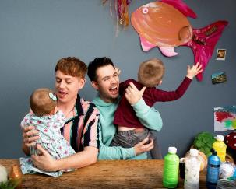
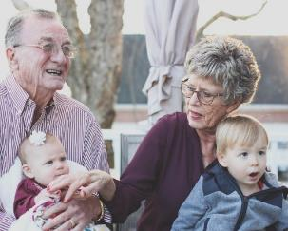
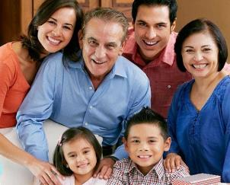
LO: To understand that everybody’s family is different
Who is in your family?
Notes:
Ask children to tell a partner about the people in their family. Choose a few children to share with the class.
Ask the children: Is everybody’s family the same?
Discuss that there are lots of things that make people’s families different, and no two families are exactly the same.

Slide 3

LO: To understand that everybody’s family is different
Notes:
As a class, read ‘My Maddy’ by Gayle Pitman.
Ask the children: Is everybody’s family the same?
Discuss that there are lots of things that make people’s families different, and no two families are exactly the same.
Explain that today the children are going to be listening to a story about a child and someone in their family.
As a class, read ‘My Maddy’ by Gayle Pitman.
As a class, discuss:
Why does the child call their parent Maddy? Talk about the fact that their Maddy is neither a man, nor a woman – they’re non-binary.
How is Maddy similar to your parents/carers?
How is Maddy different to your parents/carers?
What does the child like to do with their Maddy?

Slide 4
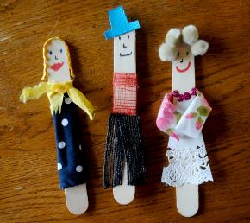

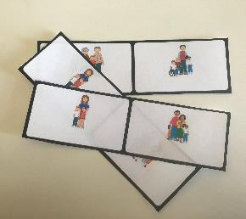
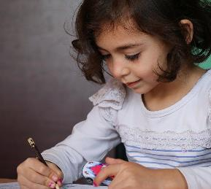
LO: To understand that everybody’s family is different
We’re going to…
Make puppets of your family
Draw a portrait of the family from the story
Play family dominoes
Write about your family
Notes:
Activity carousel:
Children make lollypop stick puppets representing the people in their family.
Children create a ‘family portrait’ of the family from the story.
Children play ‘different families’ dominoes.
Children write a sentence about a person in their family.

Slide 5
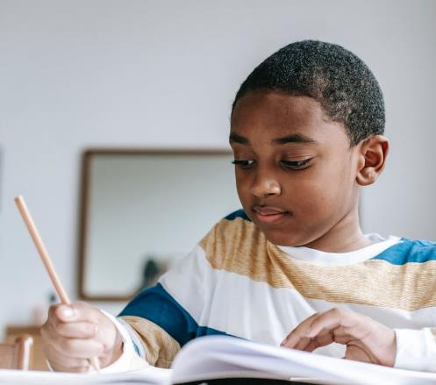
LO: To understand that everybody’s family is different
What did you learn?
Notes:
Choose some children to share their work, make sure that a wide range of families is represented.
Ask children to tell a partner one thing they have learned during the lesson.

