Slide 1
PowerPoint template to accompany the Everybody’s Family is Different RSHE lesson pack for:
Key Stage 1 - England
We know that good teaching is tailored to meet the needs of the children or young people in each individual class. That’s why we’ve created this editable PowerPoint template – feel free to adapt it to suit your teaching context or to add your school or college slide template to the background.
Who are Stonewall?
This resource is produced by Stonewall, a UK-based charity that stands for the freedom, equity and potential of all lesbian, gay, bi, trans, queer, questioning and ace (LGBTQ+) people. At Stonewall, we imagine a world where LGBTQ+ people everywhere can live our lives to the full. Founded in London in 1989, we now work in each nation of the UK and have established partnerships across the globe. Over the last three decades, we have created transformative change in the lives of LGBTQ+ people in the UK, helping win equal rights around marriage, having children and inclusive education.
Our campaigns drive positive change for our communities, and our sustained change and empowerment programmes ensure that LGBTQ+ people can thrive throughout our lives. We make sure that the world hears and learns from our communities, and our work is grounded in evidence and expertise.
Stonewall is proud to provide information, support and guidance on LGBTQ+ inclusion; working towards a world where we’re all free to be. This does not constitute legal advice, and is not intended to be a substitute for legal counsel on any subject matter. To find out more about our work, visit us at www.stonewall.org.uk.
Registered Charity No 1101255 (England and Wales) and SC039681 (Scotland)
Notes:
Visit our website for the lesson plan to accompany this PowerPoint.

Slide 2
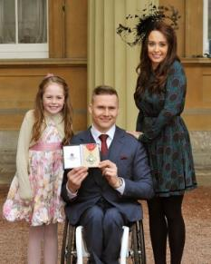
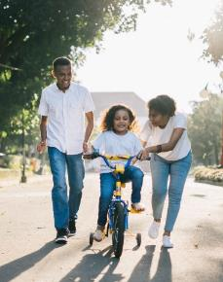

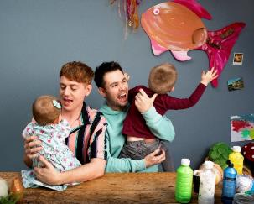
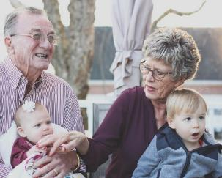
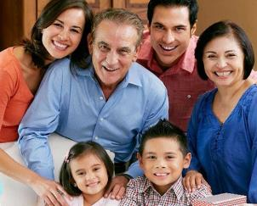
LO: To understand that everybody’s family is different
3 facts about your family
Notes:
Ask children to tell a partner three things about their family.
Choose a few children to share with the class.
Ask the children: Is everybody’s family the same?
Discuss that there are lots of things that make people’s families different and no two families are exactly the same.

Slide 3

LO: To understand that everybody’s family is different
Notes:
Explain that today the children are going to be listening to a story about a child and someone in their family.
As a class, read ‘My Maddy’ by Gayle Pitman.
As a class, discuss:
Why does the child call their parent Maddy? Talk about the fact that their Maddy is neither a man, nor a woman – they’re non-binary.
How is Maddy similar to your parents/carers?
How is Maddy different to your parents/carers?
What does the child like to do with their Maddy?

Slide 4
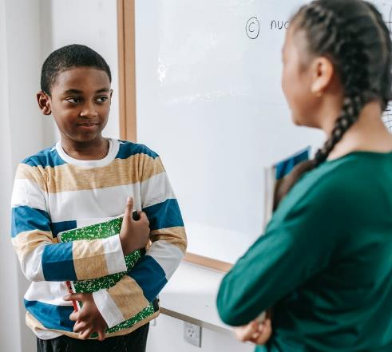
LO: To understand that everybody’s family is different
Today we’re going to do a survey.
What is a survey?
Notes:
Ask the children: What is a survey?

Slide 5

LO: To understand that everybody’s family is different
A survey is a way of finding an answer to certain types of question.
What is Year 1’s favourite colour?
How many children in Year 2 have a pet?
How many people in Key Stage 1 have siblings?
Notes:
Discuss what a survey is, reflect back on surveys may have conducted in the past. You may wish to reflect on the Census, which is the largest survey in the country.

Slide 6
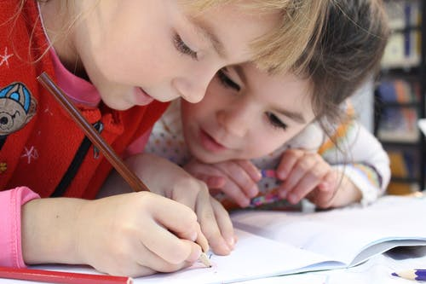
LO: To understand that everybody’s family is different
What might be important when doing a survey?
Notes:
Discuss what we need to consider when conducting a survey
What are we asking?
How are we recording answers? (model using tally marks)
How will we make sure we don’t ask someone twice?

Slide 7


LO: To understand that everybody’s family is different
We need to…
Know what we want to ask.
Have a way of recording the answers.
Make sure we don’t ask someone twice!
Notes:
Discuss what we need to consider when conducting a survey
What are we asking?
How are we recording answers? (model using tally marks)
How will we make sure we don’t ask someone twice?

Slide 8

LO: To understand that everybody’s family is different
Conduct a survey about the families of people in our class.
Choose what your question will be.
Conduct your survey
Share your results
Notes:
Explain to the children that they’re going to conduct a survey about the different families in the class.
In pairs, children decide what their survey question is going to be. They can think of their own question, but it has to help them to find out different people’s families.
Possible questions could include:
How many people are in your family?
How many siblings do you have?
What is your family’s favourite place to visit?
Children conduct their survey, using the survey template to help them.

Slide 9

LO: To understand that everybody’s family is different
What did you learn?
Notes:
Choose a pair to share the results of their survey. Discuss what they found. For example, most people had 2 siblings, but there were lots of people with fewer or more than that.
Ask children to tell someone from another table what the results of their survey were.
Ask children to tell their partner something that they learned in the lesson.

