Slide 1
PowerPoint template to accompany the Everybody is Different RSHE lesson pack for:
Secondary aged students – version 2 SEND
We know that good teaching is tailored to meet the needs of the children or young people in each individual class. That’s why we’ve created this editable PowerPoint template – feel free to adapt it to suit your teaching context or to add your school or college slide template to the background.
Who are Stonewall?
This resource is produced by Stonewall, a UK-based charity that stands for the freedom, equity and potential of all lesbian, gay, bi, trans, queer, questioning and ace (LGBTQ+) people. At Stonewall, we imagine a world where LGBTQ+ people everywhere can live our lives to the full. Founded in London in 1989, we now work in each nation of the UK and have established partnerships across the globe. Over the last three decades, we have created transformative change in the lives of LGBTQ+ people in the UK, helping win equal rights around marriage, having children and inclusive education.
Our campaigns drive positive change for our communities, and our sustained change and empowerment programmes ensure that LGBTQ+ people can thrive throughout our lives. We make sure that the world hears and learns from our communities, and our work is grounded in evidence and expertise.
Stonewall is proud to provide information, support and guidance on LGBTQ+ inclusion; working towards a world where we’re all free to be. This does not constitute legal advice, and is not intended to be a substitute for legal counsel on any subject matter. To find out more about our work, visit us at www.stonewall.org.uk.
Registered Charity No 1101255 (England and Wales) and SC039681 (Scotland)
Notes:
Visit our website for the lesson plan to accompany this PowerPoint.

Slide 2
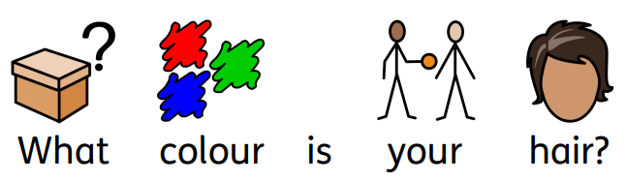
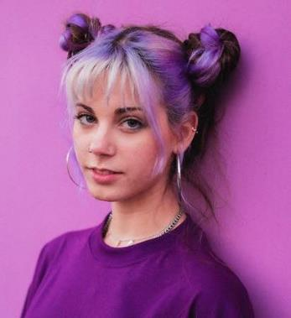

Slide 3

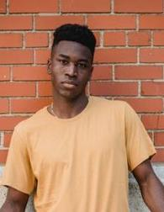
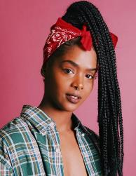

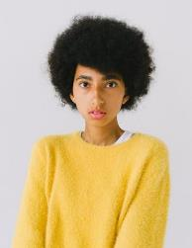


Slide 4



Slide 5
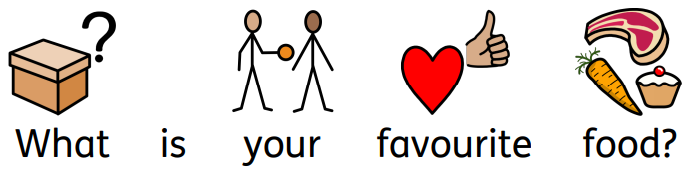
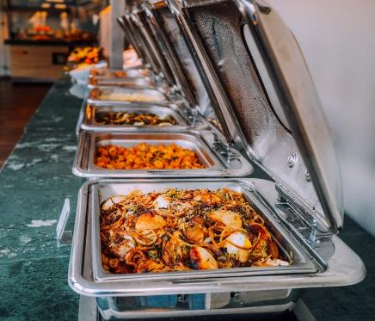

Slide 6
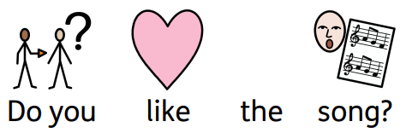
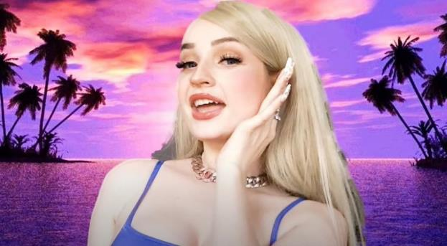
Notes:
Play ‘Malibu’ by Kim Petras. Do you like or dislike the song?

Slide 7

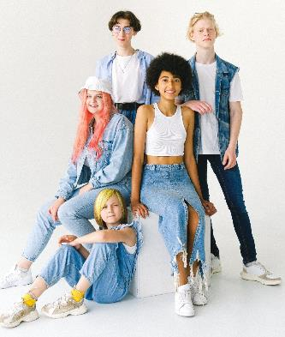
Notes:
Point out that nobody’s answers were the same for every question. Everybody is different.

Slide 8

Kim Petras

Slide 9
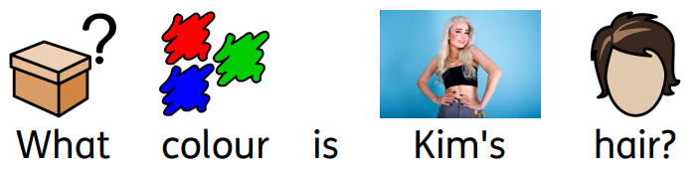
Notes:
What colour hair does Kim have? Who in this class has the same colour hair as Kim?

Slide 10
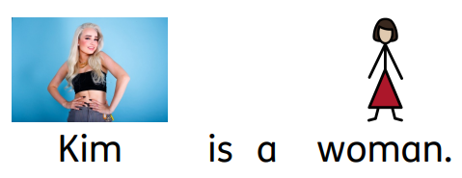
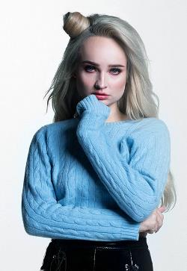

Notes:
Kim is a woman. Who else in the room is a girl or a woman?

Slide 11


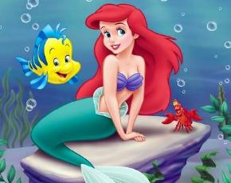
Notes:
Kim likes Disney films. Who else in this class likes Disney films?

Slide 12
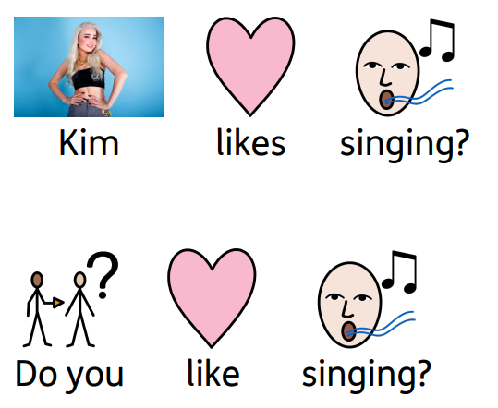
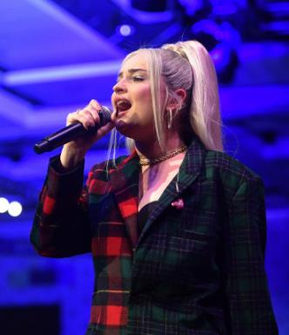
Notes:
Kim likes singing. Who else in this class likes singing?

Slide 13
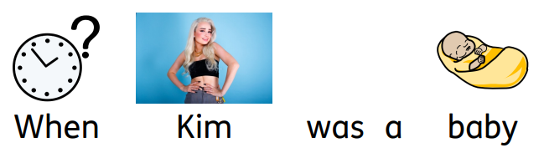
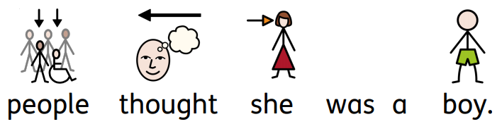
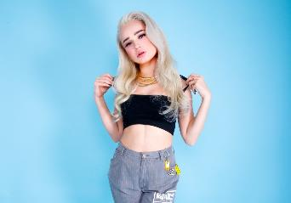
Notes:
Discuss that Kim is trans. This means that when she was born, everyone thought she was a boy. However, when she got older she told people that she is a girl/woman.

Slide 14
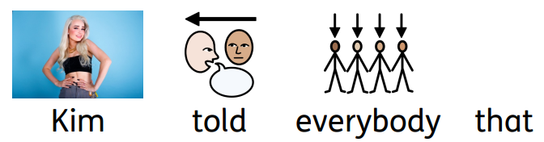
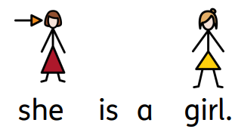
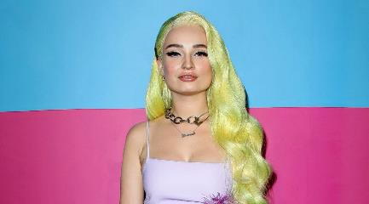
Notes:
Discuss that Kim is trans. This means that when she was born, everyone thought she was a boy. However, when she got older she told people that she is a girl/woman.

Slide 15
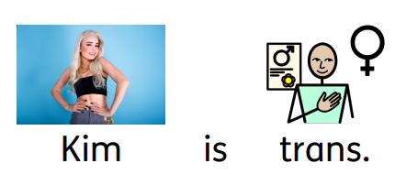
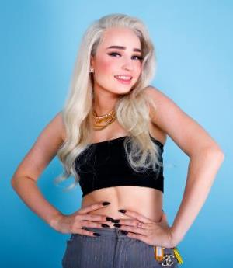
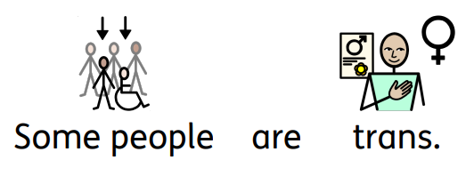


Notes:
Reiterate that Kim is trans. Some people are trans and it’s ok. Be aware of overgeneralisation. Make sure that children understand that trans boys and non-binary people also exist. For an example of a non-binary person, you could refer to Dr Ronx from Operation Ouch. For an example of a trans man, you could refer to Matty from Emmerdale.

Slide 16

Notes:
Look at the ‘Some people are trans. It’s OK.’ poster.
Discuss other things that make people are different that could be put on a poster. For example, ‘Some people like Star Trek. It’s OK.’
Children create their own ‘It’s OK’ poster.

Slide 17
Notes:
Look at the ‘Some people are trans. It’s OK.’ poster.
Discuss other things that make people are different that could be put on a poster. For example, ‘Some people like Star Trek. It’s OK.’
Children create their own ‘It’s OK’ poster.

Slide 18

like singing.
Notes:
Look at the ‘Some people are trans. It’s OK.’ poster.
Discuss other things that make people are different that could be put on a poster. For example, ‘Some people like Star Trek. It’s OK.’
Children create their own ‘It’s OK’ poster.

Slide 19

like pink.
Notes:
Look at the ‘Some people are trans. It’s OK.’ poster.
Discuss other things that make people are different that could be put on a poster. For example, ‘Some people like Star Trek. It’s OK.’
Children create their own ‘It’s OK’ poster.

Slide 20

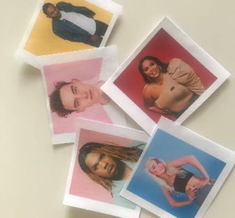

Notes:
As a class or in groups, play the memory card game. Use the language of same and different and talk about the similarities and differences of the different people in the photos.

