Slide 1
PowerPoint template to accompany the Everybody is Different RSHE lesson pack for:
Primary aged children – version 2 SEND
We know that good teaching is tailored to meet the needs of the children or young people in each individual class. That’s why we’ve created this editable PowerPoint template – feel free to adapt it to suit your teaching context or to add your school or college slide template to the background.
Who are Stonewall?
This resource is produced by Stonewall, a UK-based charity that stands for the freedom, equity and potential of all lesbian, gay, bi, trans, queer, questioning and ace (LGBTQ+) people. At Stonewall, we imagine a world where LGBTQ+ people everywhere can live our lives to the full. Founded in London in 1989, we now work in each nation of the UK and have established partnerships across the globe. Over the last three decades, we have created transformative change in the lives of LGBTQ+ people in the UK, helping win equal rights around marriage, having children and inclusive education.
Our campaigns drive positive change for our communities, and our sustained change and empowerment programmes ensure that LGBTQ+ people can thrive throughout our lives. We make sure that the world hears and learns from our communities, and our work is grounded in evidence and expertise.
Stonewall is proud to provide information, support and guidance on LGBTQ+ inclusion; working towards a world where we’re all free to be. This does not constitute legal advice, and is not intended to be a substitute for legal counsel on any subject matter. To find out more about our work, visit us at www.stonewall.org.uk.
Registered Charity No 1101255 (England and Wales) and SC039681 (Scotland)
Notes:
Visit our website for the lesson plan to accompany this PowerPoint.

Slide 2
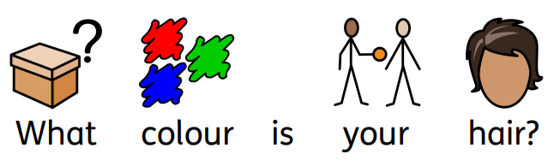
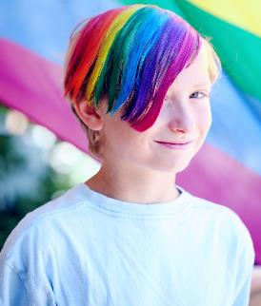

Slide 3

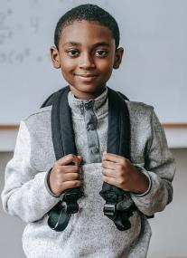
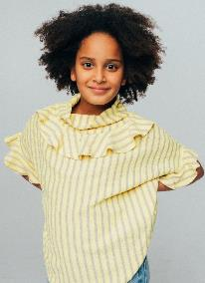

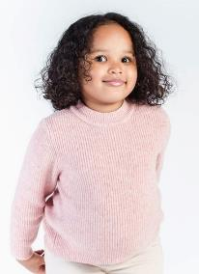


Slide 4



Slide 5
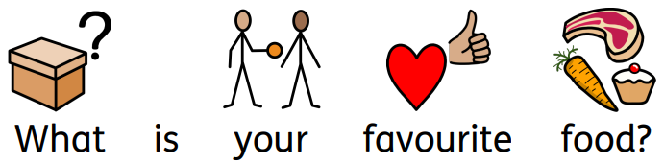
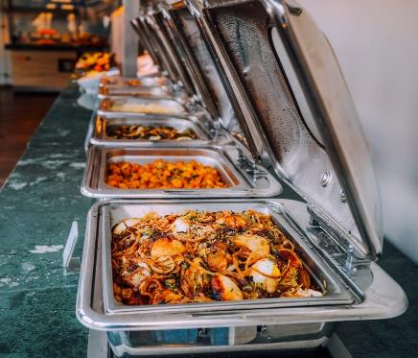

Slide 6

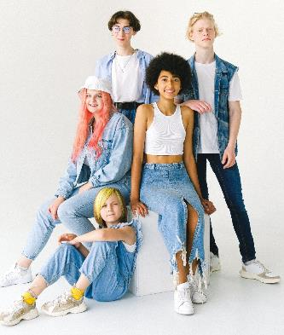
Notes:
Point out that nobody’s answers were the same for every question. Everybody is different.

Slide 7


Notes:
Read ‘I am Jazz’ by Jazz Jennings to the class.
Ask children to answer some questions about the book:
What is Jazz’s favourite colour?
What things does Jazz enjoy doing?
What does Jazz do with her friends?
How is Jazz different to her friends? Ensure that you discuss that Jazz is transgender – use the PowerPoint to support the conversation.
Does Jazz mind that she’s different?

Slide 8
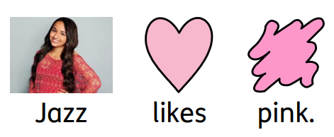
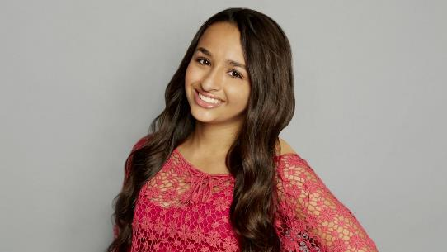
Notes:
Use the PowerPoint to talk about some of the things that Jazz likes doing, as well as the fact that Jazz is trans. Talk about the things that Jazz and her friends have in common. Give children the opportunity to say whether they like or dislike the different things that Jazz likes. Talk about the fact that everybody has their own ways of being different, and that we can still be friends with people who are different from us.

Slide 9

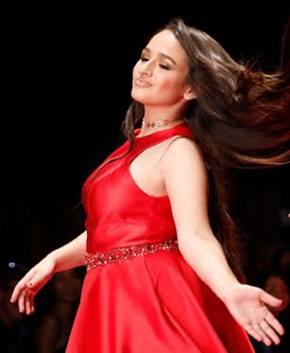
Notes:
Use the PowerPoint to talk about some of the things that Jazz likes doing, as well as the fact that Jazz is trans. Talk about the things that Jazz and her friends have in common. Give children the opportunity to say whether they like or dislike the different things that Jazz likes. Talk about the fact that everybody has their own ways of being different, and that we can still be friends with people who are different from us.

Slide 10

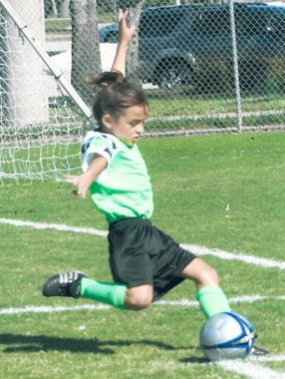
Notes:
Use the PowerPoint to talk about some of the things that Jazz likes doing, as well as the fact that Jazz is trans. Talk about the things that Jazz and her friends have in common. Give children the opportunity to say whether they like or dislike the different things that Jazz likes. Talk about the fact that everybody has their own ways of being different, and that we can still be friends with people who are different from us.

Slide 11

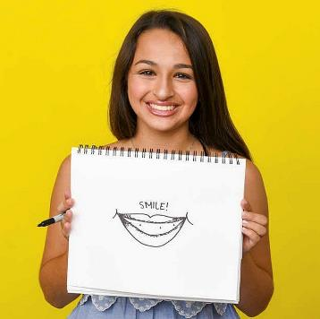
Notes:
Use the PowerPoint to talk about some of the things that Jazz likes doing, as well as the fact that Jazz is trans. Talk about the things that Jazz and her friends have in common. Give children the opportunity to say whether they like or dislike the different things that Jazz likes. Talk about the fact that everybody has their own ways of being different, and that we can still be friends with people who are different from us.

Slide 12

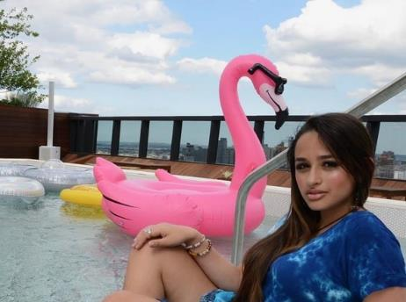
Notes:
Use the PowerPoint to talk about some of the things that Jazz likes doing, as well as the fact that Jazz is trans. Talk about the things that Jazz and her friends have in common. Give children the opportunity to say whether they like or dislike the different things that Jazz likes. Talk about the fact that everybody has their own ways of being different, and that we can still be friends with people who are different from us.

Slide 13

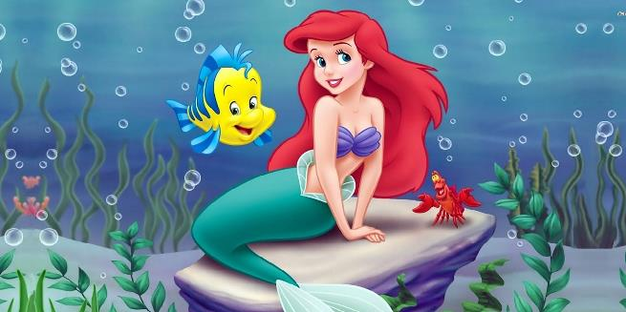
Notes:
Use the PowerPoint to talk about some of the things that Jazz likes doing, as well as the fact that Jazz is trans. Talk about the things that Jazz and her friends have in common. Give children the opportunity to say whether they like or dislike the different things that Jazz likes. Talk about the fact that everybody has their own ways of being different, and that we can still be friends with people who are different from us.

Slide 14
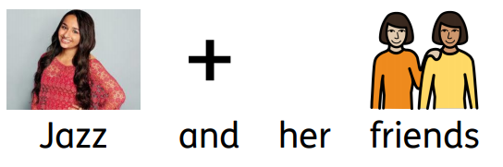

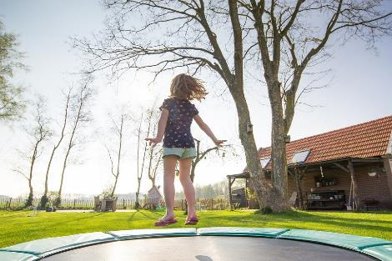
Notes:
Use the PowerPoint to talk about some of the things that Jazz likes doing, as well as the fact that Jazz is trans. Talk about the things that Jazz and her friends have in common. Give children the opportunity to say whether they like or dislike the different things that Jazz likes. Talk about the fact that everybody has their own ways of being different, and that we can still be friends with people who are different from us.

Slide 15

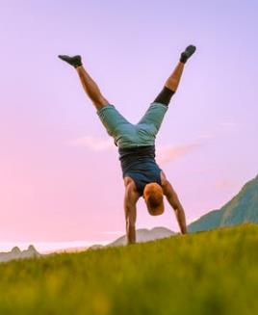

.
Notes:
Use the PowerPoint to talk about some of the things that Jazz likes doing, as well as the fact that Jazz is trans. Talk about the things that Jazz and her friends have in common. Give children the opportunity to say whether they like or dislike the different things that Jazz likes. Talk about the fact that everybody has their own ways of being different, and that we can still be friends with people who are different from us.

Slide 16


Notes:
Remind children that everybody’s different and that’s ok.

Slide 17
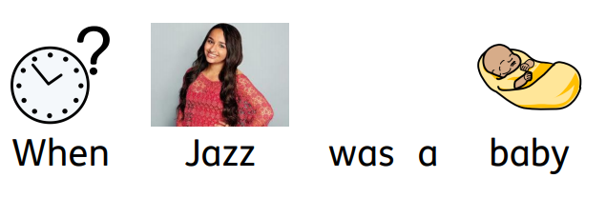
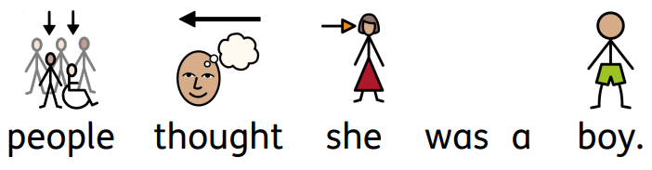
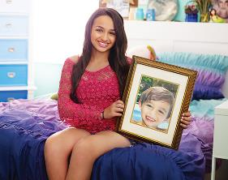
Notes:
Reiterate that Jazz is trans. Some people are trans and it’s ok. Be aware of overgeneralisation. Make sure that children understand that trans boys and non-binary people also exist. For an example of a non-binary person, you could refer to Dr Ronx from Operation Ouch. For an example of a trans man, you could refer to Matty from Emmerdale.

Slide 18
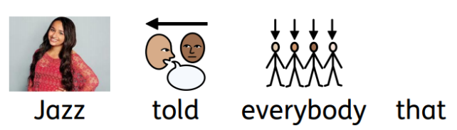
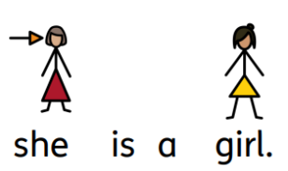
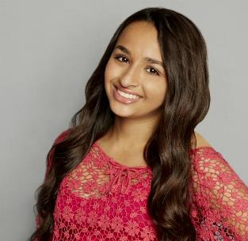
Notes:
Reiterate that Jazz is trans. Some people are trans and it’s ok. Be aware of overgeneralisation. Make sure that children understand that trans boys and non-binary people also exist. For an example of a non-binary person, you could refer to Dr Ronx from Operation Ouch. For an example of a trans man, you could refer to Matty from Emmerdale.

Slide 19

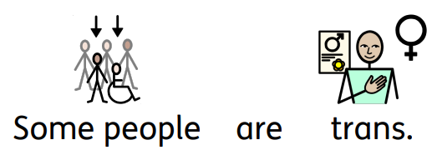


Notes:
Reiterate that Jazz is trans. Some people are trans and it’s ok. Be aware of overgeneralisation. Make sure that children understand that trans boys and non-binary people also exist. For an example of a non-binary person, you could refer to Dr Ronx from Operation Ouch. For an example of a trans man, you could refer to Matty from Emmerdale.

Slide 20

Notes:
Look at the ‘Some people are trans. It’s OK.’ poster.
Discuss other things that make people are different that could be put on a poster. For example, ‘Some people like Star Trek. It’s OK.’
Children create their own ‘It’s OK’ poster.

Slide 21
Notes:
Look at the ‘Some people are trans. It’s OK.’ poster.
Discuss other things that make people are different that could be put on a poster. For example, ‘Some people like Star Trek. It’s OK.’
Children create their own ‘It’s OK’ poster.

Slide 22

like singing.
Notes:
Look at the ‘Some people are trans. It’s OK.’ poster.
Discuss other things that make people are different that could be put on a poster. For example, ‘Some people like Star Trek. It’s OK.’
Children create their own ‘It’s OK’ poster.

Slide 23

like pink.
Notes:
Look at the ‘Some people are trans. It’s OK.’ poster.
Discuss other things that make people are different that could be put on a poster. For example, ‘Some people like Star Trek. It’s OK.’
Children create their own ‘It’s OK’ poster.

Slide 24

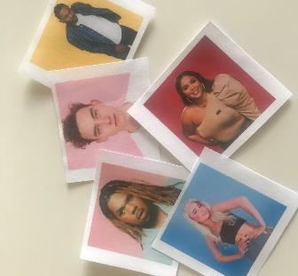

Notes:
As a class or in groups, play the memory card game. Use the language of same and different and talk about the similarities and differences of the different people in the photos.

