Slide 1
PowerPoint template to accompany the Challenging Gender Stereotypes lesson pack for:
Reception – England and Wales
P1 - Scotland
We know that good teaching is tailored to meet the needs of the children or young people in each individual class. That’s why we’ve created this editable PowerPoint template – feel free to adapt it to suit your teaching context or to add your school or college slide template to the background.
Who are Stonewall?
This resource is produced by Stonewall, a UK-based charity that stands for the freedom, equity and potential of all lesbian, gay, bi, trans, queer, questioning and ace (LGBTQ+) people. At Stonewall, we imagine a world where LGBTQ+ people everywhere can live our lives to the full. Founded in London in 1989, we now work in each nation of the UK and have established partnerships across the globe. Over the last three decades, we have created transformative change in the lives of LGBTQ+ people in the UK, helping win equal rights around marriage, having children and inclusive education.
Our campaigns drive positive change for our communities, and our sustained change and empowerment programmes ensure that LGBTQ+ people can thrive throughout our lives. We make sure that the world hears and learns from our communities, and our work is grounded in evidence and expertise.
Stonewall is proud to provide information, support and guidance on LGBTQ+ inclusion; working towards a world where we’re all free to be. This does not constitute legal advice, and is not intended to be a substitute for legal counsel on any subject matter. To find out more about our work, visit us at www.stonewall.org.uk.
Registered Charity No 1101255 (England and Wales) and SC039681 (Scotland)
Notes:
Visit our website for the lesson plan to accompany this PowerPoint.

Slide 2
LO: To be able to share my opinions

Slide 3

LO: To be able to share my opinions
Charlie’s car
Notes:
Show a picture of Charlie Martin’s racing car. Tell the children that it belongs to a racing driver called Charlie Martin.

Slide 4
LO: To be able to share my opinions
?
What does a racing driver look like?
Notes:
Ask the children to draw a picture of a racing driver on their whiteboard. What do they think a racing driver might look like?
Give them 5 minutes to do it and then ask them to hold their board up.
As a class discuss what the racing drivers all had in common. Encourage children to explain why they chose to represent the racing driver in that way. Use questioning to draw out discussion: For example, “Did anyone draw a woman?”

Slide 5

LO: To be able to share my opinions
Charlie Martin is a racing driver.
Notes:
Ask the children to draw a picture of a racing driver on their whiteboard. What do they think a racing driver might look like?
Give them 5 minutes to do it and then ask them to hold their board up.
Show the class the photo of Charlie. Were any of them surprised that she’s a woman? Discuss that not many women are racing drivers but that doesn’t need to be the case. Explain that sometimes people have the idea that some jobs are for men and that some jobs are for women, but anyone can do any job.

Slide 6
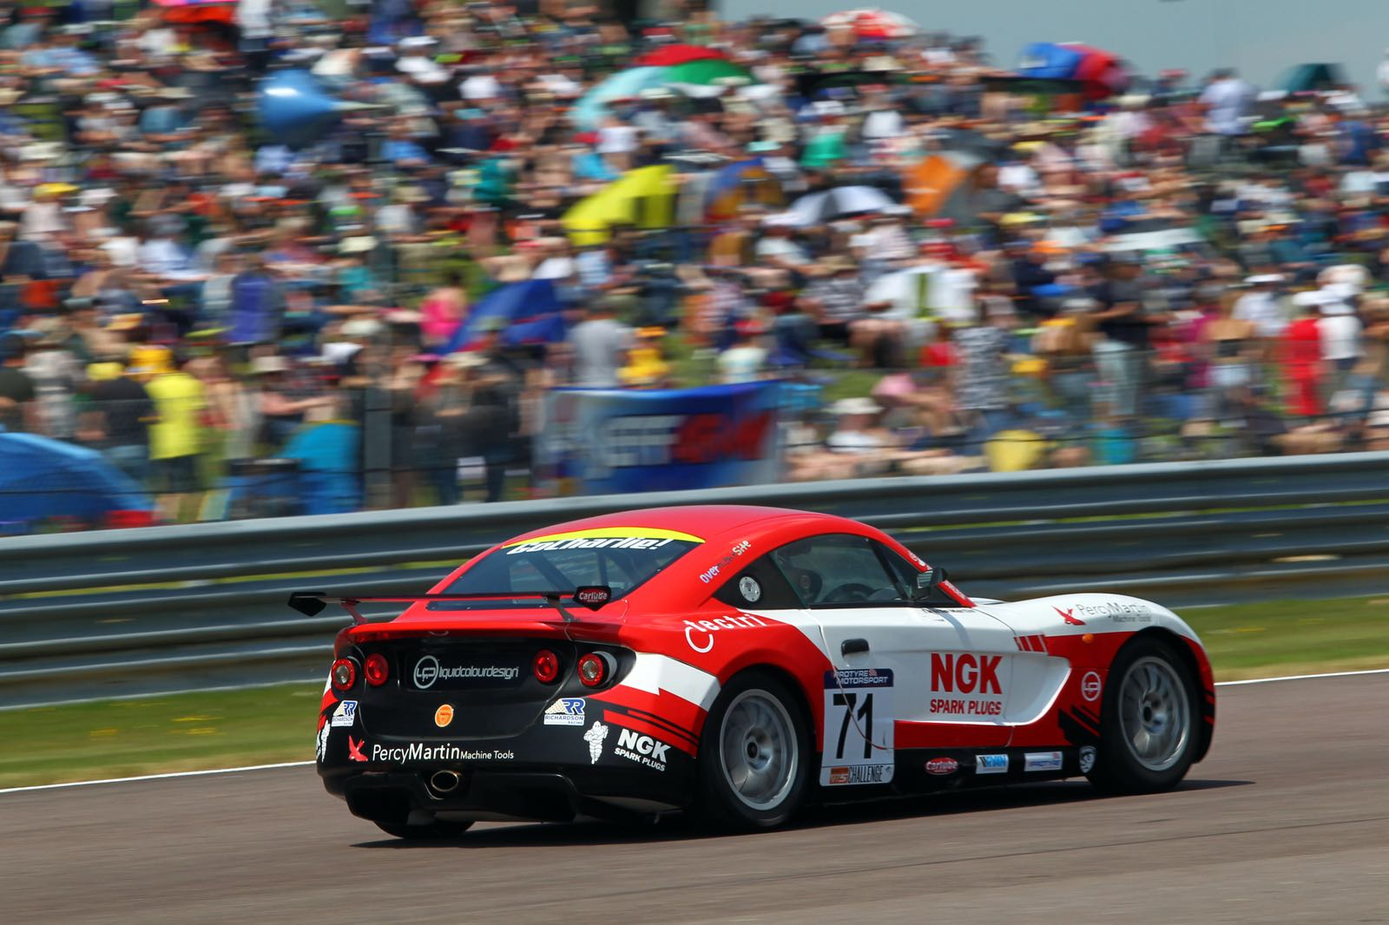
LO: To be able to share my opinions
Would you like to be a racing driver?
Notes:
Watch the Charlie Martin Racing Showreel. https://www.youtube.com/watch?v=fMIbssFfums
Ask the children: Would you like to be a racing driver? Why/why not?
Think. Pair. Share.

Slide 7

LO: To be able to share my opinions
Design a new car for Charlie.
Notes:
Children design a racing car for Charlie Martin by decorating the racing car outline on the worksheet. Remind them that it’s important to avoid gender stereotypes – just because Charlie is a woman, it doesn’t mean that she wants a pink car, colours are not gendered.

Slide 8
LO: To be able to share my opinions
?
What do you like?
What would you improve?
Notes:
Children show their racing car design to a partner, who should tell them what they like about the design and what they would improve.

