Slide 1
PowerPoint template to accompany the Black History Month 2019 lesson pack for:
Post-16 learners
We know that good teaching is tailored to meet the needs of the children or young people in each individual class. That’s why we’ve created this editable PowerPoint template – feel free to adapt it to suit your teaching context or to add your school or college slide template to the background.
Who are Stonewall?
This resource is produced by Stonewall, a UK-based charity that stands for the freedom, equity and potential of all lesbian, gay, bi, trans, queer, questioning and ace (LGBTQ+) people. At Stonewall, we imagine a world where LGBTQ+ people everywhere can live our lives to the full. Founded in London in 1989, we now work in each nation of the UK and have established partnerships across the globe. Over the last three decades, we have created transformative change in the lives of LGBTQ+ people in the UK, helping win equal rights around marriage, having children and inclusive education.
Our campaigns drive positive change for our communities, and our sustained change and empowerment programmes ensure that LGBTQ+ people can thrive throughout our lives. We make sure that the world hears and learns from our communities, and our work is grounded in evidence and expertise.
Stonewall is proud to provide information, support and guidance on LGBTQ+ inclusion; working towards a world where we’re all free to be. This does not constitute legal advice, and is not intended to be a substitute for legal counsel on any subject matter. To find out more about our work, visit us at www.stonewall.org.uk.
Registered Charity No 1101255 (England and Wales) and SC039681 (Scotland)
Notes:
Visit our website for the lesson pack to accompany this PowerPoint.

Slide 2

LO: To identify and highlight black role models throughout history and celebrate their achievements
Notes:
Create a list of ground rules as a class i.e respecting identities and opinions - this may also include no judgement, not speaking over each other and being honest with any and all questions we have.
Start with a class discussion on BHM and the form is has taken in the past.
What does BHM mean to the students? Why is BHM marked in calendars? Why is it significant? Highlight that historically racism and racist discrimination meant that black people were held back from accessing the same opportunities as white people – and also the many achievements and contributions to history of the black community were not talked about, highlighted or celebrated as much as they should have been (and sometimes not talked about at all). We’ve made progress today but black people are still underrepresented in lots of areas, including the media, politics and leadership, and racism and racist discrimination against black people still happens far too often – so it’s important that we go on having these conversations.
Is BHM the best way of celebrating black role models and the achievements of the black community? Why/why not?

Slide 3
LO: To identify and highlight black role models throughout history and celebrate their achievements
Are there parts of the black community whose stories we don’t hear as often when we talk about black history? If so, which groups do we still not hear much about?
Notes:
Have the class discuss the question on the board in their pairs or as a table. They should note down their answers for a class discussion.
Have class feedback from their group discussions. If LGBT black role models have not been brought up, direct the class towards that. Ask if they can think of any role models who are black and LGBT? If yes, then who and how do they know them? If no, why do they think they might not often hear the stories of LGBT black role models? Encourage the class to think about the fact that someone who is LGBT and black might experience discrimination because of their sexual orientation or gender identity, as well as racist discrimination. This might mean that their achievements aren’t celebrated, that discrimination makes it more difficult for them to access opportunities and be as successful as they could otherwise be and/or that we hear about other aspects of who they are (like their work or their activism) but we never near about the fact that they’re LGBT and that part of them isn’t celebrated.

Slide 4
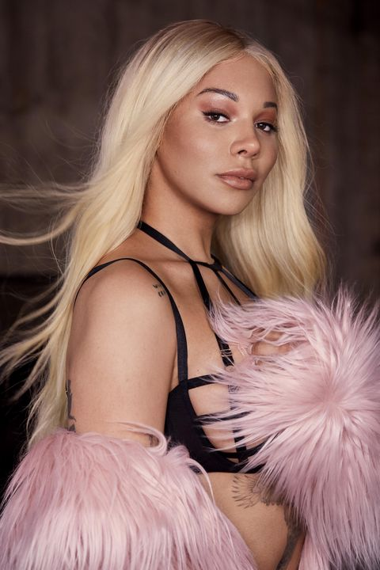
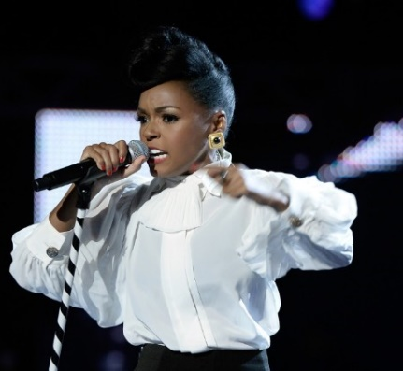
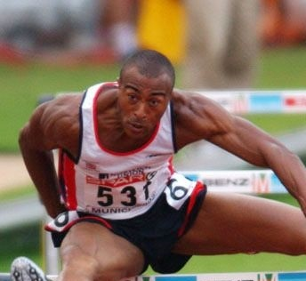
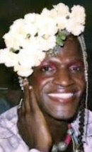
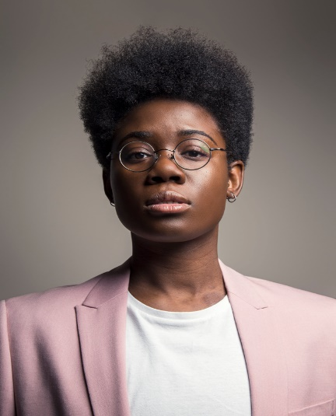
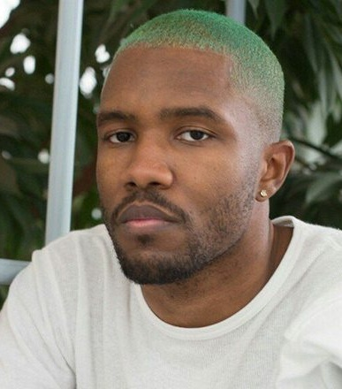
LO: To identify and highlight black role models throughout history and celebrate their achievements
Notes:
Show students different role models on the board (Colin Jackson – former hurdler, Dr Ronx – Emergency medical doctor , Marsha P Johnson – trans activist credited with starting the Stonewall Riots which sparked the modern LGBT rights movement, Munroe Bergdorf – Model and trans activist, Janelle Monae – Singer/Songwriter, Frank Ocean – Singer/Songwriter)
By show of hands, do they recognise any?
Ask: What have these people got in common? Think. Pair. Share.
Ask: What else might these people have in common? Think. Pair. Share.
Ask: Why do you think these people are role models? Think. Pair. Share.
Ask: Do you think these people are celebrated enough when looking at role models or history? Think. Pair. Share.

Slide 5
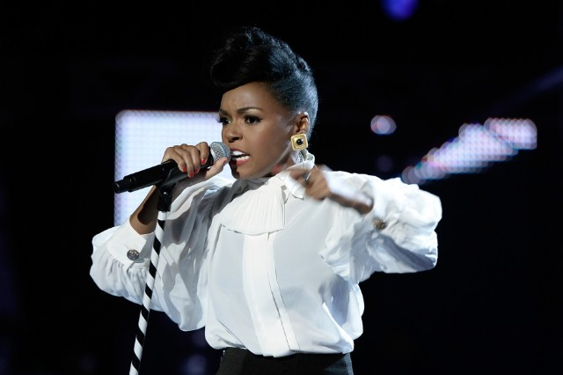
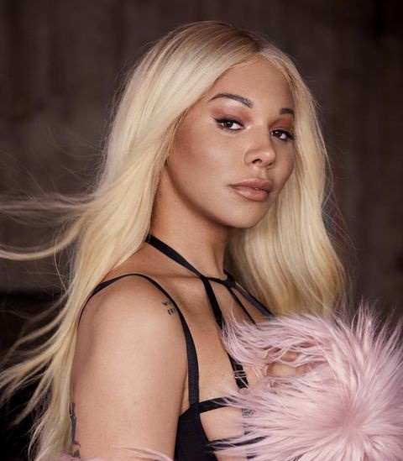
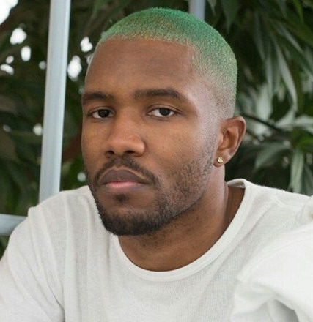
LO: To identify and highlight black role models throughout history and celebrate their achievements
Janelle Monae is an American singer/songwriter. She came out as pansexual on the cover of rolling stone in 2018.
Munroe Bergdorf is a model and activist who has walked runways at NYC and London. She is also trans.
Frank Ocean is an American singer, songwriter, rapper, record producer, and photographer. Frank Ocean came out as bi on Tumblr.
Notes:
Share the additional information about each person and discuss that they are all LGBT.

Slide 6
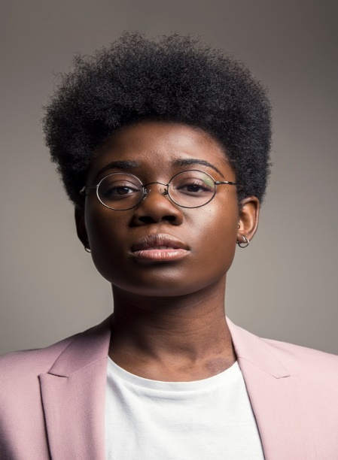
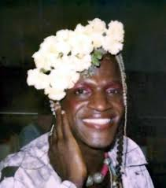
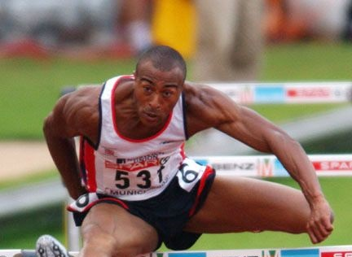
LO: To identify and highlight black role models throughout history and celebrate their achievements
Dr Ronx is an Emergency medicine doctor by profession.
They describe themselves as a queer, black, androgynous intersectional feminist.
Marsh P Johnson was a prominent figure of the Stonewall Riots in 1969 and gay rights activist. She was also trans.
Colin Jackson held the 110m hurdles world record for more than a decade. He still holds the record for 60m hurdles. He came out as gay in 2017.
Notes:
Share the additional information about each person and discuss that they are all LGBT.
Having discussed the intersections of race LGBT, ask the students about disabled black LGBT role models.
Ask: How often do you see Black LGBT role models that are also disabled? Think. Pair. Share.
Ask: Why do you think this is?

Slide 7
LO: To identify and highlight black role models throughout history and celebrate their achievements
Notes:
Have each of the students choose one of the role models they have just been told about, or any others they can think of and write a speech about who they are and the importance of blackness in history. They should include facts about them.
For the end of lesson, have any students who feel comfortable share their speech with the class.

