Slide 1
PowerPoint template to accompany the Black History Month 2019 lesson pack for:
Year 3 and 4 – England and Wales
P4 and P5 – Scotland
We know that good teaching is tailored to meet the needs of the children or young people in each individual class. That’s why we’ve created this editable PowerPoint template – feel free to adapt it to suit your teaching context or to add your school or college slide template to the background.
Who are Stonewall?
This resource is produced by Stonewall, a UK-based charity that stands for the freedom, equity and potential of all lesbian, gay, bi, trans, queer, questioning and ace (LGBTQ+) people. At Stonewall, we imagine a world where LGBTQ+ people everywhere can live our lives to the full. Founded in London in 1989, we now work in each nation of the UK and have established partnerships across the globe. Over the last three decades, we have created transformative change in the lives of LGBTQ+ people in the UK, helping win equal rights around marriage, having children and inclusive education.
Our campaigns drive positive change for our communities, and our sustained change and empowerment programmes ensure that LGBTQ+ people can thrive throughout our lives. We make sure that the world hears and learns from our communities, and our work is grounded in evidence and expertise.
Stonewall is proud to provide information, support and guidance on LGBTQ+ inclusion; working towards a world where we’re all free to be. This does not constitute legal advice, and is not intended to be a substitute for legal counsel on any subject matter. To find out more about our work, visit us at www.stonewall.org.uk.
Registered Charity No 1101255 (England and Wales) and SC039681 (Scotland)
Notes:
Visit our website for the lesson plan to accompany this PowerPoint.

Slide 2
LO: To be able to retrieve information from a text

Slide 3

Before we start….
Our ground rules
Notes:
Create a list of ground rules as a class i.e respecting identities and opinions - this may also include no judgement, not speaking over each other and being honest with any and all questions we have.

Slide 4

3 minute challenge!
Name as many role models as you can.
Stick to your category!
Notes:
3-minute challenge: Split the class into 5 teams and allocate each team a category from sport, history and politics, music, art, TV/film. Challenge them to name as many role models in that category as possible.

Slide 5
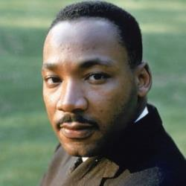
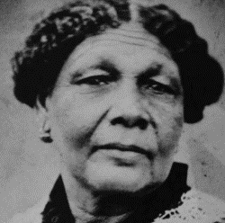
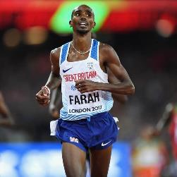
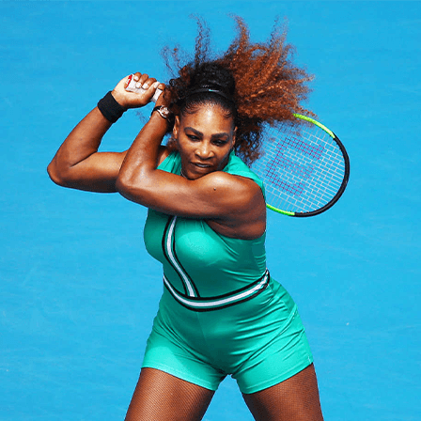
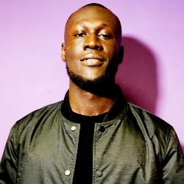
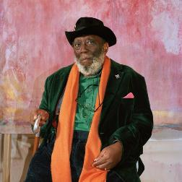
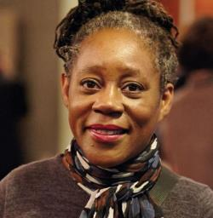
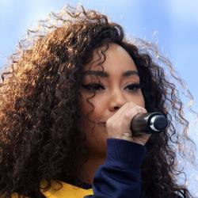
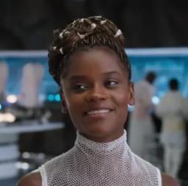
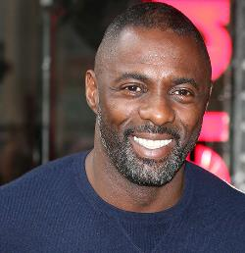
Martin Luther-King
Mary Seacole
Mo Farah
Serena Williams
Stormzy
Frank Bowling
Sonia Boyce
Leigh-Anne from Little Mix
Letitia Wright
Idris Elba
Notes:
How many black people were on their lists? Show some of the black role models on the board. Who have you heard of? Is there a reason that we’ve heard of fewer black role models? Was it easier to think of people for certain categories? Why might it be?

Slide 6
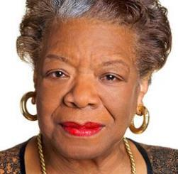
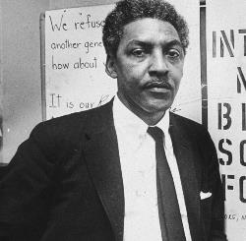
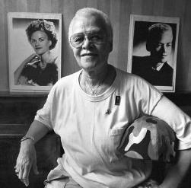
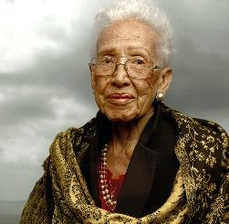
What is Black History Month?
Notes:
Ask: Who has heard of Black History Month (BHM)?
Why might we need BHM?

Slide 7
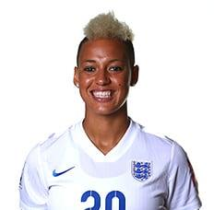
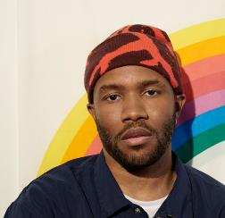

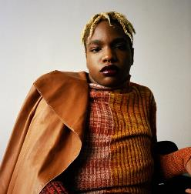
How many black LGBT people did you name?
Notes:
Had they named any black LGBT people in the challenge? Discuss that often we don’t hear about black LGBT people from history.

Slide 8
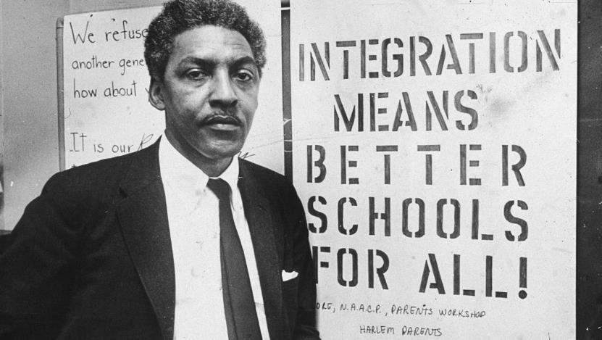
Bayard Rustin
Notes:
Explain that we’re going to be learning about a very important black LGBT role model called Bayard Rustin.

Slide 9

LO: To be able to retrieve information from a text
Work in pairs.
Use the fact sheet to research Bayard Rustin.
Make notes about Bayard.
Notes:
In pairs, children use the information sheet to research Bayard Rustin. They should make bullet point notes to help with the hot-seating activity.

Slide 10
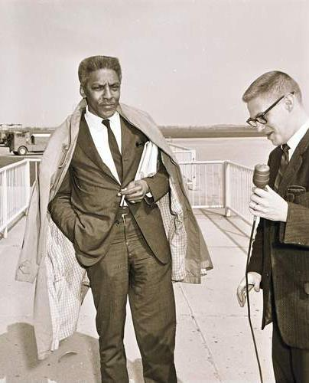
LO: To be able to retrieve information from a text
One person pretends to be Bayard Rustin.
One person pretends to be a journalist interviewing Bayard.
Use your research to help you.
Notes:
Children take on the roles of interviewer and Bayard Rustin and act out a TV interview about Bayard’s life and activism.

Slide 11
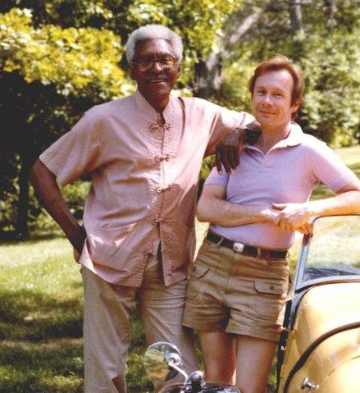
LO: To be able to retrieve information from a text
5 facts about Bayard Rustin:
Notes:
As a class, identify 5 facts about Bayard Rustin.
If there is time, share some of the interviews that children had acted out.

