Slide 1
PowerPoint template to accompany the Black History Month 2019 lesson pack for:
Reception – England and Wales
P1 – Scotland
We know that good teaching is tailored to meet the needs of the children or young people in each individual class. That’s why we’ve created this editable PowerPoint template – feel free to adapt it to suit your teaching context or to add your school or college slide template to the background.
Who are Stonewall?
This resource is produced by Stonewall, a UK-based charity that stands for the freedom, equity and potential of all lesbian, gay, bi, trans, queer, questioning and ace (LGBTQ+) people. At Stonewall, we imagine a world where LGBTQ+ people everywhere can live our lives to the full. Founded in London in 1989, we now work in each nation of the UK and have established partnerships across the globe. Over the last three decades, we have created transformative change in the lives of LGBTQ+ people in the UK, helping win equal rights around marriage, having children and inclusive education.
Our campaigns drive positive change for our communities, and our sustained change and empowerment programmes ensure that LGBTQ+ people can thrive throughout our lives. We make sure that the world hears and learns from our communities, and our work is grounded in evidence and expertise.
Stonewall is proud to provide information, support and guidance on LGBTQ+ inclusion; working towards a world where we’re all free to be. This does not constitute legal advice, and is not intended to be a substitute for legal counsel on any subject matter. To find out more about our work, visit us at www.stonewall.org.uk.
Registered Charity No 1101255 (England and Wales) and SC039681 (Scotland)
Notes:
Visit our website for the lesson plan to accompany this PowerPoint.

Slide 2
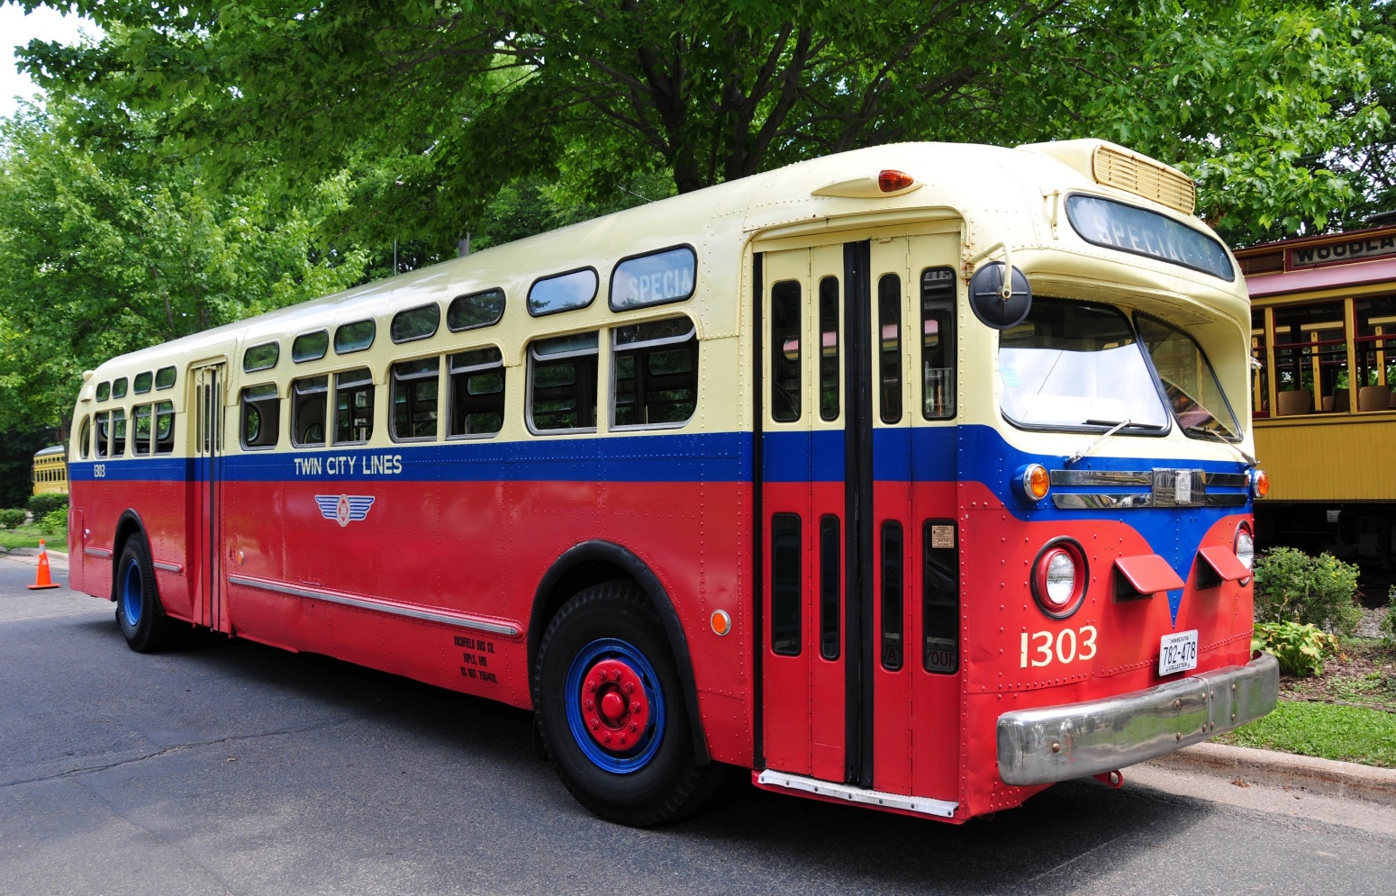
Notes:
Explain to the children that you are going to do some drama, acting out some important scenes from history. The first person is Rosa Parks.
Set up a row of pairs of seats along the classroom, this will be your ‘bus’ – there should be enough seats for all except one of your children. Mark the back 6 seats with photos of hats.
Give the hats to 7 (resilient) children to wear.
Ask most of the children (and all of the children in the hats) to get on the bus at the first ‘stop’, explain that if they are wearing a hat they need to sit on the seats with the hat photos on. Children without hats should get on the bus first.
When the 7th child in a hat can’t find a seat with a hat photo on it, get them to just sit in another seat.
Allow the children on the ‘bus’ to settle down in their seats and set off on the journey to the next ‘stop’.
Invite the children from the second ‘stop’ onto the bus.
When the last child on the bus can’t find a seat, ask the child in the hat who isn’t sitting in a ‘hat seat’ to give up their seat and stand. Explain that it wasn’t actually their seat in the first place and you were just being kind by sitting there.
Ask the children to act out being on the bus journey. The children in hats are only allowed to talk to each other. No hatless children can talk to the children in hats.
At the end of the ‘journey’, ask the children in the hats: How did it feel to only be able to talk to other children in hats and nobody else? Ask the child who had to stand: How did it feel to have to stand up, just because you were wearing a hat?

Slide 3
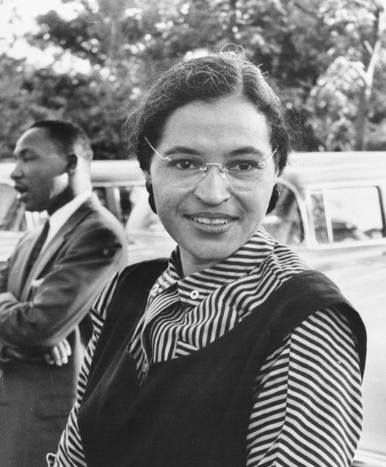
Rosa Parks said that it was not fair.
Rosa did not give her seat up.
Notes:
As a class, talk about the idea of fairness – it was not fair that the person had to stand because they were different. In this case it was because they were wearing hats, but in the past black people in America had to give up their seats to white people on the bus. However, a person called Rosa Parks made a stand against this unfair treatment – show a picture of Rosa Parks on the whiteboard.
Re-enact the bus scenario again, but this time the child should pretend to be Rosa Parks refuse to stand give up their seat.

Slide 4
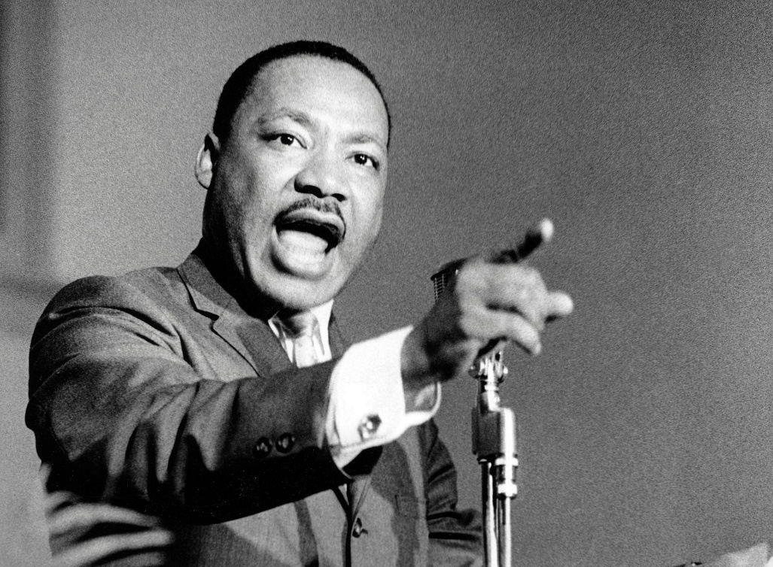
Martin Luther King Jr
Notes:
Explain that Rosa Parks inspired lots of people to stand up against the unfair treatment of black people. One other famous person to do this was a man called Martin Luther King Jr. Show a picture of Martin Luther King Jr on the board. Explain that Martin Luther King Jr is very famous for making a speech at a rally of people in Washington D.C in America. Tell children that we are going to pretend that we are at the rally.

Slide 5

LO: To explain why it is important to treat people fairly
Notes:
Children stand and watch some or all of the Martin Luther King Jr ‘I have a dream’ speech:
https://www.youtube.com/watch?v=vP4iY1TtS3s.
Encourage them to imagine that they’re in the crowd in Washington D.C. Encourage them to cheer along with the crowd.
Note: Before watching, explain to children that the word ‘negro’ was used to refer to black people in the past, but it is not appropriate to use that word any more.

Slide 6
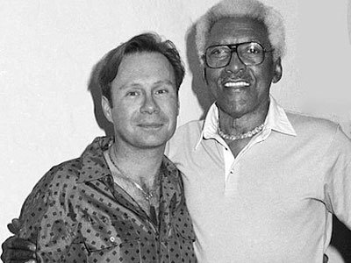
Bayard Rustin organized the speeches, protests and rallies.
Notes:
Discuss that big rallies and marches have to be organized by someone. The person that organised the march on Washington was a man called Bayard Rustin. Show the picture of Bayard Rustin on the whiteboard. Explain that the other man in the photo is Bayard’s partner. Tell the children that Bayard was treated even less fairly than other people because he was black and also because he was gay.

Slide 7

Why is it important to treat people fairly?
Notes:
Ask children: Why is it important to treat people fairly? What can we do to treat people fairly?
Tell children that we’re going to have our own rally and say something about why we should treat people fairly.
Choose a child to be like Bayard Rustin and line people up to make their speeches. Each child that wishes to should have an opportunity to come to the front of the class and say why it is important to treat people fairly. The rest of the children should be the ‘crowd’ and cheer at the end of their speech.

