Slide 1
PowerPoint template to accompany the Black History Month 2020 lesson pack for:
Learners with SEND/ALN/ASN – version 2
We know that good teaching is tailored to meet the needs of the children or young people in each individual class. That’s why we’ve created this editable PowerPoint template – feel free to adapt it to suit your teaching context or to add your school or college slide template to the background.
Who are Stonewall?
This resource is produced by Stonewall, a UK-based charity that stands for the freedom, equity and potential of all lesbian, gay, bi, trans, queer, questioning and ace (LGBTQ+) people. At Stonewall, we imagine a world where LGBTQ+ people everywhere can live our lives to the full. Founded in London in 1989, we now work in each nation of the UK and have established partnerships across the globe. Over the last three decades, we have created transformative change in the lives of LGBTQ+ people in the UK, helping win equal rights around marriage, having children and inclusive education.
Our campaigns drive positive change for our communities, and our sustained change and empowerment programmes ensure that LGBTQ+ people can thrive throughout our lives. We make sure that the world hears and learns from our communities, and our work is grounded in evidence and expertise.
Stonewall is proud to provide information, support and guidance on LGBTQ+ inclusion; working towards a world where we’re all free to be. This does not constitute legal advice, and is not intended to be a substitute for legal counsel on any subject matter. To find out more about our work, visit us at www.stonewall.org.uk.
Registered Charity No 1101255 (England and Wales) and SC039681 (Scotland)
Notes:
Visit our website for the lesson plan to accompany this PowerPoint.

Slide 2
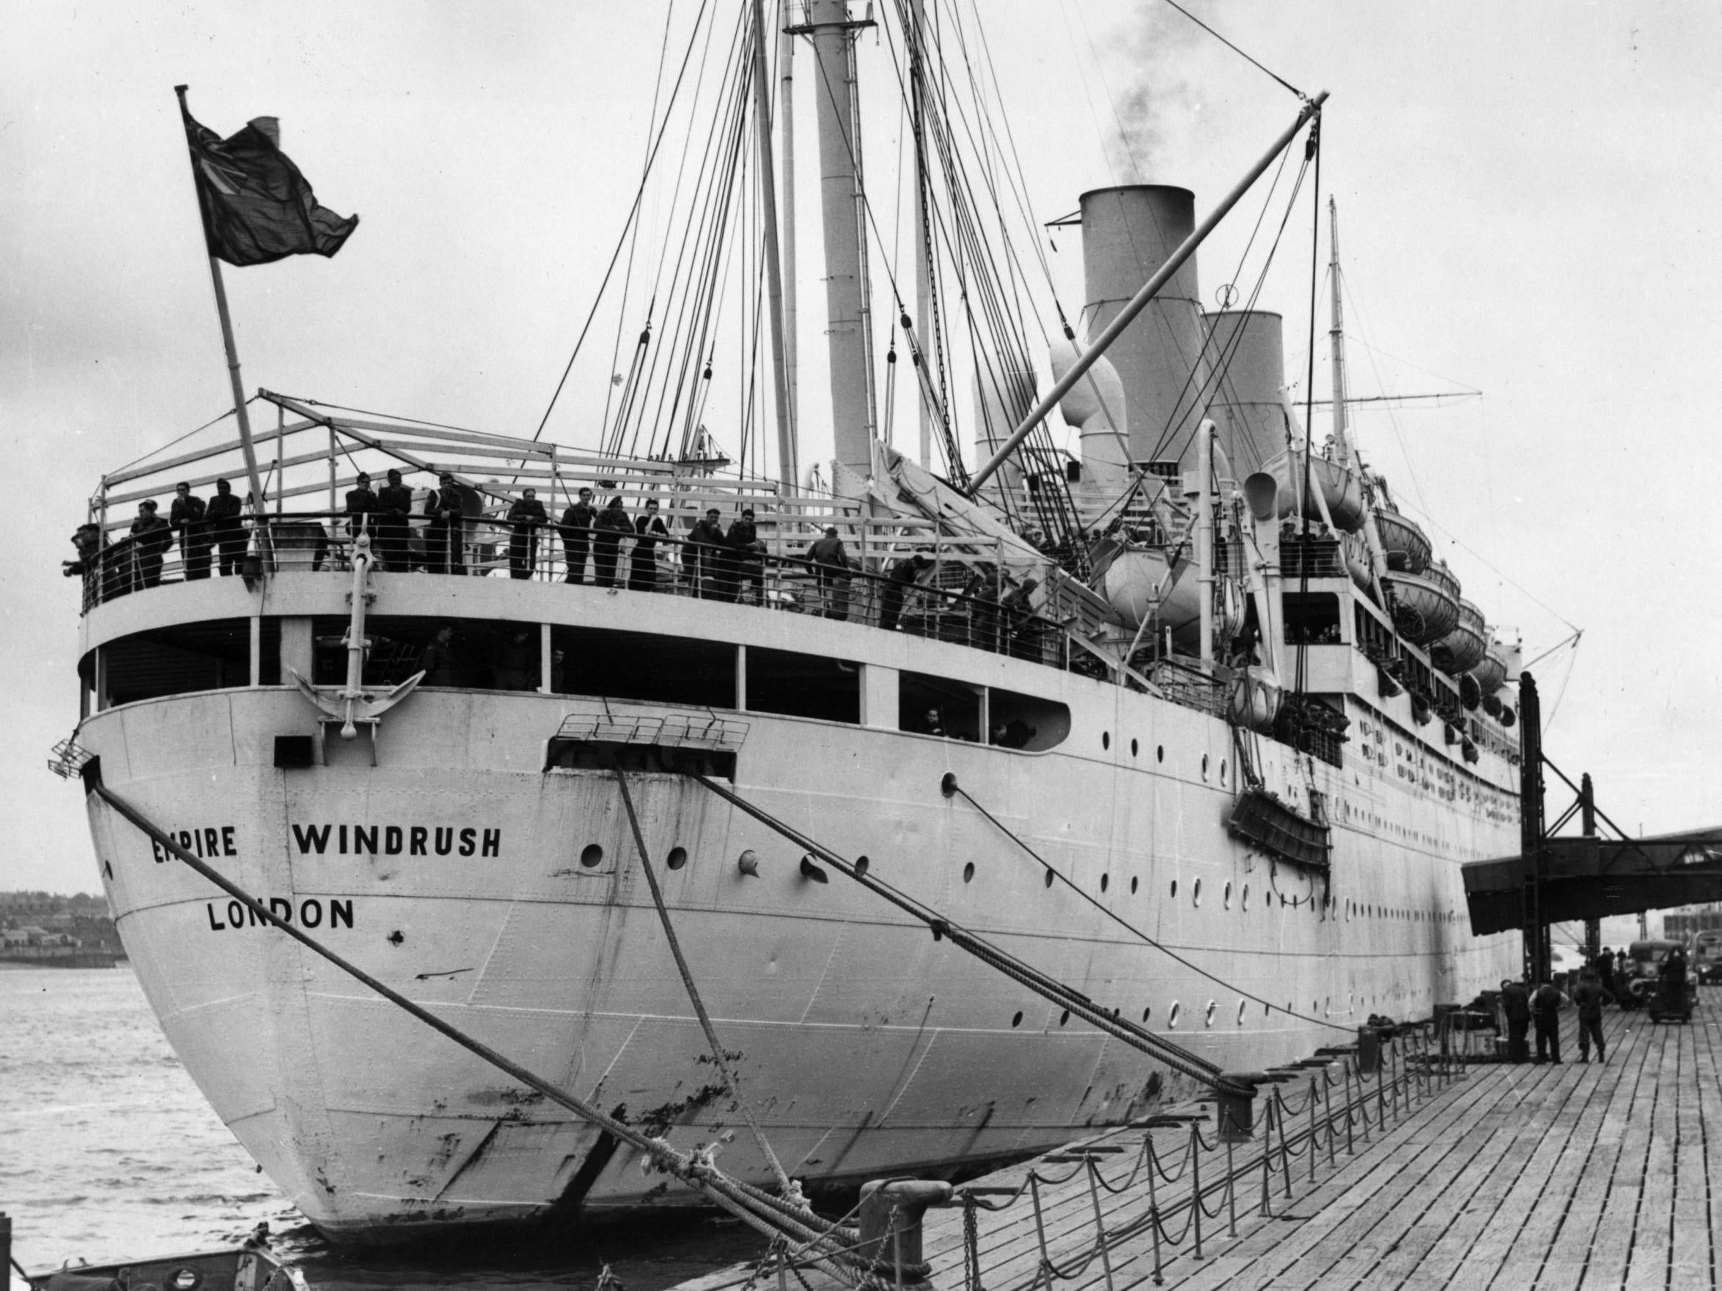
What was Windrush?
Notes:
Watch the video about the Windrush: https://www.bbc.co.uk/newsround/43793769

Slide 3
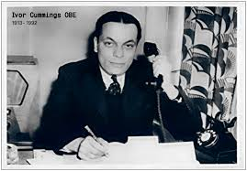
Ivor Cummings
Notes:
Explain that the person that met the people off the boat in England was a man called Ivor Cummings.

Slide 4
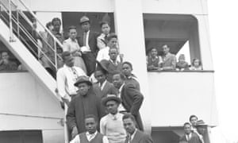
Ivor Cummings was at the dock waiting for Windrush.
Notes:
Explain that the person that met the people off the boat in England was a man called Ivor Cummings.

Slide 5
It was Ivor’s job to help people who had moved to Britain.
Notes:
He worked for the government to help people who had moved from different Caribbean and African Commonwealth countries.

Slide 6
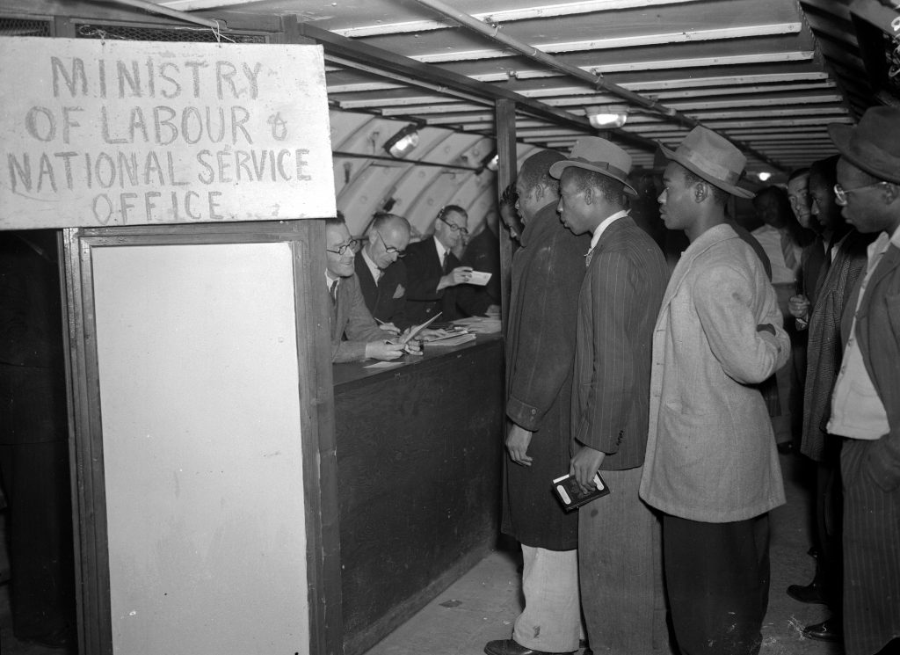
Ivor helped people to find jobs and somewhere to live.
Notes:
He worked for the government to help people who had moved from different Caribbean and African Commonwealth countries.

Slide 7
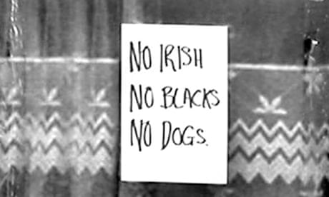
Black people were treated badly because of the colour of their skin.
People were mean to Ivor because he
was Black.
This is called racism. Racism is wrong.
Notes:
It was hard because people were mean to Black people and didn’t want to give them a job or somewhere to live. If someone is mean to someone because of the colour of someone’s skin, it is called racism. Racism is wrong.

Slide 8
People were mean to Ivor because he was gay.
This is called homophobia.
Homophobia is wrong.
It is ok to be gay.
Notes:
Explain that people were mean to Ivor because he was Black, but also because he was gay. Being gay is when a man wants a boyfriend and doesn’t want a girlfriend. Being mean to someone because they are gay is called homophobia. Homophobia is wrong.

Slide 9
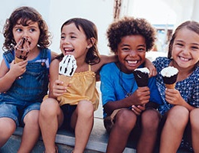
It is good to be kind.
It is important to treat people fairly.
Notes:
Discuss why it is important to be kind to people and to treat people fairly. Discuss what students should do if they see someone being treated unfairly, or if they are treated unfairly themselves. Discuss why it is important to be kind to people and to treat people fairly. Discuss what students should do if they see someone being treated unfairly, or if they are treated unfairly themselves.

Slide 10
What can you remember about Windrush and Ivor Cummings?
Notes:
As a class or in small groups, play Windrush “memory”. Shuffle all of the cards and place them face down on the table. Students take turns to turn over two cards, with the objective of sharing matching pairs.
Emphasise the importance of fairness when playing games as a group: taking turns, following the rules.
Use the images on the different cards to…
Check students’ understanding of the previous activity:
Boat – what was the boat called
Ivor Cummings – what was this man called?
Jamaican flag – where had the people travelled from?
English flag – where did the people travel to?
House – who helped the people to find somewhere to live?
Someone at work – why did people find it hard to find a job?

Slide 11
Make a picture of Ivor
welcoming the people from Windrush.
Notes:
Students either create their own picture of Ivor Cummings welcoming the people off Windrush or use the line drawing to create a collage to represent the arrival of Windrush.
Extension:
Students label key aspects of their collage using some of the key words from the lesson
Students write a sentence about Ivor Cummings.

Slide 12

True or false?
True
False
Notes:
As a class play a True/False quiz about Windrush.
Windrush was a boat. True
People travelled on the Windrush from Germany. False – the Windrush brought people from Jamaica.
Ivor Cummings helped people to get jobs and places to live. True – it was his job to help the people find jobs and places to live.
Ivor Cummings had a wife. False – Ivor was gay.
Black people were treated badly (and sadly often still are) because of the colour of their skin. True. Recap what students should do if they see someone being unkind to someone else.

