Slide 1
PowerPoint template to accompany the Black History Month 2020 lesson pack for:
Year 3 and 4 – England and Wales
P4 and P5 – Scotland
We know that good teaching is tailored to meet the needs of the children or young people in each individual class. That’s why we’ve created this editable PowerPoint template – feel free to adapt it to suit your teaching context or to add your school or college slide template to the background.
Who are Stonewall?
This resource is produced by Stonewall, a UK-based charity that stands for the freedom, equity and potential of all lesbian, gay, bi, trans, queer, questioning and ace (LGBTQ+) people. At Stonewall, we imagine a world where LGBTQ+ people everywhere can live our lives to the full. Founded in London in 1989, we now work in each nation of the UK and have established partnerships across the globe. Over the last three decades, we have created transformative change in the lives of LGBTQ+ people in the UK, helping win equal rights around marriage, having children and inclusive education.
Our campaigns drive positive change for our communities, and our sustained change and empowerment programmes ensure that LGBTQ+ people can thrive throughout our lives. We make sure that the world hears and learns from our communities, and our work is grounded in evidence and expertise.
Stonewall is proud to provide information, support and guidance on LGBTQ+ inclusion; working towards a world where we’re all free to be. This does not constitute legal advice, and is not intended to be a substitute for legal counsel on any subject matter. To find out more about our work, visit us at www.stonewall.org.uk.
Registered Charity No 1101255 (England and Wales) and SC039681 (Scotland)
Notes:
Visit our website for the lesson plan to accompany this PowerPoint.

Slide 2
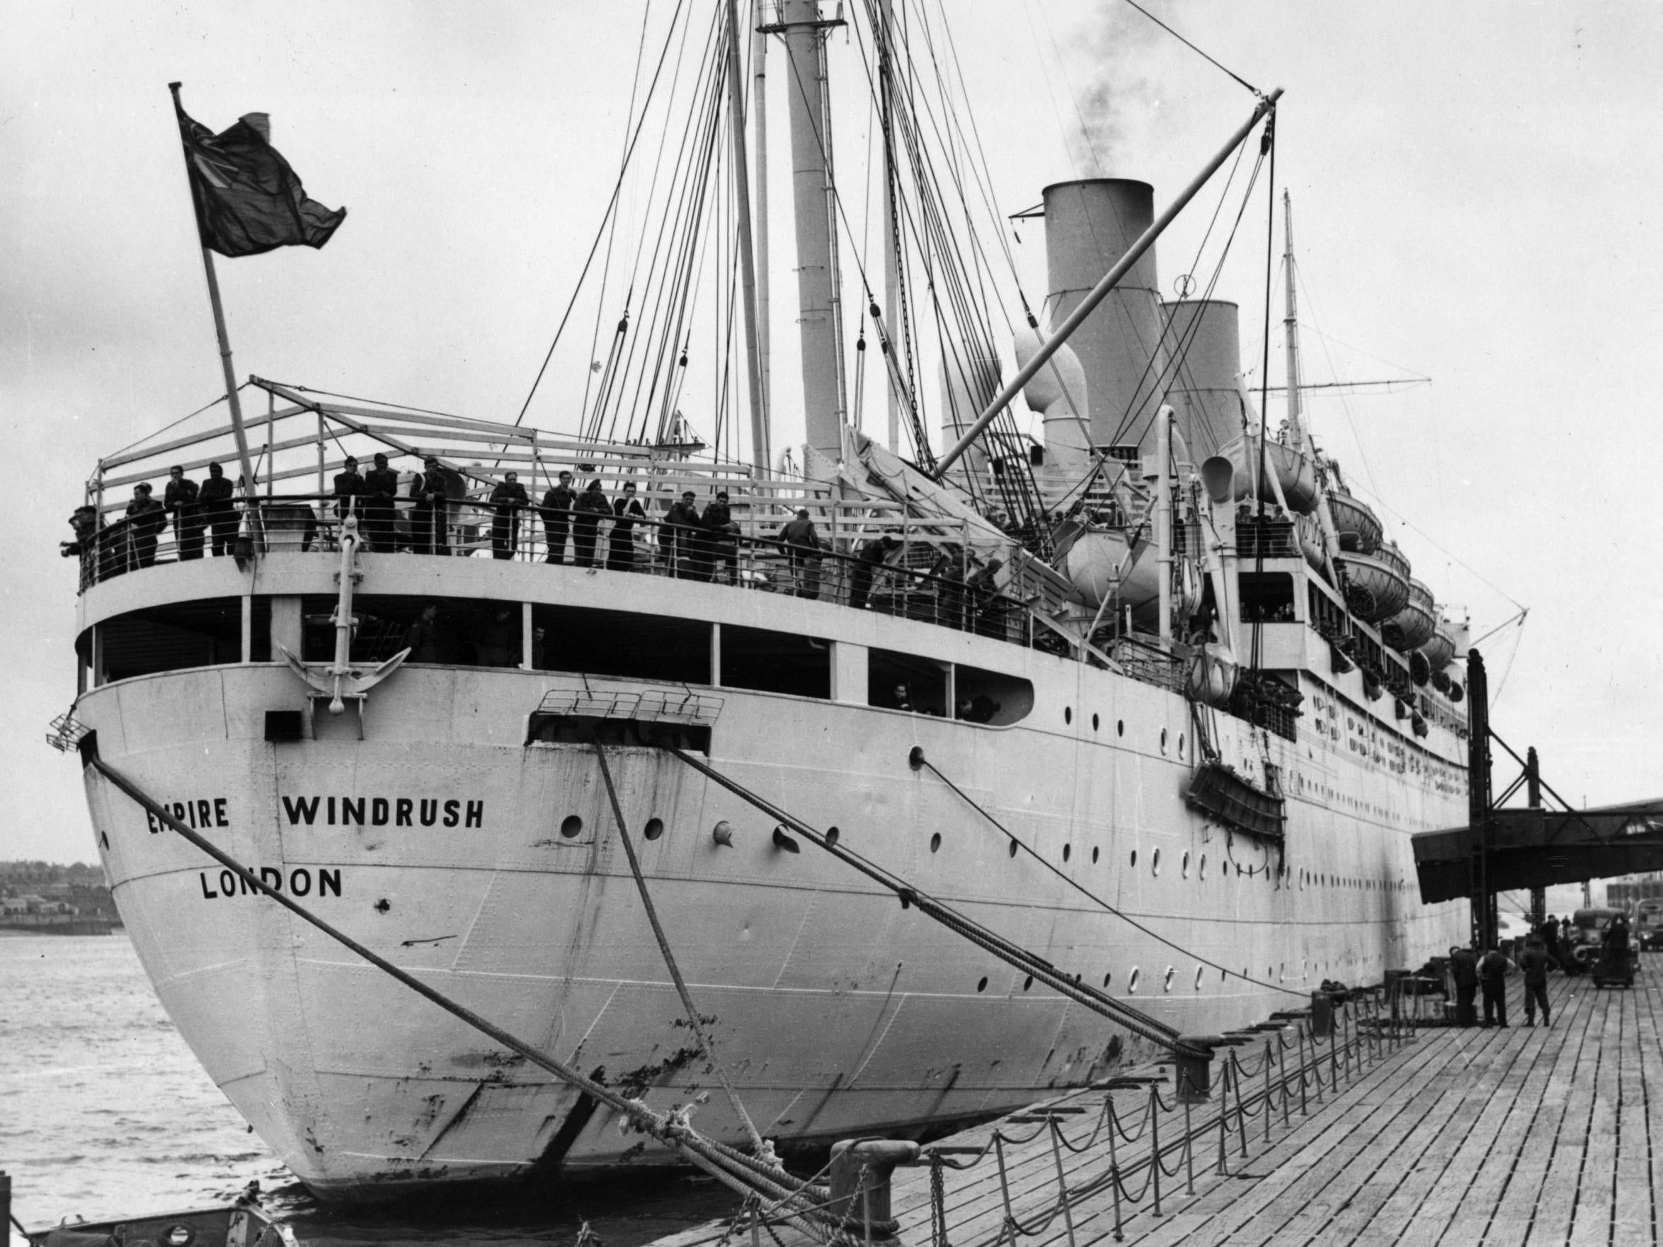
What was Windrush?
Notes:
Watch https://www.bbc.co.uk/newsround/43793769 https://www.bbc.co.uk/newsround/43793769

Slide 3
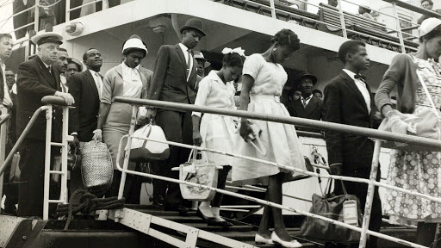
Adjective challenge
How might it feel to move to a new country?
Notes:
Challenge children to think of as many adjectives as possible to describe how it might feel to move to a different country. Write their ideas on the board.
Give any children the opportunity to talk about their own experiences of having moved to a different country – if they are comfortable to.

Slide 4
How might it feel to move to a new country?
Notes:
Challenge children to think of as many adjectives as possible to describe how it might feel to move to a different country. Write their ideas on the board.
Give any children the opportunity to talk about their own experiences of having moved to a different country – if they are comfortable to.

Slide 5
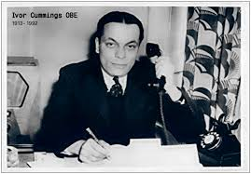
LO: To consider what the experience of discrimination might feel like
Ivor Cummings
Notes:
Explain that the person they will be learning about had an important part to play in helping the people that migrated on The Windrush.

Slide 6
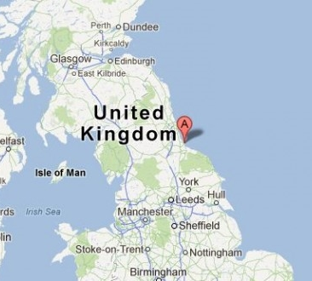
LO: To consider what the experience of discrimination might feel like
Ivor Cummings was born in Hartlepool in 1913.

Slide 7
LO: To consider what the experience of discrimination might feel like
He worked for the government, helping people who had moved to Britain from different Caribbean and African Commonwealth countries.
Ivor was the only Black person at his workplace.
Notes:
He worked for the government to help people who had moved from different Caribbean and African Commonwealth countries.

Slide 8
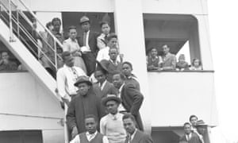
LO: To consider what the experience of discrimination might feel like
As part of his job, Ivor was one of the first people to meet the people arriving to Britain on the Windrush.
He was responsible for helping people find jobs and a place to live.
Notes:
Ivor was in charge of organising housing and other arrangements for the 492 people that came over on a boat called the Empire Windrush and was there to meet them at Tilbury Docks

Slide 9

LO: To consider what the experience of discrimination might feel like
The people that came to Britain on Windrush experienced a lot of racism. Because of this they found it hard to get jobs and housing.
This is why it was so important that Ivor went out of his way to help everyone.
Notes:
Black people found it hard to find homes and jobs. They experienced racism and attacks. It was hard to settle in. Ivor He went over and above, helping people to find jobs and settle down in the UK. Ivor will also have experienced Racism

Slide 10

LO: To consider what the experience of discrimination might feel like
Ivor experienced a lot of prejudice and discrimination himself. He will have
experienced racism,
but life was also hard
because he was gay.
It was against the law to
be gay in the 1950s.
Notes:
Help the children to understand that Ivor Cummings’ life would have been difficult at times. People would have treated him badly because he was gay and fell in love with other men. People will also have treated him badly because he was Black.

Slide 11
LO: To consider what the experience of discrimination might feel like
How might it feel?
Notes:
What might have made it difficult for people to find jobs in the UK? Use the opportunity to discuss racist discrimination and how would it feel. Write their ideas on the board.
How would Ivor’s life have been difficult as a gay man? Discuss fear of arrest, having to be secretive, fear of discrimination. Write their ideas on the board.

Slide 12
LO: To consider what the experience of discrimination might feel like
Freeze frame
Ivor Cummings greeting the passengers of the Windrush
Ivor Cummings telling a friend that he’s gay
A person being turned away from a shop because they were Black
Notes:
In threes or fours, children to freeze frame the following scenarios:
Ivor Cummings greeting the passengers of the Windrush
Ivor Cummings telling a friend that he’s gay
A person being turned away from a shop because they were Black
Each child in the freeze frame should consider what their character might be thinking and feeling..

Slide 13
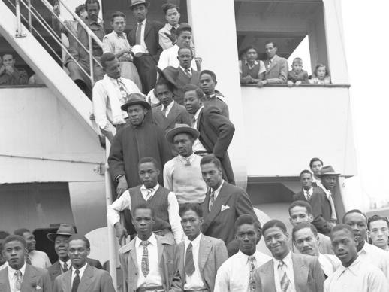
LO: To consider what the experience of discrimination might feel like
What were they thinking?
Notes:
Give different the groups the opportunity to share one of their freeze frames, each time ask the different characters what they’re thinking.
Discuss common themes as a class.
End the lesson by discussing the importance of challenging racism, homophobia and other types of discriminatory behaviour. Discuss with children what they would do if they saw heard or saw someone being discriminated against. Also make sure that you discuss what children should do if they are discriminated against themselves.

