Slide 1
PowerPoint template for the 2020 Anti-Bullying Week Assembly for:
Learners with SEND/ALN/ASN – version 1
We know that good teaching is tailored to meet the needs of the children or young people in each individual class. That’s why we’ve created this editable PowerPoint template – feel free to adapt it to suit your teaching context or to add your school or college slide template to the background.
Who are Stonewall?
This resource is produced by Stonewall, a UK-based charity that stands for the freedom, equity and potential of all lesbian, gay, bi, trans, queer, questioning and ace (LGBTQ+) people. At Stonewall, we imagine a world where LGBTQ+ people everywhere can live our lives to the full. Founded in London in 1989, we now work in each nation of the UK and have established partnerships across the globe. Over the last three decades, we have created transformative change in the lives of LGBTQ+ people in the UK, helping win equal rights around marriage, having children and inclusive education.
Our campaigns drive positive change for our communities, and our sustained change and empowerment programmes ensure that LGBTQ+ people can thrive throughout our lives. We make sure that the world hears and learns from our communities, and our work is grounded in evidence and expertise.
Stonewall is proud to provide information, support and guidance on LGBTQ+ inclusion; working towards a world where we’re all free to be. This does not constitute legal advice, and is not intended to be a substitute for legal counsel on any subject matter. To find out more about our work, visit us at www.stonewall.org.uk.
Registered Charity No 1101255 (England and Wales) and SC039681 (Scotland)
Notes:
Other versions of this assembly are available on Stonewall’s website: www.stonewall.org.uk

Slide 2

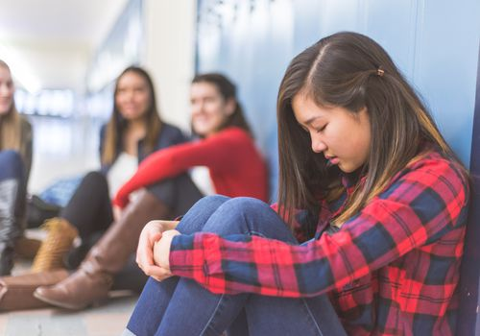
Notes:
Ask students what they think bullying is

Slide 3

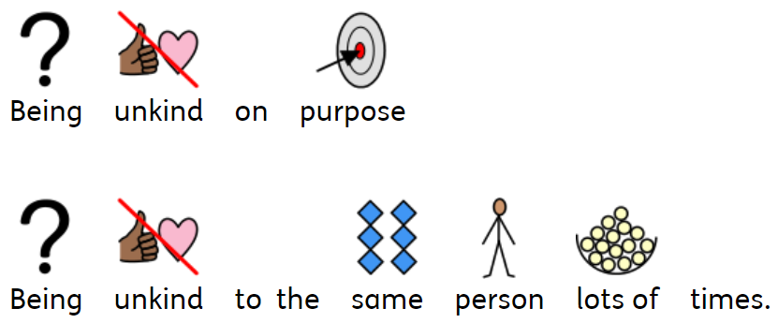
Notes:
Explain that sometimes people are unkind to others because there is something about them that is different. If someone is mean to someone lots of times and on purpose, this is called bullying.

Slide 4
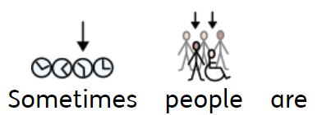
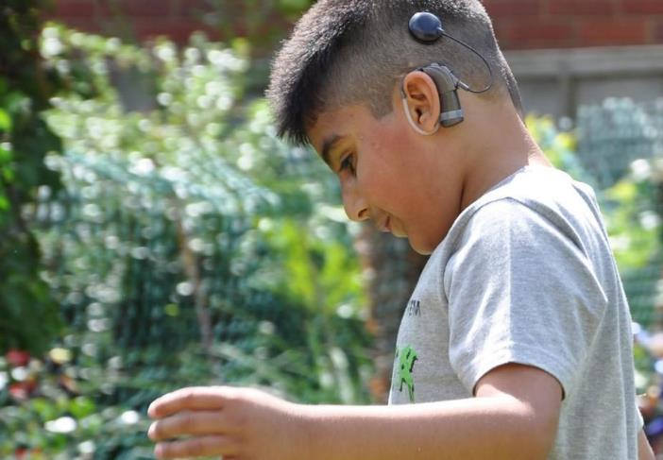
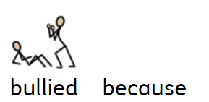

Notes:
Explain that people are often bullied because of something different about them but…

Slide 5
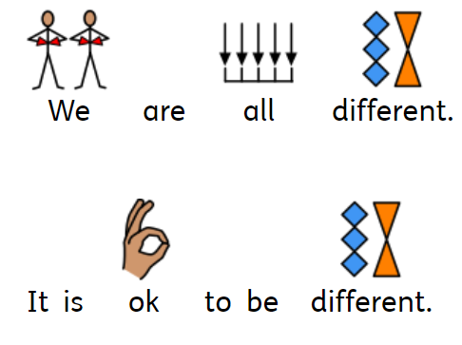

Notes:
…we are all different from each other and it’s ok to be different from each other. Take the opportunities to highlight some differences – height, interests, skin colour, gender, religion etc

Slide 6

Notes:
Reiterate that bullying is not ok – ask someone to remind everybody what bullying is.

Slide 7
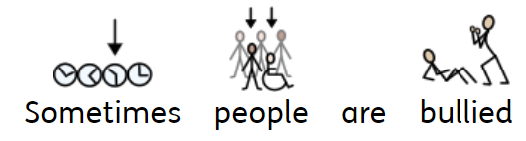
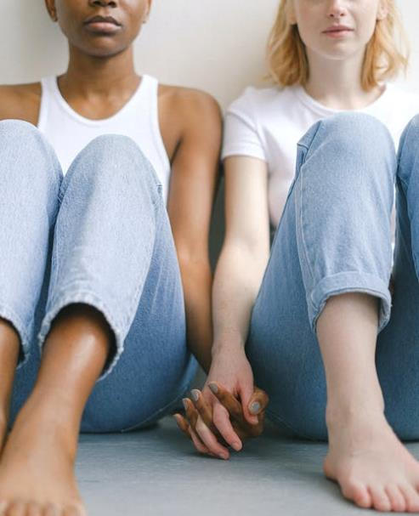
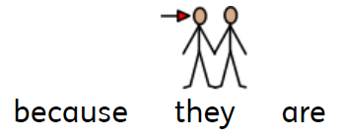


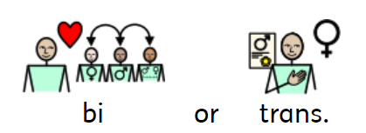
Notes:
Explain that some people are being bullied for being LGBT.

Slide 8
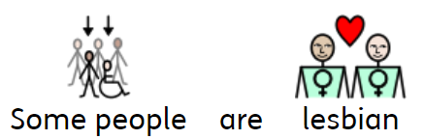

Notes:
Explain that a lesbian is a woman that loves other women. It is ok to be lesbian.

Slide 9
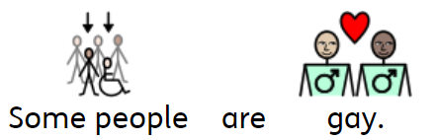
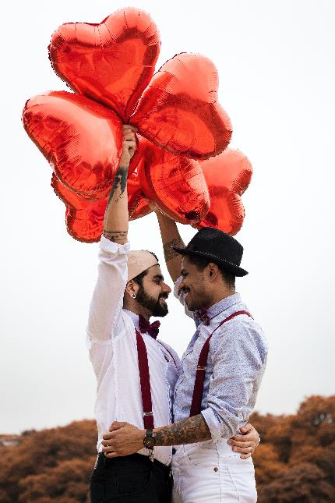

Notes:
Explain that gay men are men that love other men. Lesbian women are women that love other women. It is ok to be gay.

Slide 10
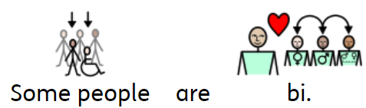
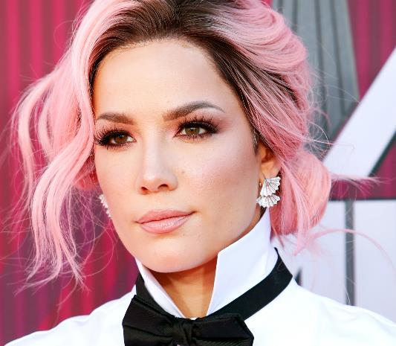
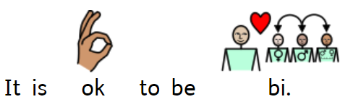
Notes:
Explain that some people fall in love with people of all genders, that is what being bi means. It’s ok to be bi.

Slide 11
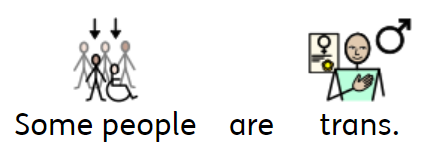
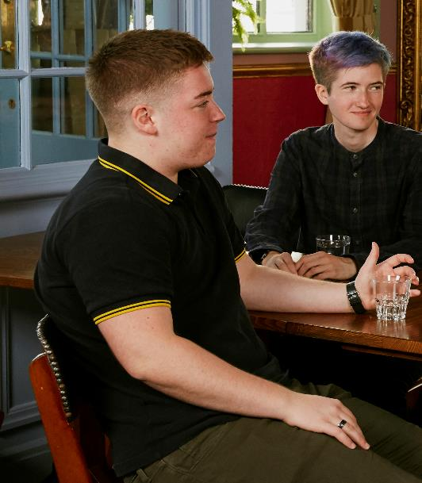

Notes:
Explain that if someone is trans it means that:
For a trans boy, even through the doctors thought they were a girl when they were born, they grew up and said “I’m a boy”.
For a trans girl, even through the doctors thought they were a boy when they were born, they grew up and said “I’m a girl”.
For a non-binary person, the doctors would have either said “it’s a girl” or “it’s a boy” when they were born but actually they grew up and said “I’m not a boy and I’m not a girl, I’m non-binary”.
Some people are trans and it’s ok

Slide 12
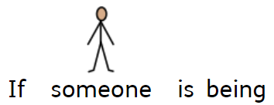

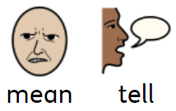
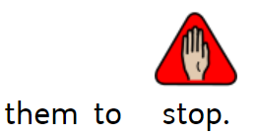
Notes:
Discuss with students what they should do if they see someone being bullied or if they are bullied themselves

Slide 13
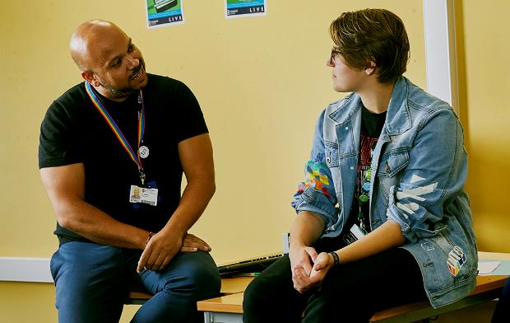
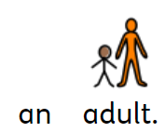
Notes:
Discuss with students what they should do if they see someone being bullied or if they are bullied themselves

