Slide 1
PowerPoint template for the 2020 Anti-Bullying Week Assembly for:
Reception and Key Stage 1 – England and Wales
P1 to P3 - Scotland
We know that good teaching is tailored to meet the needs of the children or young people in each individual class. That’s why we’ve created this editable PowerPoint template – feel free to adapt it to suit your teaching context or to add your school or college slide template to the background.
Who are Stonewall?
This resource is produced by Stonewall, a UK-based charity that stands for the freedom, equity and potential of all lesbian, gay, bi, trans, queer, questioning and ace (LGBTQ+) people. At Stonewall, we imagine a world where LGBTQ+ people everywhere can live our lives to the full. Founded in London in 1989, we now work in each nation of the UK and have established partnerships across the globe. Over the last three decades, we have created transformative change in the lives of LGBTQ+ people in the UK, helping win equal rights around marriage, having children and inclusive education.
Our campaigns drive positive change for our communities, and our sustained change and empowerment programmes ensure that LGBTQ+ people can thrive throughout our lives. We make sure that the world hears and learns from our communities, and our work is grounded in evidence and expertise.
Stonewall is proud to provide information, support and guidance on LGBTQ+ inclusion; working towards a world where we’re all free to be. This does not constitute legal advice, and is not intended to be a substitute for legal counsel on any subject matter. To find out more about our work, visit us at www.stonewall.org.uk.
Registered Charity No 1101255 (England and Wales) and SC039681 (Scotland)
Notes:
Other versions of this assembly are available on Stonewall’s website: www.stonewall.org.uk

Slide 2
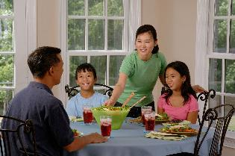
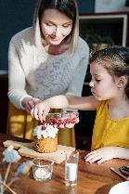
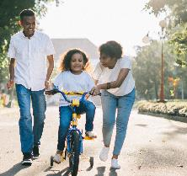
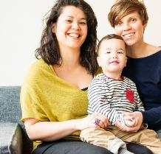
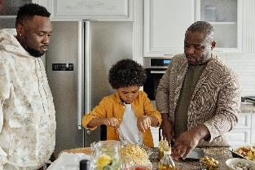
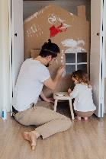
Notes:
How are these children and their families different? (race, gender, family, religion, interest) How are they similar?

Slide 3
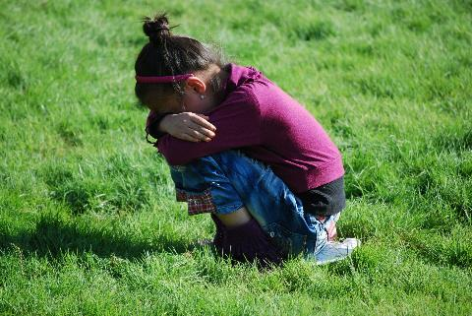
What is bullying?
Notes:
Explain that sometimes people are mean to others because there is something about them that is different. If someone is mean to someone lots of times and on purpose, this is called bullying.

Slide 4
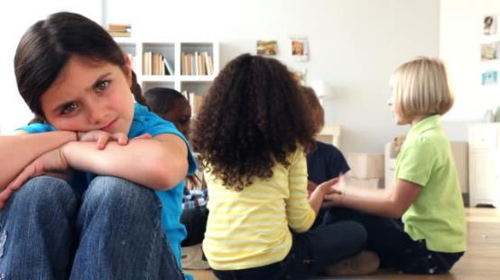
How might it feel?
Notes:
Jameela lives with her two dads. When her friends found out that Jameela has two dads, they stopped letting her play. How might that make Jameela feel?

Slide 5
What could you do?
Notes:
What could you do if you saw someone being left out because they had two dads, or because people were being mean for any other reason? Discuss kind things that they could do in the first instance – for example asking Jameela to play with them instead, asking if she’s ok. Discuss the school anti-bullying policy and how children can report bullying.

Slide 6
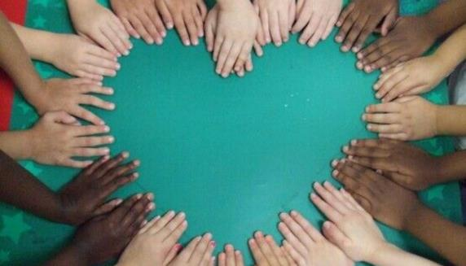
United against bullying
Notes:
Explain to children that it’s anti-bullying week this week and the theme is United Against Bullying. It’s a time of the year where we reflect on what we can do to prevent bullying, but we always need to play our part in stopping bullying – every single week of the year. We need to unite against bullying every day.
Ask children to remind you what they can do if they see someone being bullied, or if they are bullied themselves.

