Slide 1
PowerPoint template for the 2020 Anti-Bullying Week Assembly for:
Key Stage 2 – England and Wales
P4 to P7 - Scotland
We know that good teaching is tailored to meet the needs of the children or young people in each individual class. That’s why we’ve created this editable PowerPoint template – feel free to adapt it to suit your teaching context or to add your school or college slide template to the background.
Who are Stonewall?
This resource is produced by Stonewall, a UK-based charity that stands for the freedom, equity and potential of all lesbian, gay, bi, trans, queer, questioning and ace (LGBTQ+) people. At Stonewall, we imagine a world where LGBTQ+ people everywhere can live our lives to the full. Founded in London in 1989, we now work in each nation of the UK and have established partnerships across the globe. Over the last three decades, we have created transformative change in the lives of LGBTQ+ people in the UK, helping win equal rights around marriage, having children and inclusive education.
Our campaigns drive positive change for our communities, and our sustained change and empowerment programmes ensure that LGBTQ+ people can thrive throughout our lives. We make sure that the world hears and learns from our communities, and our work is grounded in evidence and expertise.
Stonewall is proud to provide information, support and guidance on LGBTQ+ inclusion; working towards a world where we’re all free to be. This does not constitute legal advice, and is not intended to be a substitute for legal counsel on any subject matter. To find out more about our work, visit us at www.stonewall.org.uk.
Registered Charity No 1101255 (England and Wales) and SC039681 (Scotland)
Notes:
In advance of the assembly you will need 6 volunteers to act out some scenarios. Choose a confident child to play the role of Jessica.
Other versions of this assembly are available on Stonewall’s website: www.stonewall.org.uk

Slide 2
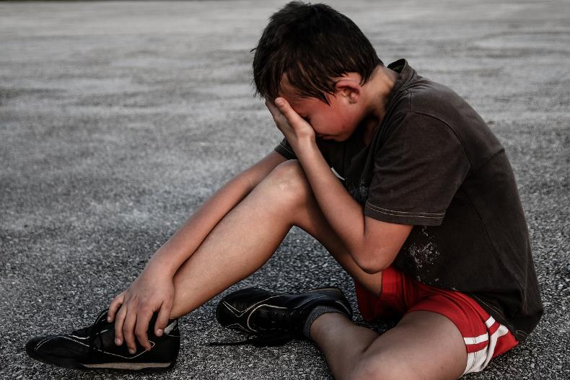
What is bullying?
Notes:
Ask children what bullying is. Remind them that bullying is the act of being mean on purpose, on several occasions.
Ask children for suggestions about the types of thing people are bullied for. Ensure you have included: the colour of their skin, their religion, being disabled, having two mums or two dads, having different interests.

Slide 3
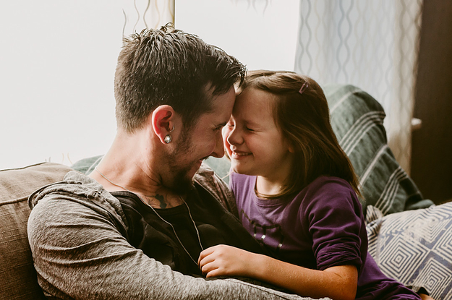
Jessica and her dad
Notes:
This is Jessica and her dad. Jessica’s dad is trans. This means that when he was born people thought he was a girl, but when he was older he told them that actually he’s a man.
We’re going to act out a situation that Jessica encountered.

Slide 4
How might it feel?
Notes:
Role play 1:
One of the children makes fun out of Jessica by saying “Haha your dad used to be a girl. That’s so weird. You’re so weird.”
Jessica looks sad.
2 children see and start joining in laughing at Jessica, 2 walk on by and do nothing.
Freeze frame: How might Jessica feel?

Slide 5

Rewind
Notes:
Ask children: What was wrong with the situation?
Discuss that two of the children in the situation joined in and two walked by without doing anything differently.
If we could rewind the situation, what could happen differently? Talk about the other children speaking out against the bullying and not joining in or ignoring it.

Slide 6
Let’s try again
Notes:
Role play 2:
One of the children makes fun out of Jessica by saying “Haha your dad used to be a girl. That’s so weird. You’re so weird.”
Jessica looks sad.
4 children come along. They tell the bully to stop and that it’s not ok to make fun of Jessica or her dad. They ask Jessica if she’s OK and offer to go and talk to the teacher.
Freeze frame: How might Jessica feel in this situation?

Slide 7
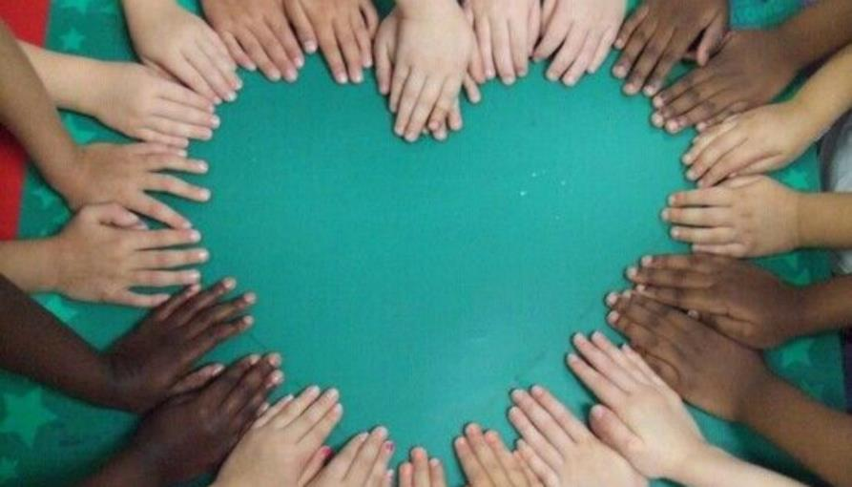
United against bullying
Notes:
Ask the children what made the second situation better. Discuss the importance of not being a bystander – by speaking out, the other children made Jessica feel supported and less alone. Of course, the best situation would be for nobody to have been making fun of her or her dad in the first place.
Explain to children that it’s Anti-bullying Week this week and the theme is United Against Bullying. It’s a time of the year where we reflect on what we can do to prevent bullying, but we always need to play our part in stopping bullying – every single week of the year. We need to unite against bullying every day.
Ask children to remind you what they can do if they see someone being bullied, or if they are bullied themselves.

