Slide 1
PowerPoint template to accompany the Rainbow Laces 2020 activity pack for:
SEND/ALN/ASN – version 2
We know that good teaching is tailored to meet the needs of the children or young people in each individual class. That’s why we’ve created this editable PowerPoint template – feel free to adapt it to suit your teaching context or to add your school or college slide template to the background.
Who are Stonewall?
This resource is produced by Stonewall, a UK-based charity that stands for the freedom, equity and potential of all lesbian, gay, bi, trans, queer, questioning and ace (LGBTQ+) people. At Stonewall, we imagine a world where LGBTQ+ people everywhere can live our lives to the full. Founded in London in 1989, we now work in each nation of the UK and have established partnerships across the globe. Over the last three decades, we have created transformative change in the lives of LGBTQ+ people in the UK, helping win equal rights around marriage, having children and inclusive education.
Our campaigns drive positive change for our communities, and our sustained change and empowerment programmes ensure that LGBTQ+ people can thrive throughout our lives. We make sure that the world hears and learns from our communities, and our work is grounded in evidence and expertise.
Stonewall is proud to provide information, support and guidance on LGBTQ+ inclusion; working towards a world where we’re all free to be. This does not constitute legal advice, and is not intended to be a substitute for legal counsel on any subject matter. To find out more about our work, visit us at www.stonewall.org.uk.
Registered Charity No 1101255 (England and Wales) and SC039681 (Scotland)
Notes:
Visit our website for the activity pack to accompany this PowerPoint.

Slide 2
Making sport everyone’s game
Notes:
Use this SEND specific PowerPoint with your students to introduce them to Rainbow Laces and the importance of LGBT inclusion in sports.

Slide 3
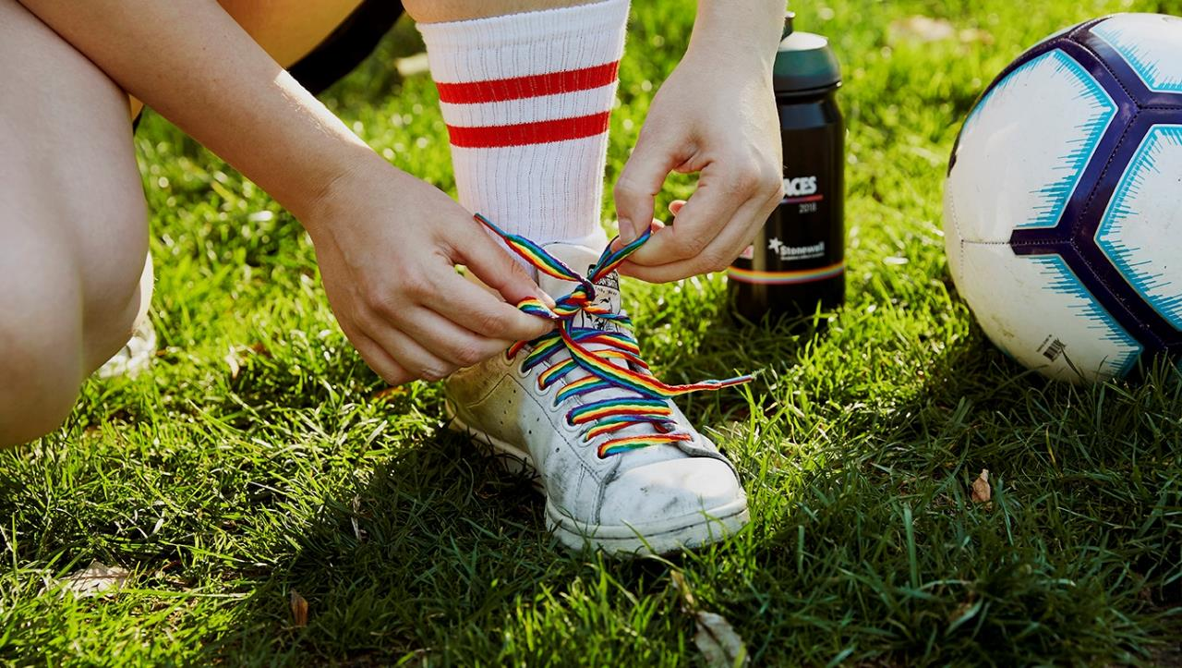
What can you see in the picture?
Notes:
Ask students what they can see in the picture.
What might we be talking about in this lesson?

Slide 4
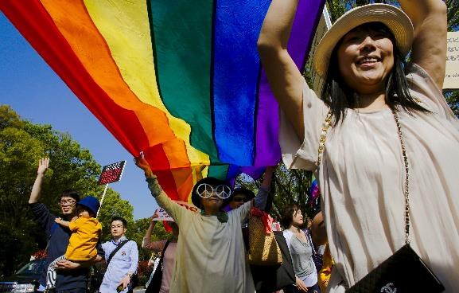
The rainbow flag
The rainbow flag is used all around the world to represent LGBT people.
It is sometimes used to represent peace and the NHS too.
Notes:
Ensure that the students understand that the rainbow flag has long been a symbol of LGBT acceptance and pride. If needed, revisit what the acronym LGBT means.
Ask students if they can remember what LGBT means

Slide 5
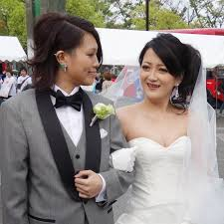
What does LGBT mean?
Lesbian
A woman that falls in love with other women.
Notes:
Lesbian: a woman that falls in love with other women

Slide 6
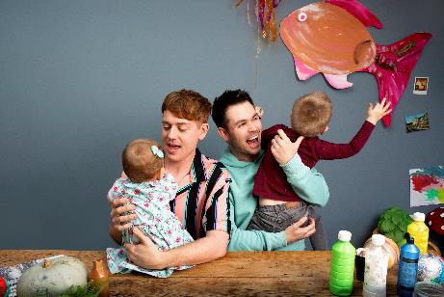
What does LGBT mean?
Gay
A man that falls in love with other men.
A woman that falls in love with other women.
Notes:
Gay: a man that falls in love with other men or a woman that falls in love with other women

Slide 7
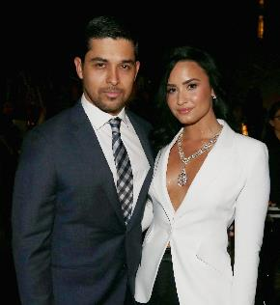
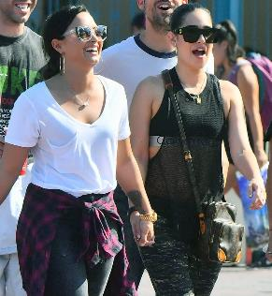
What does LGBT mean?
Bi
A bi person might fall in love with a man, a woman or a non-binary person.
Notes:
Bi: a person that falls in love with people of different genders

Slide 8
What does LGBT mean?
Trans
When she was born people thought Jazz was a boy.
Jazz told them she is a girl.
Jazz is trans.
Notes:
Trans: someone that was given the wrong gender label when they were born (eg boy, girl) and who has now asked people to use the correct gender label (eg boy, girl, non-binary)

Slide 9
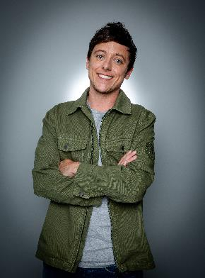
What does LGBT mean?
Trans
When he was born people thought Ash was a girl.
Ash told them he is a man.
Ash is trans.
Notes:
Trans: someone that was given the wrong gender label when they were born (eg boy, girl) and who has now asked people to use the correct gender label (eg boy, girl, non-binary)

Slide 10
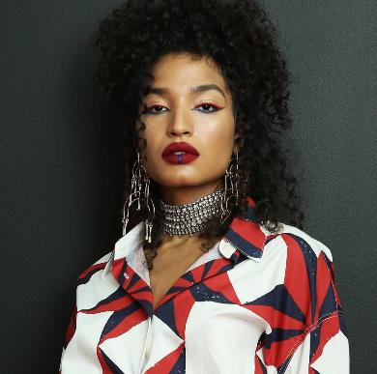
What does LGBT mean?
Trans
When Indya was born people thought Indya was a boy.
Indya told them they are not a boy or a girl.
Indya is non-binary.
Notes:
Trans: someone that was given the wrong gender label when they were born (eg boy, girl) and who has now asked people to use the correct gender label (eg boy, girl, non-binary)

Slide 11
How are the two flags different?
Rainbow Flag
Inclusive Rainbow Flag
Notes:
Ask students how the two flags are different

Slide 12
Black and brown stripes
A reminder that people of
all skin colours should
be treated fairly.
Notes:
Discuss what it means to be treated fairly and what it means to be treated unfairly.
Introduce the word racism and explain that is when people with black or brown skin are treated unfairly, Ensure students know what they can do if they see this happening or if it happens to them.

Slide 13
Blue, pink and white stripes
A reminder that
trans people should
be treated fairly.
Notes:
Introduce the word transphobia and explain that is when people with black or brown skin are treated unfairly, Ensure children know what they can do if they see this happening or if it happens to them.

Slide 14
Rainbow laces
Notes:
Bring the students back to the idea of rainbow shoe laces. Have they ever seen anyone wearing rainbow laces? If so, where? Do they know what rainbow laces are for?

Slide 15
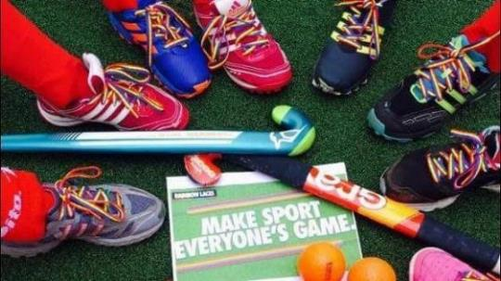
Sometimes people say and do things that are unkind to LGBT people.
This can happen when they are doing sports.
If people are unkind it might make someone not want to do sports any more.
Notes:
Explain that sometimes people are unkind to LGBT people because they are different to them. Discuss what being unkind might include: using offensive language, leaving someone off the team just because they are LGBT etc.

Slide 16
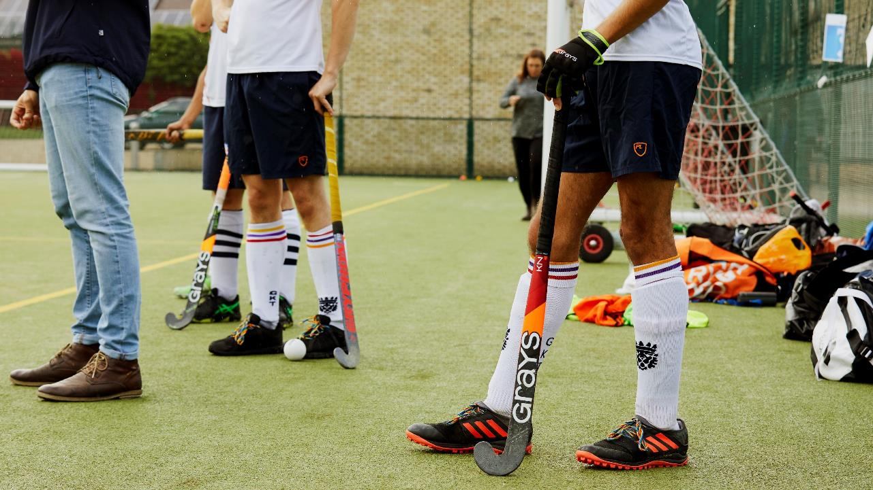
What does it feel like when someone is unkind to you?
Notes:
Ask students to reflect on a time or a place where someone was unkind? What had the person done that was unkind? How did it make them feel?
Ensure that they understand that if someone is treated unfairly or if someone was unkind, it doesn’t feel very good. It can make people sad, upset, lonely, angry.

Slide 17
What does it feel like when someone is kind to you?
Notes:
Ask students to reflect on a time or a place where someone was kind. What did the person do that was kind? How did it feel when someone was kind to you? Did you feel happy? Excited? Relieved?

Slide 18
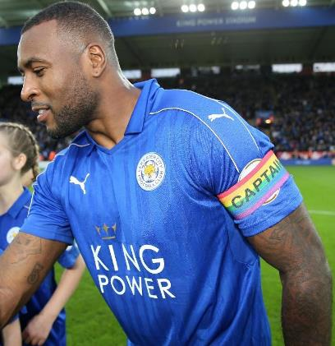
People wear Rainbow Laces (and even rainbow arm bands) to show that they want everyone to be kind to LGBT people.
When a sports person wears Rainbow Laces it shows LGBT people that they are welcome to join in with that sport.
Notes:
Explain why people wear rainbow laces and armbands. Encourage students to look out for sports people on TV wearing Rainbow Laces.
Make sure that students understand that they can be kind to LGBT people without wearing rainbow laces and that wearing other laces doesn’t mean that someone dislikes LGBT people.

Slide 19
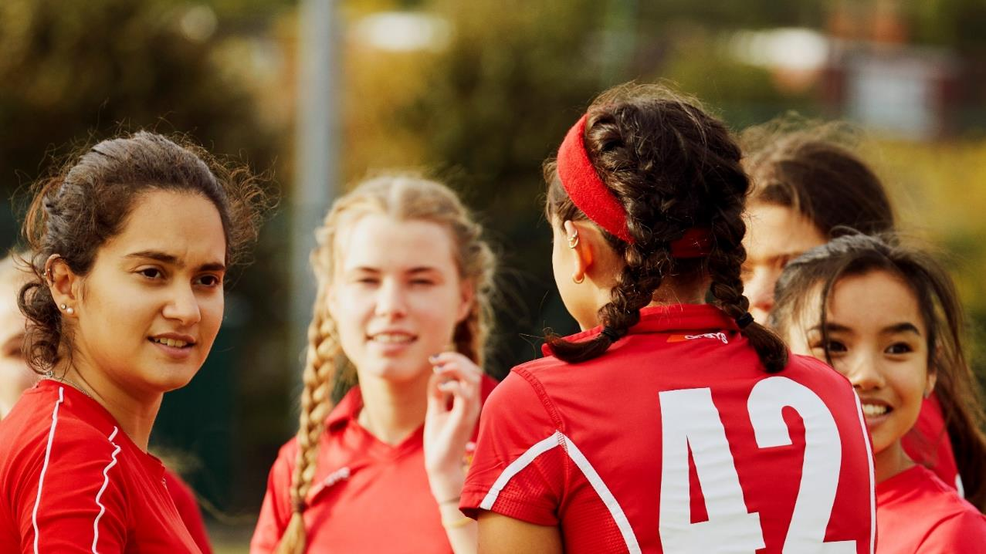
What kind things will you do?
Notes:
Ask students to make a commitment to being kind to others feel welcome and included. What will they do?

