Slide 1
PowerPoint template to accompany the Rainbow Laces 2020 activity pack for:
Learners with SEND/ALN/ASN – version 1
We know that good teaching is tailored to meet the needs of the children or young people in each individual class. That’s why we’ve created this editable PowerPoint template – feel free to adapt it to suit your teaching context or to add your school or college slide template to the background.
Who are Stonewall?
This resource is produced by Stonewall, a UK-based charity that stands for the freedom, equity and potential of all lesbian, gay, bi, trans, queer, questioning and ace (LGBTQ+) people. At Stonewall, we imagine a world where LGBTQ+ people everywhere can live our lives to the full. Founded in London in 1989, we now work in each nation of the UK and have established partnerships across the globe. Over the last three decades, we have created transformative change in the lives of LGBTQ+ people in the UK, helping win equal rights around marriage, having children and inclusive education.
Our campaigns drive positive change for our communities, and our sustained change and empowerment programmes ensure that LGBTQ+ people can thrive throughout our lives. We make sure that the world hears and learns from our communities, and our work is grounded in evidence and expertise.
Stonewall is proud to provide information, support and guidance on LGBTQ+ inclusion; working towards a world where we’re all free to be. This does not constitute legal advice, and is not intended to be a substitute for legal counsel on any subject matter. To find out more about our work, visit us at www.stonewall.org.uk.
Registered Charity No 1101255 (England and Wales) and SC039681 (Scotland)
Notes:
Visit our website for the activity pack to accompany this PowerPoint.

Slide 2
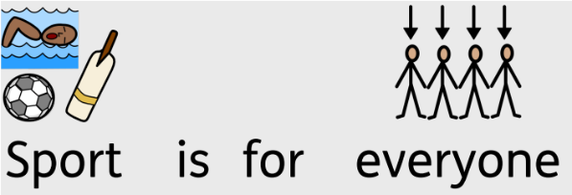
Notes:
Use this SEND specific PowerPoint with your students to introduce them to Rainbow Laces and the importance of LGBT inclusion in sports.

Slide 3
Notes:
Ask students what they can see in the picture.
What might we be talking about in this lesson?

Slide 4
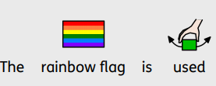
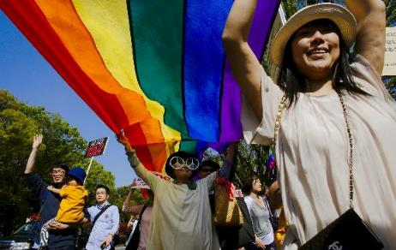
Notes:
Ensure that the students understand that the rainbow flag has long been a symbol of LGBT acceptance and pride. If needed, revisit what the acronym LGBT means.
Ask students if they can remember what LGBT means

Slide 5
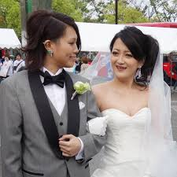
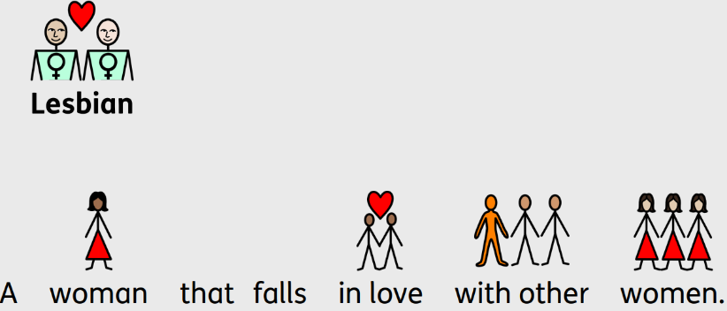
Notes:
Lesbian: a woman that falls in love with other women

Slide 6
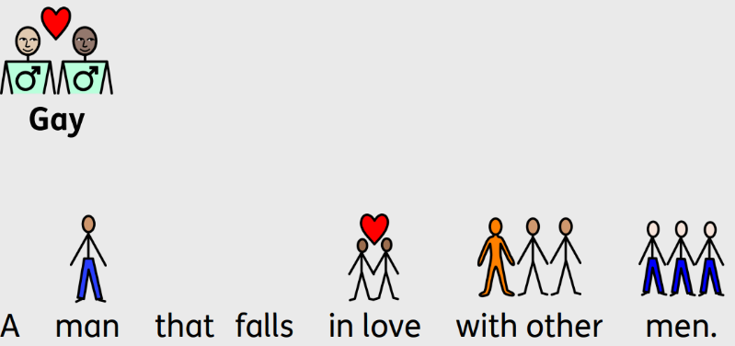
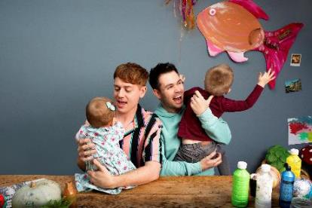
Notes:
Gay: a man that falls in love with other men or a woman that falls in love with other women

Slide 7
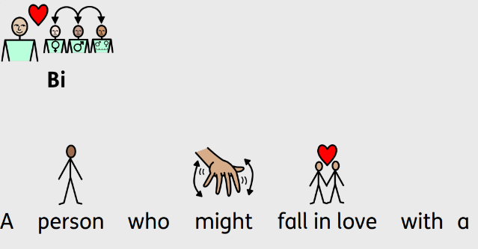
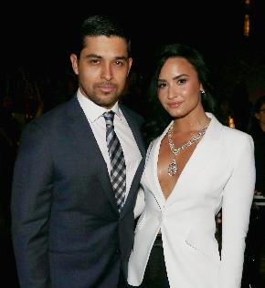
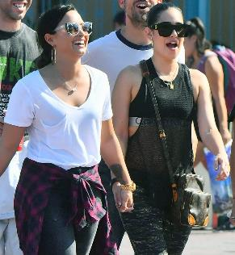
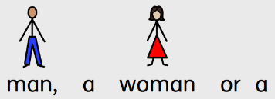
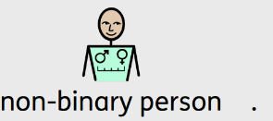
Notes:
Bi: a person that falls in love with people of different genders

Slide 8
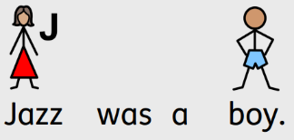
Notes:
Trans: someone that was given the wrong gender label when they were born (eg boy, girl) and who has now asked people to use the correct gender label (eg boy, girl, non-binary)

Slide 9
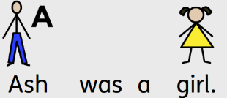
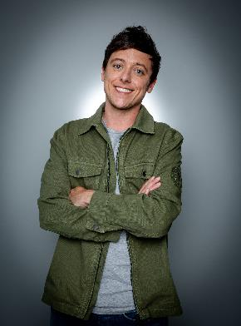
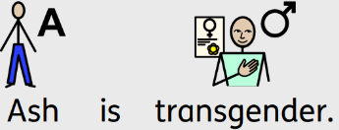
Notes:
Trans: someone that was given the wrong gender label when they were born (eg boy, girl) and who has now asked people to use the correct gender label (eg boy, girl, non-binary)

Slide 10
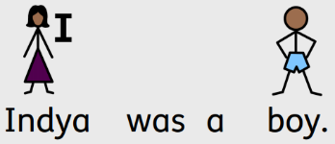
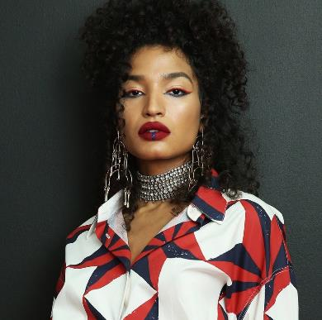
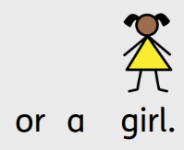
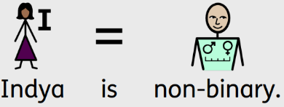
Notes:
Trans: someone that was given the wrong gender label when they were born (eg boy, girl) and who has now asked people to use the correct gender label (eg boy, girl, non-binary)

Slide 11
Rainbow Flag
Inclusive Rainbow Flag
Notes:
Ask students how the two flags are different

Slide 12
Notes:
Discuss what it means to be treated fairly and what it means to be treated unfairly.
Introduce the word racism and explain that is when people with black or brown skin are treated unfairly, Ensure students know what they can do if they see this happening or if it happens to them.

Slide 13
Notes:
Introduce the word transphobia and explain that is when people with black or brown skin are treated unfairly, Ensure children know what they can do if they see this happening or if it happens to them.

Slide 14
Notes:
Bring the students back to the idea of rainbow shoe laces. Have they ever seen anyone wearing rainbow laces? If so, where? Do they know what rainbow laces are for?

Slide 15
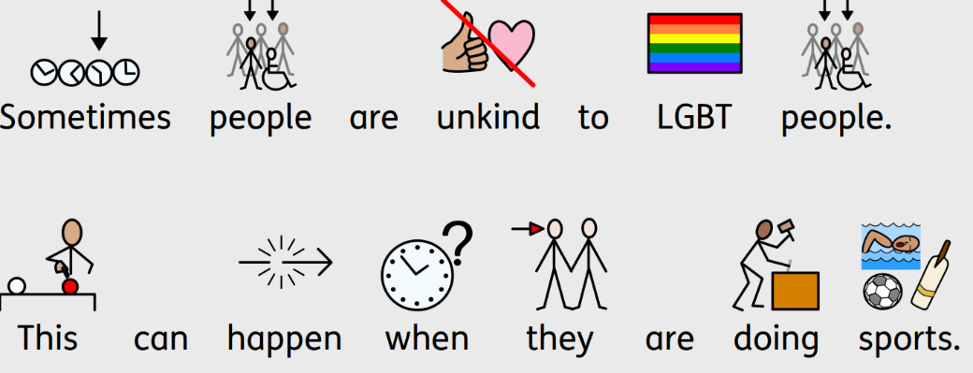
Notes:
Explain that sometimes people are unkind to LGBT people because they are different to them. Discuss what being unkind might include: using offensive language, leaving someone off the team just because they are LGBT etc.

Slide 16
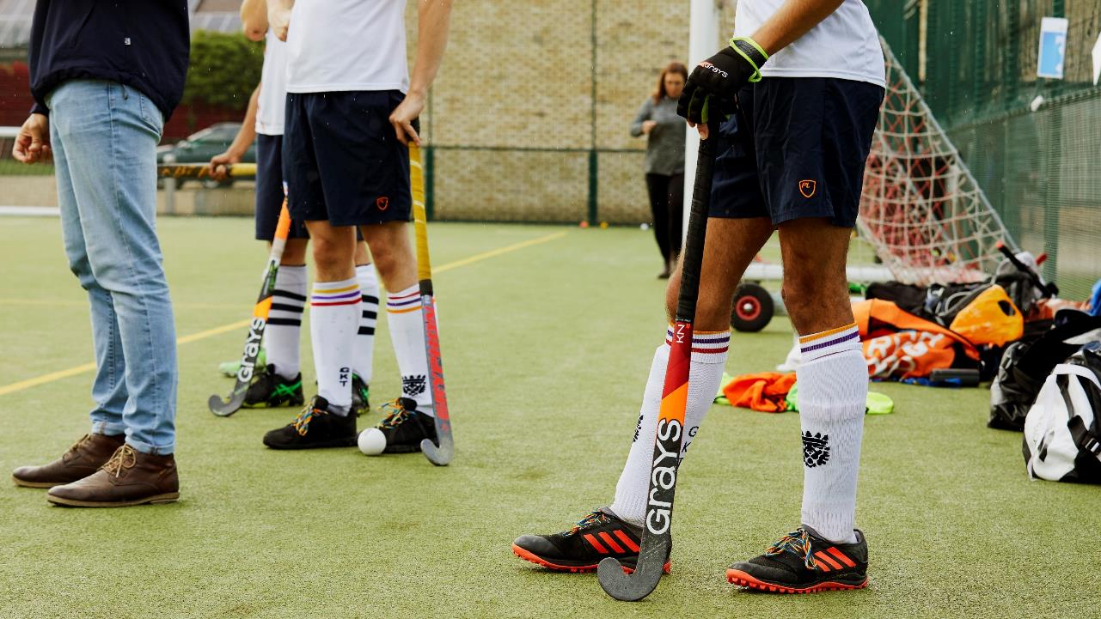
Notes:
Ask students to reflect on a time or a place where someone was unkind? What had the person done that was unkind? How did it make them feel?
Ensure that they understand that if someone is treated unfairly or if someone was unkind, it doesn’t feel very good. It can make people sad, upset, lonely, angry.

Slide 17
Notes:
Ask students to reflect on a time or a place where someone was kind. What did the person do that was kind? How did it feel when someone was kind to you? Did you feel happy? Excited? Relieved?

Slide 18
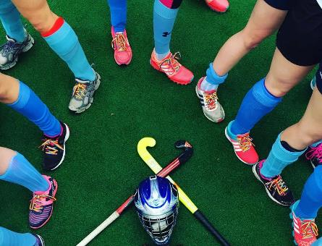
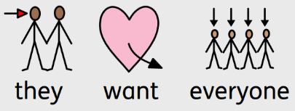
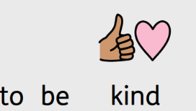
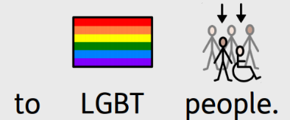
Notes:
Explain why people wear rainbow laces and armbands. Encourage students to look out for sports people on TV wearing Rainbow Laces.
Make sure that students understand that they can be kind to LGBT people without wearing rainbow laces and that wearing other laces doesn’t mean that someone dislikes LGBT people.

Slide 19
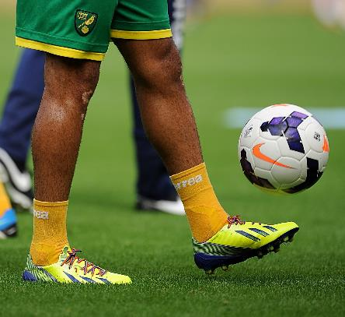
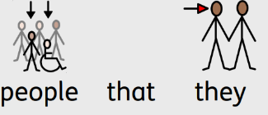
Notes:
Explain why people wear rainbow laces and armbands. Encourage students to look out for sports people on TV wearing Rainbow Laces.
Make sure that students understand that they can be kind to LGBT people without wearing rainbow laces and that wearing other laces doesn’t mean that someone dislikes LGBT people.

Slide 20
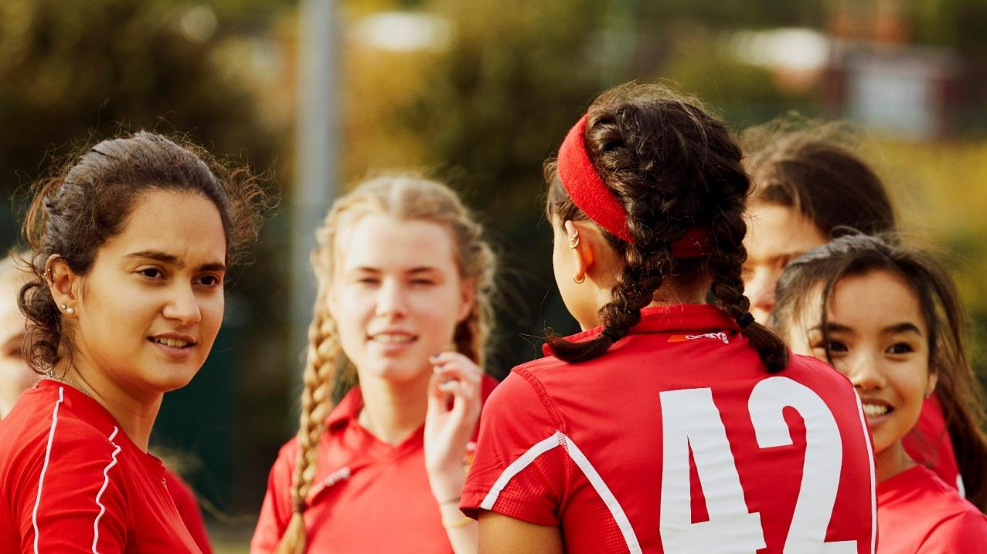
Notes:
Ask students to make a commitment to being kind to others feel welcome and included. What will they do?

