Slide 1
PowerPoint template to accompany the Rainbow Laces 2020 activity pack for:
Post-16 learners
We know that good teaching is tailored to meet the needs of the children or young people in each individual class. That’s why we’ve created this editable PowerPoint template – feel free to adapt it to suit your teaching context or to add your school or college slide template to the background.
Who are Stonewall?
This resource is produced by Stonewall, a UK-based charity that stands for the freedom, equity and potential of all lesbian, gay, bi, trans, queer, questioning and ace (LGBTQ+) people. At Stonewall, we imagine a world where LGBTQ+ people everywhere can live our lives to the full. Founded in London in 1989, we now work in each nation of the UK and have established partnerships across the globe. Over the last three decades, we have created transformative change in the lives of LGBTQ+ people in the UK, helping win equal rights around marriage, having children and inclusive education.
Our campaigns drive positive change for our communities, and our sustained change and empowerment programmes ensure that LGBTQ+ people can thrive throughout our lives. We make sure that the world hears and learns from our communities, and our work is grounded in evidence and expertise.
Stonewall is proud to provide information, support and guidance on LGBTQ+ inclusion; working towards a world where we’re all free to be. This does not constitute legal advice, and is not intended to be a substitute for legal counsel on any subject matter. To find out more about our work, visit us at www.stonewall.org.uk.
Registered Charity No 1101255 (England and Wales) and SC039681 (Scotland)
Notes:
Visit our website for the activity pack to accompany this PowerPoint.

Slide 2
Making sport everyone’s game
PoST-16 Learners
Notes:
Use this PowerPoint with your post-16 students to introduce them to Rainbow Laces and the importance of LGBT inclusion in sports.

Slide 3
What Do You know about
Rainbow Laces?
Notes:
Ask students:
Have you heard about the Rainbow Laces campaign? If so where?
Have you seen people wearing rainbow laces? What do they wear them for?

Slide 4
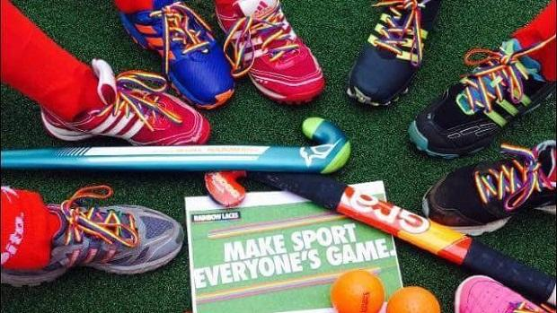
What is the Rainbow Laces campaign?
Rainbow Laces aims to make sure that LGBT people, as well as other people that often face discrimination within sport, feel welcome within sport – whether they’re watching or taking part, whether they’re professional or playing in the park with their friends.
LGBT people and their allies wear Rainbow Laces and armbands to show their commitment to making sport everyone’s game.
Notes:
Use this slide to fill in any gaps of students’ prior knowledge in relation to the Rainbow Laces campaign.
Ask students: Which groups of people might feel less welcome in sport? What is it that might make them feel less welcome? (homophobia, biphobia, transphobia, racism, sexism etc)

Slide 5
Why is the campaign needed?
43% of LGBT people think sports events aren’t a welcoming space for them.
One in seven LGBT students have been bullied during PE.
64% of trans students say they are not able to play for the sports team they feel comfortable in.
One in five LGBT young people have experienced discrimination while exercising or at a sport group.
28% of trans people have been discriminated against while exercising or taking part in group sport.
Notes:
Ask students what their perception of this is. Is it in line with what they have seen or heard? Has anything surprised them?

Slide 6
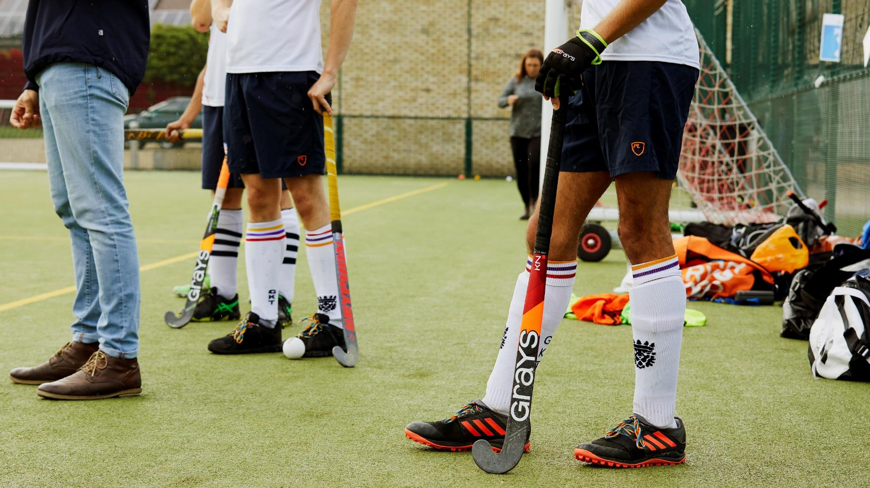
What is the impact of feeling excluded from sport?
Notes:
Ask students to reflect on a time or a place where they felt excluded. What did it feel like?
Discuss other possible impacts of exclusion from sport: health implications, mental health implications, lack of LGBT people in professional sport meaning that there are fewer LGBT role models.

Slide 7
Why a rainbow?
The rainbow flag is a symbol of LGBT pride, with different colours symbolizing different aspects of LGBT life.
Many people have now started using the Inclusive Pride Flag, which has 5 extra stripes to remind people to challenge racism (black and brown) and transphobia (blue, pink and white).
Notes:
Ask students if they know why Stonewall might have chosen rainbow laces and ensure that they understand that the 6 stripe rainbow flag is a symbol of LGBT pride.
Ask students if they have seen the Inclusive Pride Flag. What is the difference? Why might the extra stripes have been added?

Slide 8
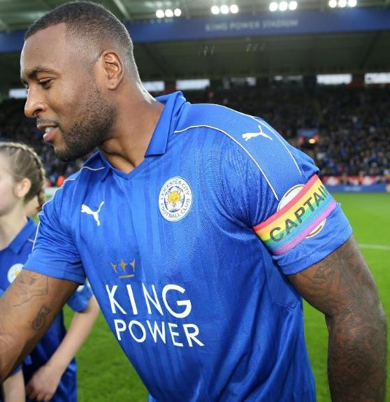
What is an ally?
Someone outside of a community that:
speaks out against discrimination (whether it’s homophobia, biphobia, transphobia, racism or any other form of discrimination)
speaks up for others
takes action to make sure everybody can feel welcome and included
LGBT people can be allies to other members of the LGBT community. For example, by speaking out against racism or sexism.
Notes:
Ask students what they think an ally is. Have they heard the word before? In what context?
What would being an ally to LGBT people look like?
Why is it important to be an ally?
Ensure that students understand the importance of being an ally. It is important for non-LGBT people to be an ally to LGBT people, but LGBT people should also be allies – to people with different LGBT identities to them, against racism, against faith based prejudice, against sexism etc.

Slide 9
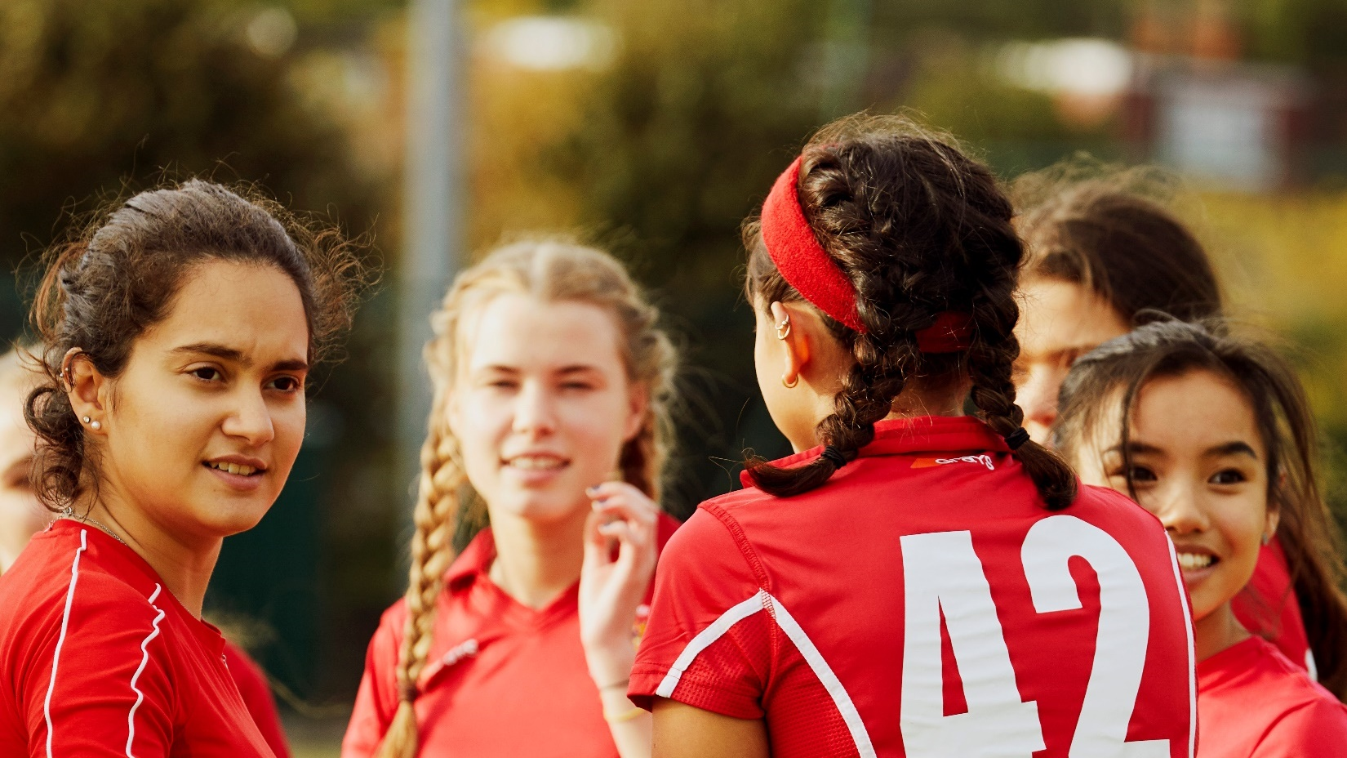
Why are allies important?
Notes:
Ask students why allyship is important.
Ensure that the discussion includes the following points: people need to speak out against discrimination when they see it, otherwise it will keep happening; if someone is an ally to members of another community, they often have more structural power and will find it easier to make their voice heard; showing that you’re an ally shows people from those communities that you support them; if people see visible allies in an organisation or setting they are more likely to feel welcome and comfortable to be themselves.

Slide 10
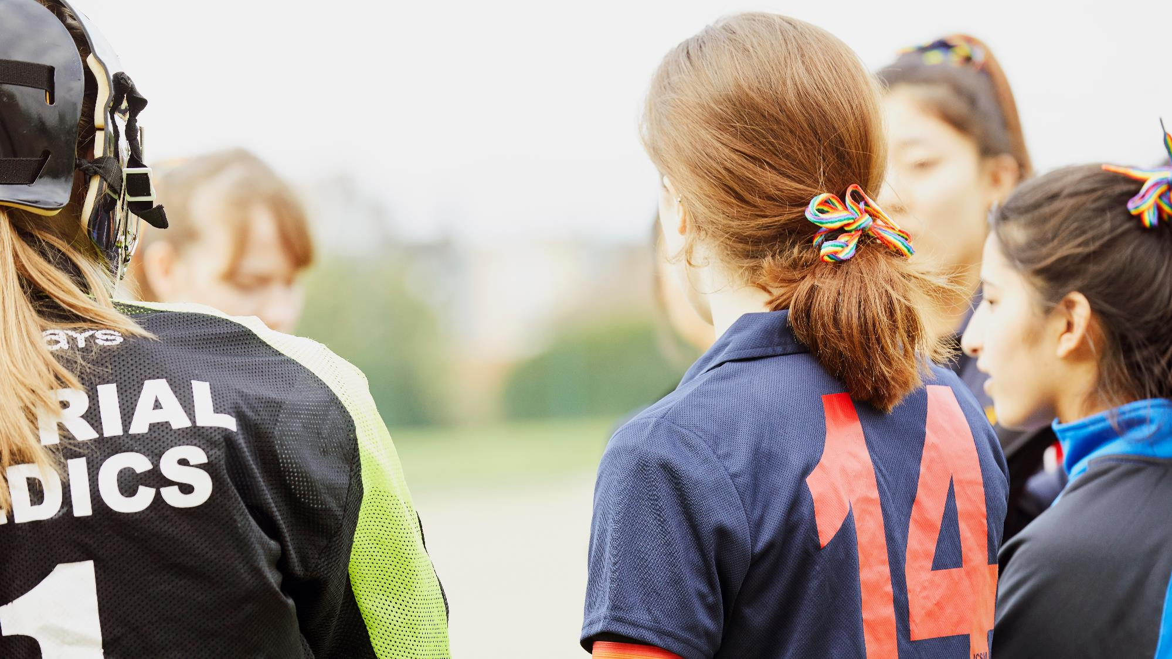
How will you show your allyship?
Notes:
Ask students what they will do to show allyship to members of other communities.

