Slide 1
PowerPoint template to accompany the LGBT+ History Month 2021 lesson pack for:
Learners with SEND/ALN/ASN
We know that good teaching is tailored to meet the needs of the children or young people in each individual class. That’s why we’ve created this editable PowerPoint template – feel free to adapt it to suit your teaching context or to add your school or college slide template to the background.
Who are Stonewall?
This resource is produced by Stonewall, a UK-based charity that stands for the freedom, equity and potential of all lesbian, gay, bi, trans, queer, questioning and ace (LGBTQ+) people. At Stonewall, we imagine a world where LGBTQ+ people everywhere can live our lives to the full. Founded in London in 1989, we now work in each nation of the UK and have established partnerships across the globe. Over the last three decades, we have created transformative change in the lives of LGBTQ+ people in the UK, helping win equal rights around marriage, having children and inclusive education.
Our campaigns drive positive change for our communities, and our sustained change and empowerment programmes ensure that LGBTQ+ people can thrive throughout our lives. We make sure that the world hears and learns from our communities, and our work is grounded in evidence and expertise.
Stonewall is proud to provide information, support and guidance on LGBTQ+ inclusion; working towards a world where we’re all free to be. This does not constitute legal advice, and is not intended to be a substitute for legal counsel on any subject matter. To find out more about our work, visit us at www.stonewall.org.uk.
Registered Charity No 1101255 (England and Wales) and SC039681 (Scotland)
Notes:
Visit our website for the lesson plan to accompany this PowerPoint or for the non-Widgit symbol supported version of this PowerPoint (Version 1).

Slide 2
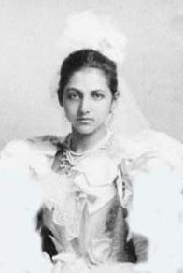
Catherine Duleep Singh
Notes:
Explain to students that they’re going to be learning about a woman named Catherine Duleep Singh that lived a long time ago.
Put all of the artefacts into different coloured bags or boxes. Give each student the chance to open one of the bags or boxes and explore the artefact. They should then show it to the rest of the group. For each artefact, click on the corresponding photo on the PowerPoint. Talk about the event from Catherine’s life related to the artefact before returning to the main page of the PowerPoint.

Slide 3
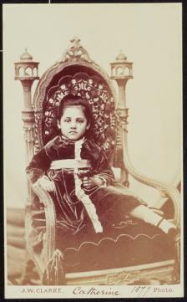
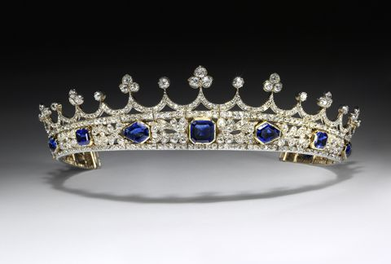
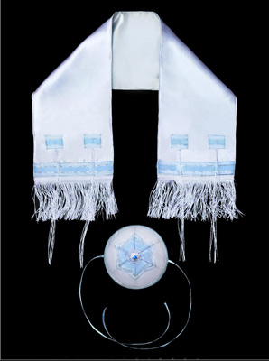
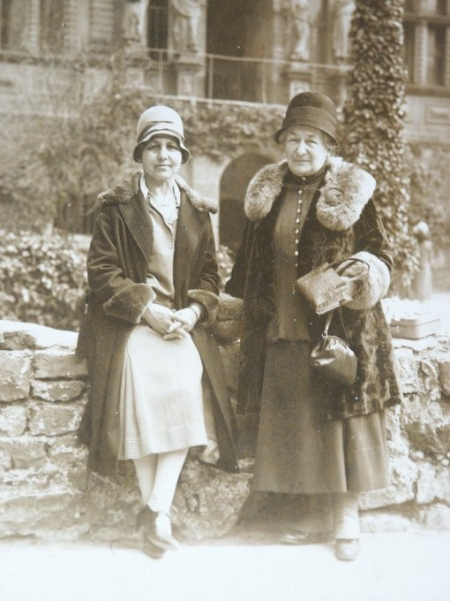
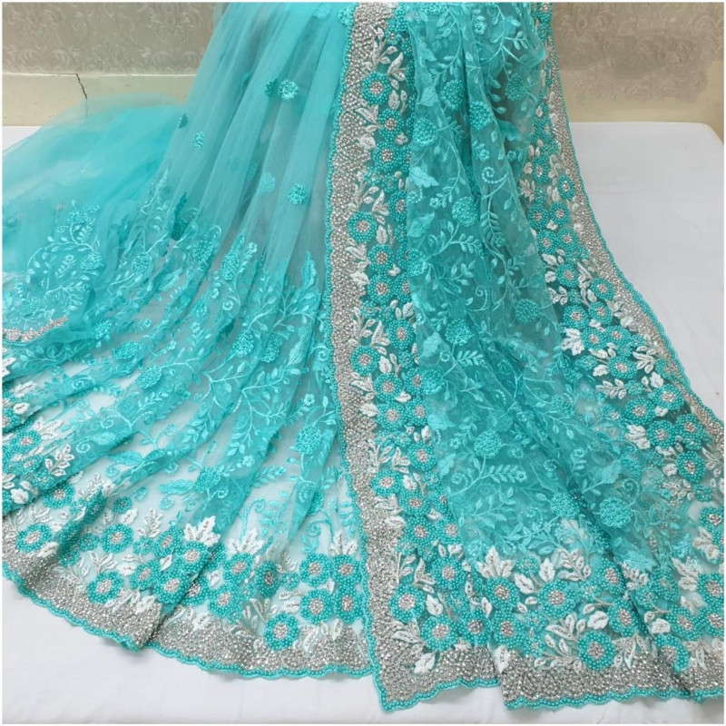
Notes:
Explain to students that they’re going to be learning about a woman named Catherine Duleep Singh that lived a long time ago.
Put all of the artefacts into different coloured bags or boxes. Give each student the chance to open one of the bags or boxes and explore the artefact. They should then show it to the rest of the group. For each artefact, click on the corresponding photo on the PowerPoint. Talk about the event from Catherine’s life related to the artefact before returning to the main page of the PowerPoint.

Slide 4
Back
Notes:
Click ‘back’ to return to the picture menu.

Slide 5
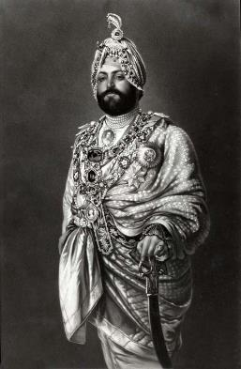
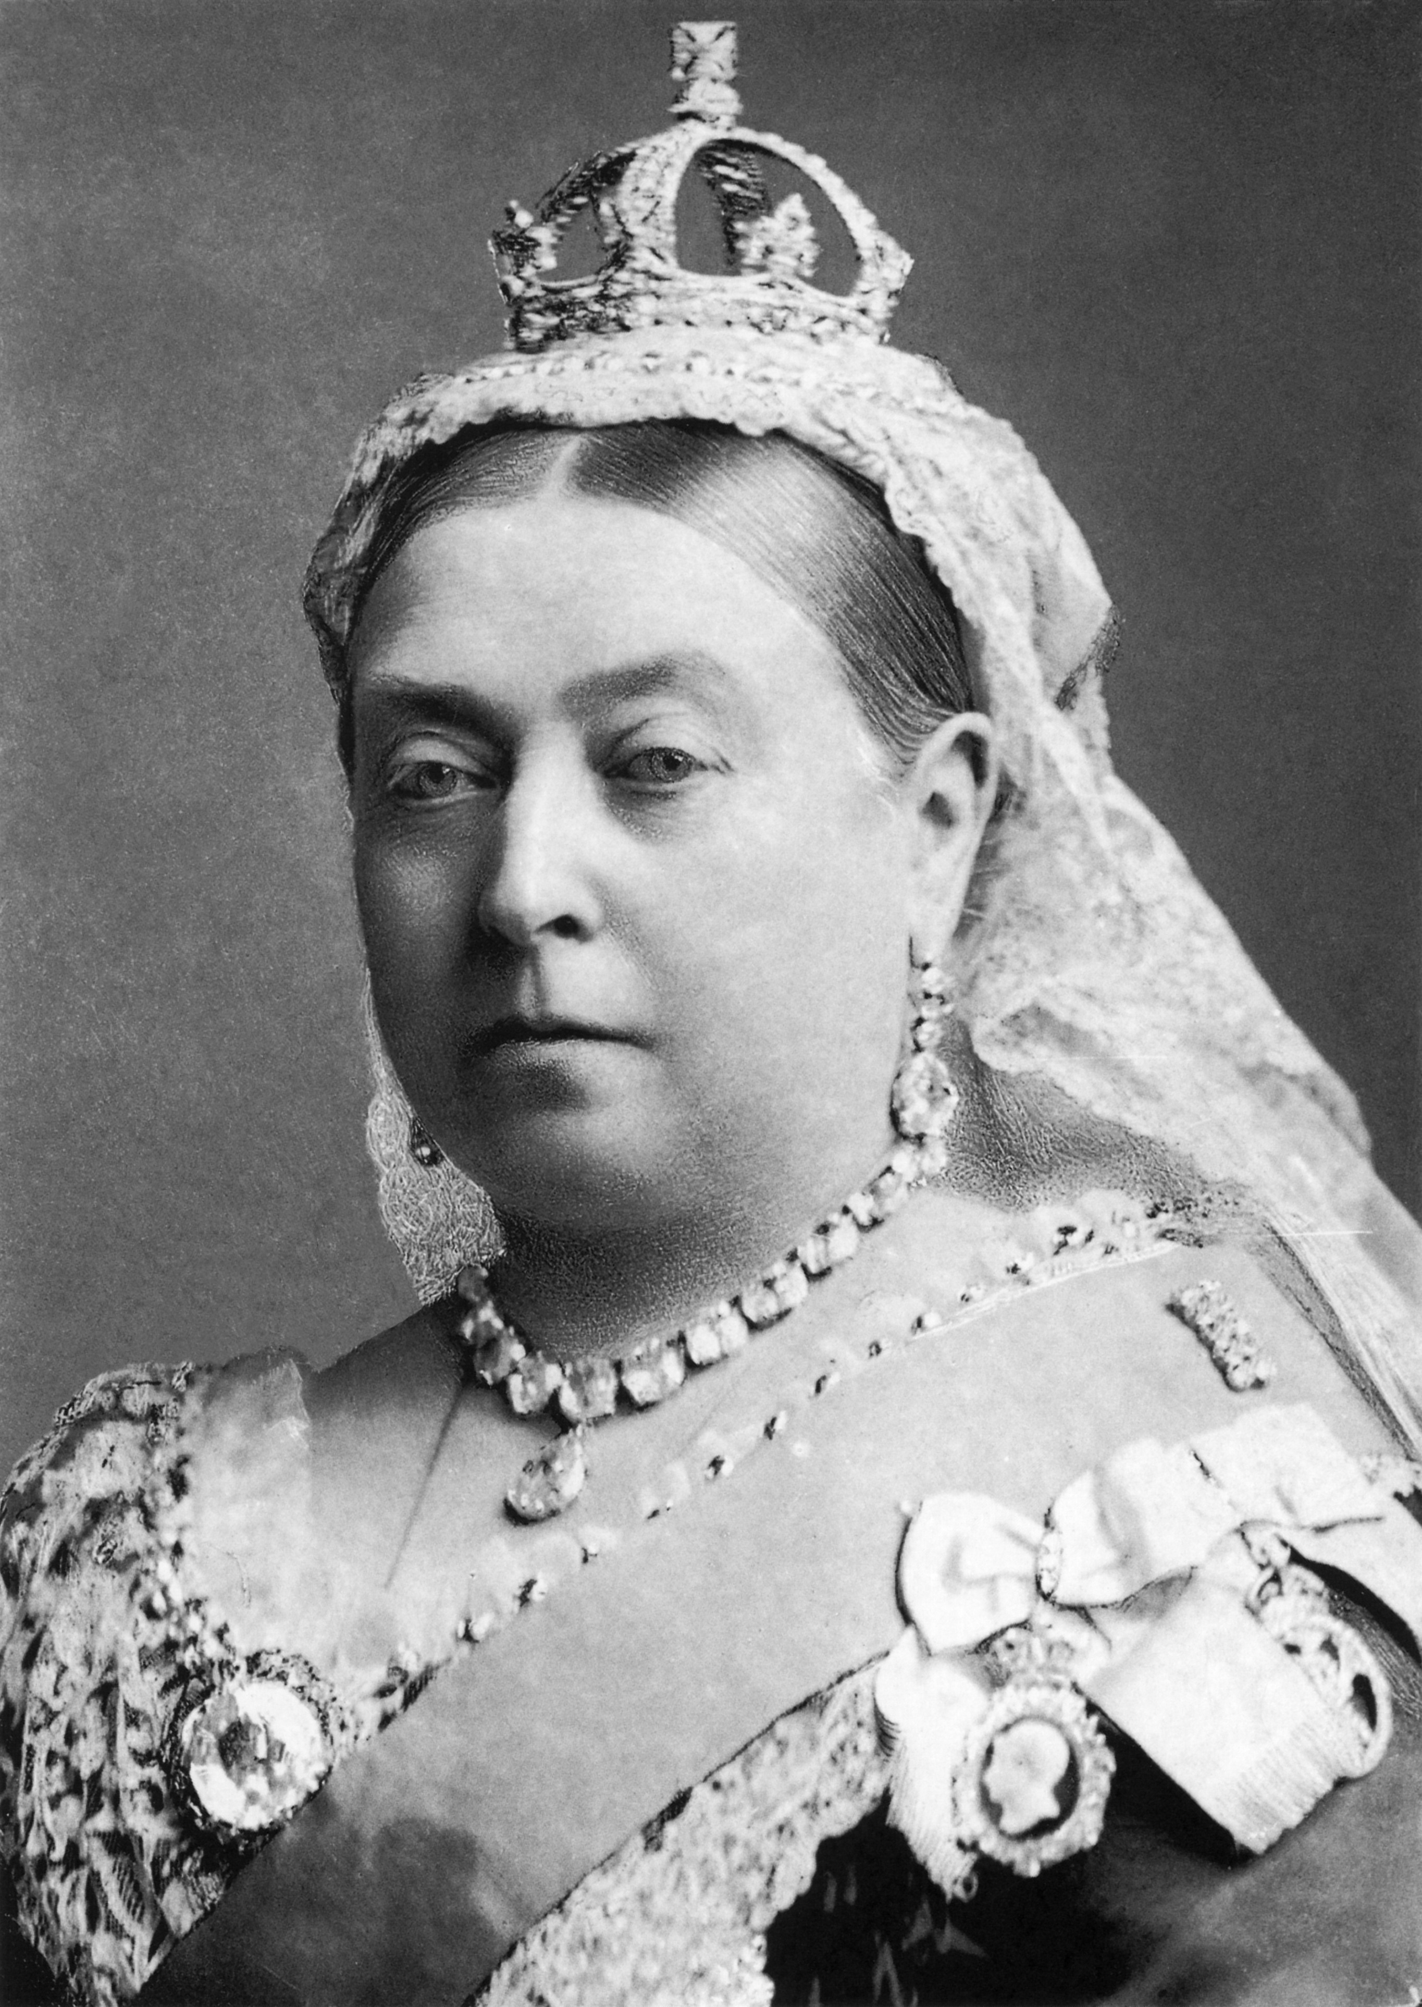
Back
Notes:
Click ‘back’ to return to the picture menu.

Slide 6
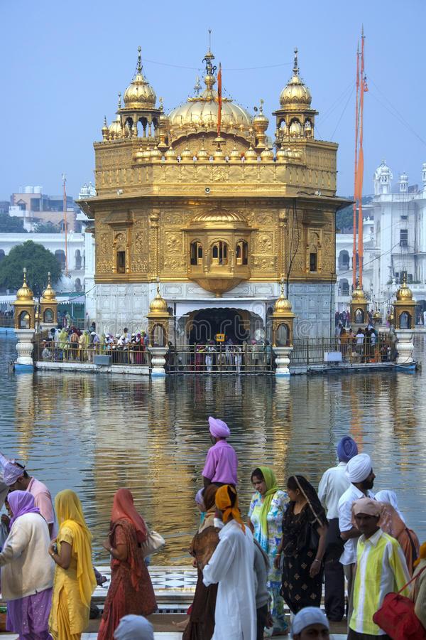
Back
Notes:
Click ‘back’ to return to the picture menu.

Slide 7
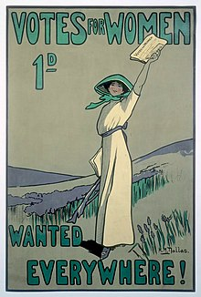
Back
Notes:
Click ‘back’ to return to the picture menu.

Slide 8
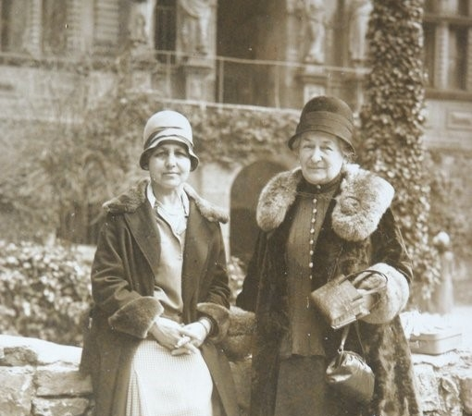
Back
Notes:
Click ‘back’ to return to the picture menu.

Slide 9
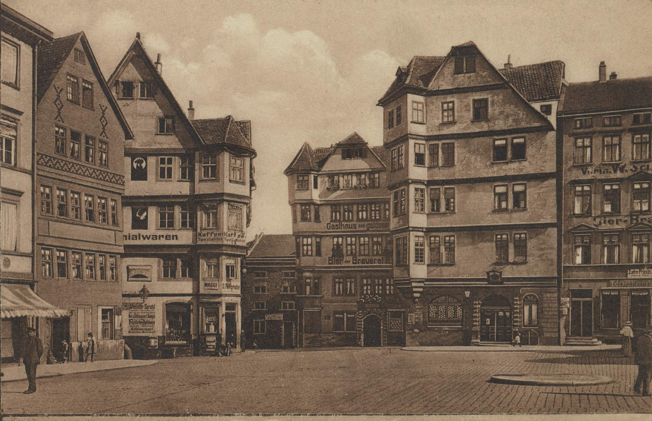
Back
Notes:
Click ‘back’ to return to the picture menu.

Slide 10
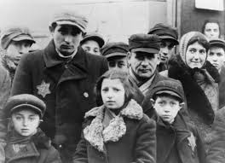
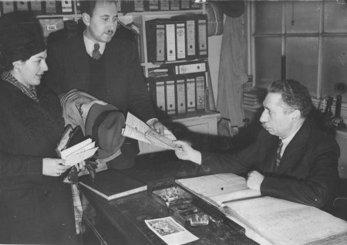
Back
Notes:
Click ‘back’ to return to the picture menu.

