Slide 1
PowerPoint template to accompany the LGBT+ History Month 2021 lesson pack for:
Reception – England and Wales
P1 – Scotland
We know that good teaching is tailored to meet the needs of the children or young people in each individual class. That’s why we’ve created this editable PowerPoint template – feel free to adapt it to suit your teaching context or to add your school or college slide template to the background.
Who are Stonewall?
This resource is produced by Stonewall, a UK-based charity that stands for the freedom, equity and potential of all lesbian, gay, bi, trans, queer, questioning and ace (LGBTQ+) people. At Stonewall, we imagine a world where LGBTQ+ people everywhere can live our lives to the full. Founded in London in 1989, we now work in each nation of the UK and have established partnerships across the globe. Over the last three decades, we have created transformative change in the lives of LGBTQ+ people in the UK, helping win equal rights around marriage, having children and inclusive education.
Our campaigns drive positive change for our communities, and our sustained change and empowerment programmes ensure that LGBTQ+ people can thrive throughout our lives. We make sure that the world hears and learns from our communities, and our work is grounded in evidence and expertise.
Stonewall is proud to provide information, support and guidance on LGBTQ+ inclusion; working towards a world where we’re all free to be. This does not constitute legal advice, and is not intended to be a substitute for legal counsel on any subject matter. To find out more about our work, visit us at www.stonewall.org.uk.
Registered Charity No 1101255 (England and Wales) and SC039681 (Scotland)
Notes:
Visit our website for the lesson plan to accompany this PowerPoint.

Slide 2
LO: To talk about the life of someone from the past
brave
Notes:
Ask children to explain what they think word ‘brave’ means. Where have they heard the word used before?
Talk about different types of bravery or courage – overcoming a fear, trying a new challenge, speaking up for what you know is right, etc

Slide 3
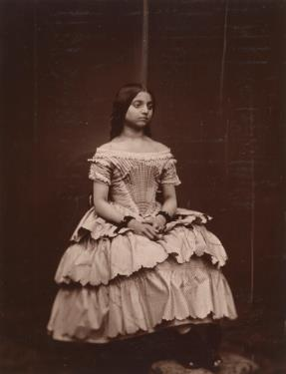
LO: To talk about the life of someone from the past
Catherine Duleep Singh
Notes:
Share the LO. Explain that today the children are going to be learning about a brave woman called Catherine Duleep Singh.
Look at some photos of Catherine. Ask the children: What might we be able to tell about Catherine? Was she rich or poor? Was she alive recently or a long time ago? What were the clues that led them to their answers?

Slide 4
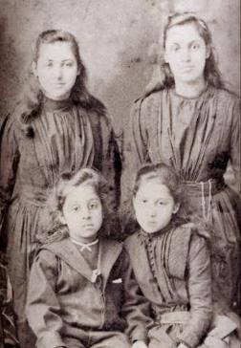
LO: To talk about the life of someone from the past
Catherine Duleep Singh
Notes:
Share the LO. Explain that today the children are going to be learning about a brave woman called Catherine Duleep Singh.
Look at some photos of Catherine. Ask the children: What might we be able to tell about Catherine? Was she rich or poor? Was she alive recently or a long time ago? What were the clues that led them to their answers?

Slide 5
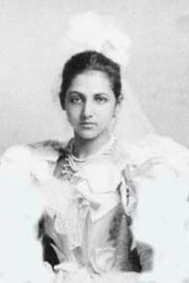
LO: To talk about the life of someone from the past
Catherine Duleep Singh
Notes:
Share the LO. Explain that today the children are going to be learning about a brave woman called Catherine Duleep Singh.
Look at some photos of Catherine. Ask the children: What might we be able to tell about Catherine? Was she rich or poor? Was she alive recently or a long time ago? What were the clues that led them to their answers?

Slide 6
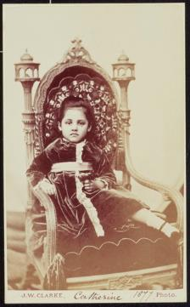
LO: To talk about the life of someone from the past
Catherine was born on 27th October 1871.
Notes:
Work through the PowerPoint about Catherine Duleep Singh and her life.
Ask the children to reflect on the aspects of Catherine’s life that required her to be brave

Slide 7
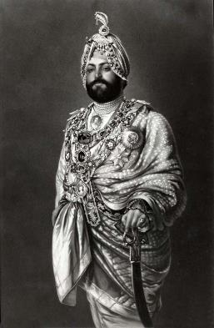
LO: To talk about the life of someone from the past
Catherine’s dad had been a member of a royal family in India.
Notes:
Work through the PowerPoint about Catherine Duleep Singh and her life.
Ask the children to reflect on the aspects of Catherine’s life that required her to be brave

Slide 8
LO: To talk about the life of someone from the past
The family lived in a big house in England.
Notes:
Work through the PowerPoint about Catherine Duleep Singh and her life.
Ask the children to reflect on the aspects of Catherine’s life that required her to be brave

Slide 9
LO: To talk about the life of someone from the past
In the past, women were not allowed to vote.
Notes:
Work through the PowerPoint about Catherine Duleep Singh and her life.
Ask the children to reflect on the aspects of Catherine’s life that required her to be brave

Slide 10
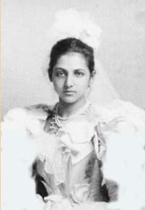
LO: To talk about the life of someone from the past
Catherine knew that it was unfair that she could not vote.
Notes:
Work through the PowerPoint about Catherine Duleep Singh and her life.
Ask the children to reflect on the aspects of Catherine’s life that required her to be brave

Slide 11
LO: To talk about the life of someone from the past
She was part of groups that asked for women to be treated fairly.
Notes:
Work through the PowerPoint about Catherine Duleep Singh and her life.
Ask the children to reflect on the aspects of Catherine’s life that required her to be brave

Slide 12
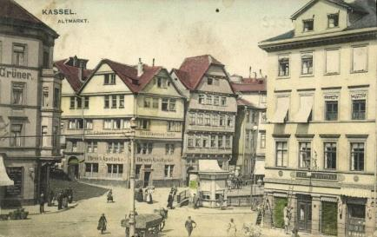
LO: To talk about the life of someone from the past
Catherine’s partner was called Lina and she went to live in Germany with her.
Notes:
Work through the PowerPoint about Catherine Duleep Singh and her life.
Ask the children to reflect on the aspects of Catherine’s life that required her to be brave

Slide 13
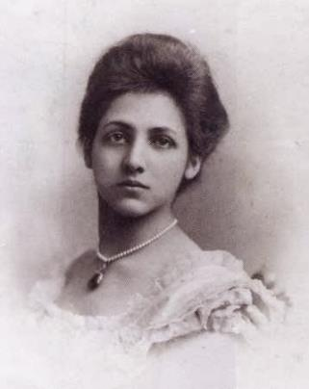
LO: To talk about the life of someone from the past
People were unkind to Catherine because of the colour of her skin.
Notes:
Work through the PowerPoint about Catherine Duleep Singh and her life.
Ask the children to reflect on the aspects of Catherine’s life that required her to be brave

Slide 14
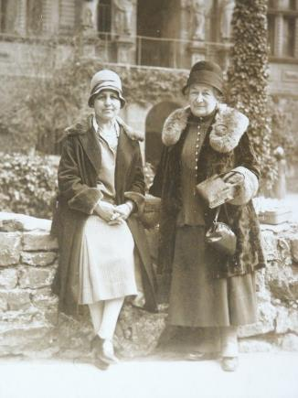
LO: To talk about the life of someone from the past
People were unkind to Catherine because her partner was a woman.
Notes:
Work through the PowerPoint about Catherine Duleep Singh and her life.
Ask the children to reflect on the aspects of Catherine’s life that required her to be brave

Slide 15
LO: To talk about the life of someone from the past
At that time in Germany, the people in charge treated Jewish people very badly indeed.
Notes:
Work through the PowerPoint about Catherine Duleep Singh and her life.
Ask the children to reflect on the aspects of Catherine’s life that required her to be brave

Slide 16
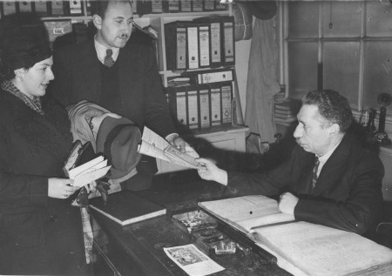
LO: To talk about the life of someone from the past
Catherine and Lina helped Jewish people to escape and live in a country where they would be safe.
Notes:
Work through the PowerPoint about Catherine Duleep Singh and her life.
Ask the children to reflect on the aspects of Catherine’s life that required her to be brave

Slide 17
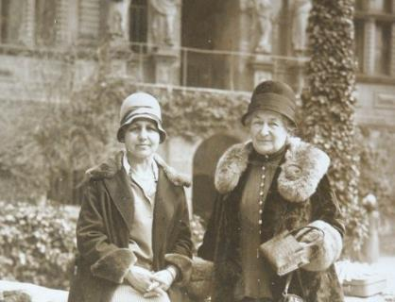
LO: To talk about the life of someone from the past
If they had been caught, Catherine and Lina could have been in danger themselves.
Notes:
Work through the PowerPoint about Catherine Duleep Singh and her life.
Ask the children to reflect on the aspects of Catherine’s life that required her to be brave

Slide 18
LO: To talk about the life of someone from the past
What did Catherine do that was brave?
Notes:
Work through the PowerPoint about Catherine Duleep Singh and her life.
Ask the children to reflect on the aspects of Catherine’s life that required her to be brave

Slide 19
LO: To talk about the life of someone from the past
Draw a picture of Catherine Duleep Singh.
Write a sentence about Catherine.
Notes:
Children draw a picture of Catherine Duleep Singh and write some words or a sentence about her.

Slide 20
LO: To talk about the life of someone from the past
What was the most interesting thing you found out about Catherine Duleep Singh?
Notes:
Ask the children: What was the most interesting thing you found out about Catherine Duleep Singh? Think. Pair. Share.

