Slide 1
PowerPoint template to accompany the LGBT+ History Month 2021 lesson pack for:
Post-16 students
We know that good teaching is tailored to meet the needs of the children or young people in each individual class. That’s why we’ve created this editable PowerPoint template – feel free to adapt it to suit your teaching context or to add your school or college slide template to the background.
Who are Stonewall?
This resource is produced by Stonewall, a UK-based charity that stands for the freedom, equity and potential of all lesbian, gay, bi, trans, queer, questioning and ace (LGBTQ+) people. At Stonewall, we imagine a world where LGBTQ+ people everywhere can live our lives to the full. Founded in London in 1989, we now work in each nation of the UK and have established partnerships across the globe. Over the last three decades, we have created transformative change in the lives of LGBTQ+ people in the UK, helping win equal rights around marriage, having children and inclusive education.
Our campaigns drive positive change for our communities, and our sustained change and empowerment programmes ensure that LGBTQ+ people can thrive throughout our lives. We make sure that the world hears and learns from our communities, and our work is grounded in evidence and expertise.
Stonewall is proud to provide information, support and guidance on LGBTQ+ inclusion; working towards a world where we’re all free to be. This does not constitute legal advice, and is not intended to be a substitute for legal counsel on any subject matter. To find out more about our work, visit us at www.stonewall.org.uk.
Registered Charity No 1101255 (England and Wales) and SC039681 (Scotland)
Notes:
Visit our website for the lesson plan to accompany this PowerPoint.

Slide 2
LO: To analyse the role of key figures in influencing social change
What is social change?
Notes:
Share the LO.
Ensure that learners understand what is meant by ‘social change’

Slide 3
LO: To analyse the role of key figures in influencing social change
2 minute challenge
Women involved in bringing about social change:
name as many as you can
Notes:
Share the LO.
Ensure that learners understand what is meant by ‘social change’
Challenge the students to name as many women involved in bringing about social change as they can. Give them 2 minutes to complete the challenge.
Share some of the names as a group. Where had the learners heard about the women? How many were celebrities? How many did they learn about at school or college? Did the women belong to particular movements? How many women of colour did they name? How many disabled women did they name? How many of the women were LGBT?
If some women weren’t represented, why might that be? Discuss the impact racism, ableism, homophobia, biphobia and transphobia has on whose voices are heard within society?

Slide 4
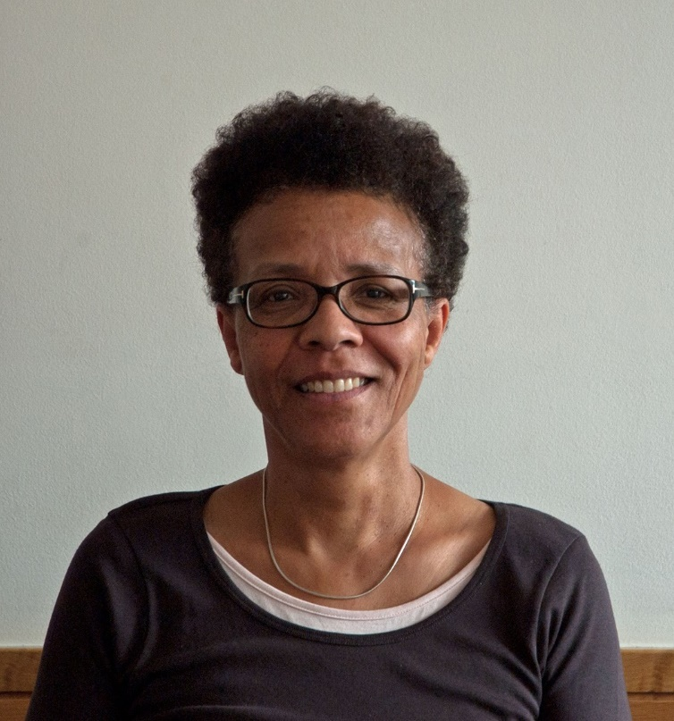
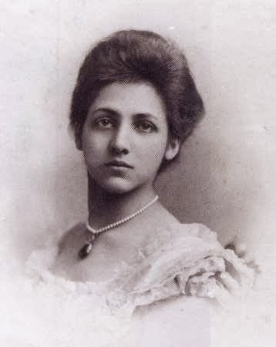
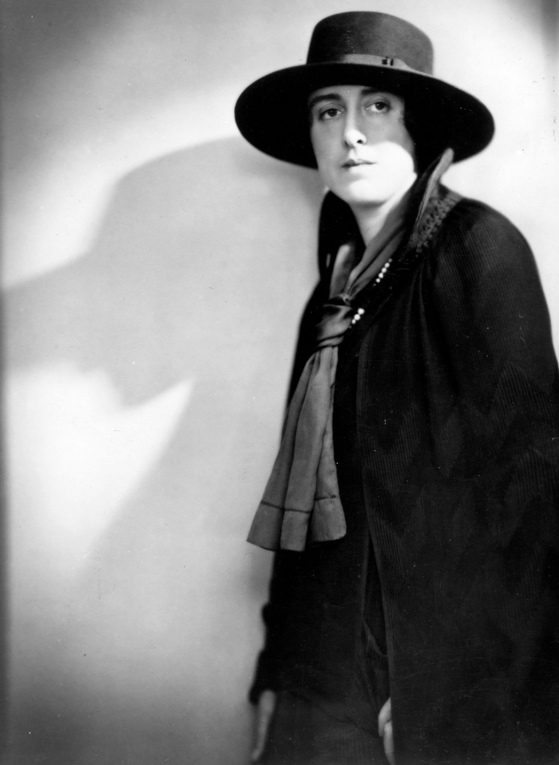
LO: To understand the of key figures in influencing social change
Gail Lewis
Catherine Duleep Singh
Jan Morris
Vita Sackville-West
What impact did this woman do to contribute to social change and what has been the impact of that change on our lives today?
Notes:
Introduce the 5 inspirational LGBT women. Learners should choose a woman to research. Refer back to the LO and agree the success criteria.
They should use a range of research methods to answer the question: What did this woman do to contribute to social change and what has been the impact of that change on our lives today?
Learners should use the fact files and ‘evidence pack’ provided, plus any additional resources they identity, to complete their research. They should ensure that they have used a range of evidence.
They should present their answer however they see fit, but some options could include:
A PowerPoint presentation
A magazine feature or newspaper article
A one minute video
A segment for a podcast
If learners under 18 are using online research materials, please use the websites and videos recommended in the research pack to ensure that the content they are accessing is appropriate. Always remind learners of safe internet use.
v

Slide 5
LO: To understand the of key figures in influencing social change
What did you discover?
Notes:
Discuss each of the 5 women and ask learners to share the findings of their research. Were there any differences in the approaches that different women took? Do learners think those same women would have used the same approach to bringing about social change in 2021 as she had in the past?

