Slide 1
PowerPoint template to accompany the LGBT+ History Month 2021 lesson pack for:
Year 3 and 4 – England and Wales
P4 to P5 – Scotland
We know that good teaching is tailored to meet the needs of the children or young people in each individual class. That’s why we’ve created this editable PowerPoint template – feel free to adapt it to suit your teaching context or to add your school or college slide template to the background.
Who are Stonewall?
This resource is produced by Stonewall, a UK-based charity that stands for the freedom, equity and potential of all lesbian, gay, bi, trans, queer, questioning and ace (LGBTQ+) people. At Stonewall, we imagine a world where LGBTQ+ people everywhere can live our lives to the full. Founded in London in 1989, we now work in each nation of the UK and have established partnerships across the globe. Over the last three decades, we have created transformative change in the lives of LGBTQ+ people in the UK, helping win equal rights around marriage, having children and inclusive education.
Our campaigns drive positive change for our communities, and our sustained change and empowerment programmes ensure that LGBTQ+ people can thrive throughout our lives. We make sure that the world hears and learns from our communities, and our work is grounded in evidence and expertise.
Stonewall is proud to provide information, support and guidance on LGBTQ+ inclusion; working towards a world where we’re all free to be. This does not constitute legal advice, and is not intended to be a substitute for legal counsel on any subject matter. To find out more about our work, visit us at www.stonewall.org.uk.
Registered Charity No 1101255 (England and Wales) and SC039681 (Scotland)
Notes:
Visit our website for the lesson plan to accompany this PowerPoint.

Slide 2
LO: To use a range of historical research methods
2 minute challenge
Inspirational women from history
Notes:
Discuss as a class: What does the word ‘inspirational’ mean to you?
2 minute challenge:
How many inspirational women from history can you think of?
Working in groups, challenge the children to write as many inspirational women as they can in 2 minutes.

Slide 3
LO: To use a range of historical research methods
Courageous women
Her name
Her job
What she did that was brave
Any other information you can find
Notes:
Share the LO. Explain that today the children are going to be learning about 5 courageous women. They are going be history detectives. As a class, develop the success criteria.
Split the class into 5 groups and give each group different ‘evidence pack’.
They should look at the ‘evidence pack’ and identity:
The name of the person
What her job is/was
Something that she did that was brave
Any other information they can gather.
They should write their ideas on whiteboards or in their books.

Slide 4
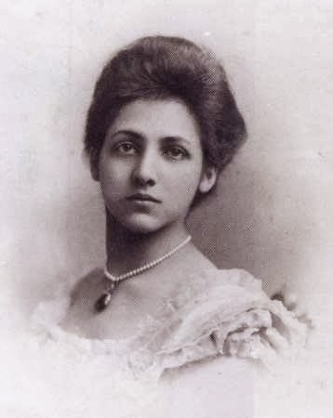
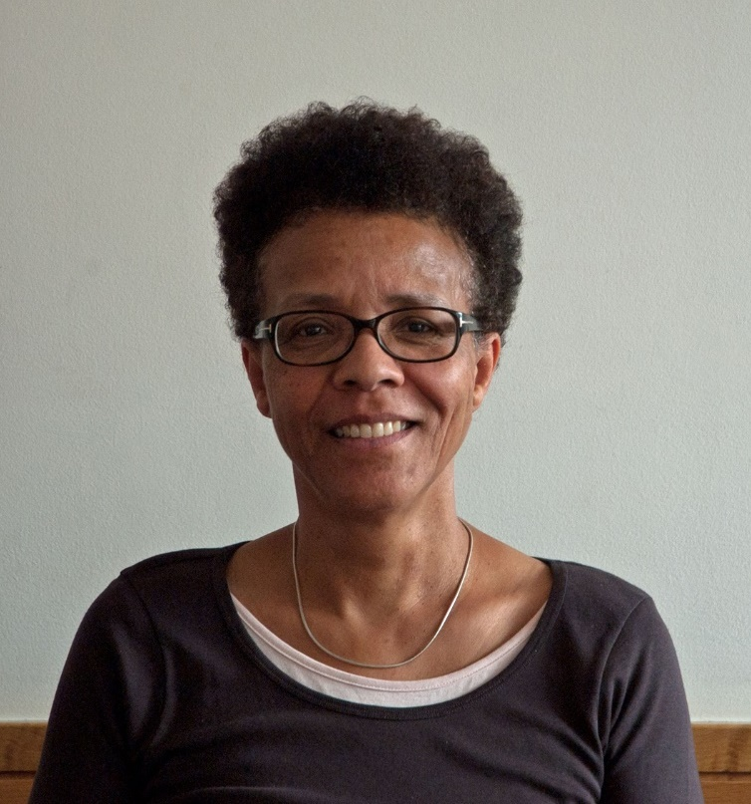
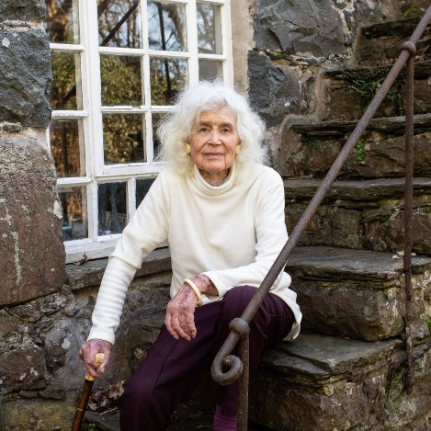
LO: To use a range of historical research methods
Top trumps
Who is/was she?
What is/was courageous about her?
One additional fact
Notes:
Individually or in pairs, children read the fact file that corresponds to the woman from their ‘evidence pack’.
They should then each make a ‘top trumps’ card to represent the woman they had learnt about.
Re-group the children so that children are in groups of 5 with children that had been researching different women to them.
Ask them to compare their ‘top trumps’ cards with each other. Each child should explain who their courageous woman was/is, what it was that made/makes her courageous and one additional fact about her.

Slide 5
LO: To use a range of historical research methods
What do you know?
Notes:
As a whole class, children take part in the quiz from the PowerPoint.

Slide 6
LO: To use a range of historical research methods
What do you know?
Which countries did Catherine Duleep Singh live in?
Notes:
Which countries did Catherine Duleep Singh live in? Germany, Switzerland and England

Slide 7
LO: To use a range of historical research methods
What do you know?
What was Jan Morris’ job?
Notes:
What was Jan Morris’ job? Writer

Slide 8
LO: To use a range of historical research methods
What do you know?
What is Gail Lewis’ job now?
Notes:
What is Gail Lewis’ job now? Works at a university as an academic.

Slide 9
LO: To use a range of historical research methods
What do you know?
What decade was Brixton Black Women’s group set up in?
Notes:
What decade was Brixton Black Women’s group set up in? 1970s.

Slide 10
LO: To use a range of historical research methods
What do you know?
Who reported from Mount Everest?
Notes:
Who reported from Mount Everest? Jan Morris.

Slide 11
LO: To use a range of historical research methods
What do you know?
Who was Queen Victoria’s god daughter?
Notes:
Who was Queen Victoria’s god daughter? Catherine Duleep Singh

Slide 12
LO: To use a range of historical research methods
What do you know?
Who did Catherine Duleep Singh help to escape from Germany?
Notes:
As a whole class, children take part in the quiz from the PowerPoint.
After the quiz, ask the children: What different methods did you use to learn about someone from history in this lesson? What was your preferred method? Think. Pair. Share.
Who did Catherine Duleep Singh help escape from Germany? Jewish families

Slide 13
LO: To use a range of historical research methods
What do you know?
How old was Jan Morris when she got her first job?
Notes:
How old was Jan Morris when she got her first job? 16

Slide 14
LO: To use a range of historical research methods
What do you know?
Name someone that was involved in Brixton Black Women’s group.
Notes:
As a whole class, children take part in the quiz from the PowerPoint.
After the quiz, ask the children: What different methods did you use to learn about someone from history in this lesson? What was your preferred method? Think. Pair. Share.
Name someone that was involved in Brixton Black Women’s group. Gail Lewis, but bonus points if they know the name of Olive Morris or any of the other women that were involved.

Slide 15
LO: To use a range of historical research methods
Which research methods did you use?
Notes:
What different methods did you use to learn about someone from history in this lesson? What was your preferred method? Think. Pair. Share.

